Slide 1
Interviewing: Do's and Don'ts
Brandi Kissel, CIH, CSP, COHC

Slide 2
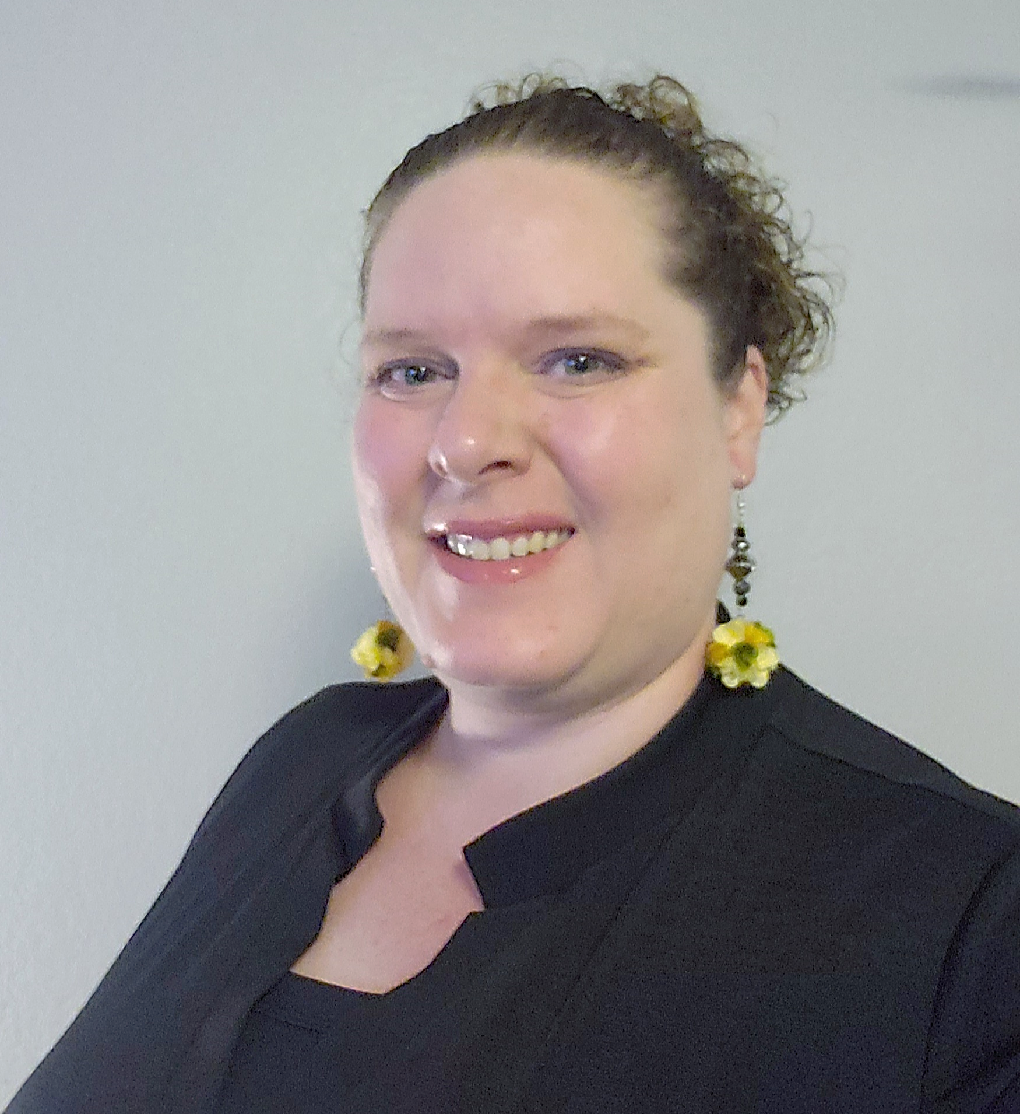
Presenter
Brandi Kissel, CIH, CSP, COHC
Industrial Hygiene and Wellness Manager
The Mosaic Company
Fun Fact:
I crochet when not taking cooking classes or exploring surrounding nature areas.
Notes:
She obtained her Bachelor of Arts in Biology with a Minor in Chemistry from Keuka College in Keuka Park, NY. She has been working in the Industrial Hygiene field since 2008 with experience in the coal, natural gas and hydropower electric generation industries, aluminum smelting industry, academia with focus on laboratories and facilities, electronics manufacturing and silicone/rubbers manufacturing. Prior to her time as an Industrial Hygienist, she worked in water, wastewater and an environmental testing laboratory. Brandi has been actively involved with a variety of committees within National AIHA. She is also active within ASSP on the Governance Advisory Board and WISE. In her spare time, she enjoys taking cooking classes, reading and exploring the natural beauty of various national parks around the country.

Slide 3
Key Points
Know about the organization and job you are applying for
Apply early
Link your resume & skill set to the specific job
Have an updated resume
Practice, Practice, Practice!
Interviewing managers are trying to determine 3 main things:
Can you do the job?
Are you motivated to do the job?
Will you fit in the organization?

Slide 4
Research the Company and the Job
Notes:
Learn about the Company
Use all of your resources
Make connections with people in the company
Figure out company or employer politics to find out who you should focus your attention
Do you know someone who can help?
Don’t make unreasonable requests!
Don’t ask for a car right out of school
Some things are negotiable, like salary and vacation but know the company. They may have a rigid entry level system.
Use your experience and expertise to get additional perks
Understand the local economy.
Make sure you can afford to live on the salary offered.
Cost of living has a major impact on the value of the offer.
4 –

Slide 5
Research
Prepare by learning about the company
Review their website thoroughly
Ask others about the company
Find out who is conducting the interview, position in the company and something about them, if possible
LinkedIn, web search, professional organizations
Know what the company does, market competing in, locations, etc.

Slide 6
Preparing for the Interview
Notes:
Understand the job requirements and what they actually want you to do
Don’t waste your time or the time of the hiring manager if the job is not a match
Read the job description, does it match what you are you looking for
Prepare for the interview
Do a mock interview with a friend
Prepare talking points
Have questions ready
What are their expectations
You are selling yourself and your abilities
Don’t be ashamed to toot your own horn
However, don’t be too self serving

Slide 7
Preparing for an Interview
Commonly asked questions and tips for answering:
What interested you in the company? (position?)
Tell me about a time you have had to deal with a difficult project that was behind schedule.
What is one thing you don’t want me to know about you?
Are you familiar with [proprietary software]?
Where do you see yourself in 5 years?
What is your desired salary?
Notes:
What interested you in the company? (position?)
Prior to your interview, research the company. Find synergies between your interest and experience and what they do.
If you know the interviewer, research them as well and find tie-ins that you can weave into your answer.
Be honest!
Tell me about a time you have had to deal with a difficult project that was behind schedule.
We have all encountered these situations, have one prepared and ready to discuss.
Cover, briefly:
The problem
Your approach to it
The outcome
What went well and what you learned going forward
If you do not have a situation that fits exactly, instead talk about how you would handle the situation if you were faced with it.
What is one thing you don’t want me to know about you?
This is a new way of saying “tell me your biggest weakness” – it is a terrible question, but a common question
Answer honestly, but keep it professional
Don’t get flustered if some odd-ball questions are thrown into an interview
Are you familiar with [proprietary software]?
If you have used it before, talk about your experience using it and some of your favorite features to demonstrate real knowledge.
If you have not used it before, talk about how you are a fast learner and give an example of how you have quickly learned new software in the past.
Where do you see yourself in 5 years?
Again, a terrible but common question.
Read your audience, if you think a joke will play well here and you can deliver it, go with a joke followed by a serious answer.
It is okay to say that you are still mapping out your career and are hoping this internship can expose you to different areas of Industrial Hygiene/EHS
What is your desired salary?
With internships, this may be a less common question than with your first job out of college, but you should be prepared with an answer, just in case.
Do your research! Often sites like salary.com, glassdoor.com, etc. are inflated. Reliable (validated) salary information can be obtained from the BLS (o*net) or from salary studies.

Slide 8
Interviewing
Skills to Emphasis
Demonstrate your Preparation
Be Authentic – Show who you are
Notes:
2 – Don’t be late for the interview!!!
1 – Dress for Success
Find out the dress for the interview
Business casual
Suit

Slide 9
Skills to Emphasize
Teamwork – the ability to work well with others
Flexibility – willingness to take on new and varied projects
Detail-Oriented – being organized, meticulous – can work well without constant supervision
Self-Motivated – self starters
Accomplishments – No matter the size

Slide 10
Demonstrate your preparation and interest
Prepare by making a list of questions to ask about the job and company
Confirm organization structure
Ask about others in a group, both peers and experienced level staff

Slide 11
Tell them who you are and show your worth
Prepare by creating “stories” to respond to behaviorally-based interview questions
Tell about what you have done in comparison to the job description
Talk about how you reacted in a given situation and how you may have reacted different with experience
Show confidence and maturity
Be confident, but not overly so

Slide 12
Interview Types
Phone
Virtual
In Person

Slide 13
Phone interviews
Prepare for phone interviews just like you would for face-to-face
Be professional and polite
Be ready at least 5 minutes in advance of the time
Reminder there may be a script and persons interviewing may not understand the job, may be a screener from HR

Slide 14
Preparing for an Interview: Virtual Interviews
Many job interviews are being held virtually
Prior to your interview, be sure to:
Test your technology
Are your ear buds charged or headphones working?
Can you log into the website or do you have the necessary software downloaded (Zoom, Google Meet, etc.)?
Test your camera angle
Are you properly framed in the picture?
Is there anything around you that you would not want to show up during the interview?
Limit distractions – roommates, pets, cell phones

Slide 15
In Person Interview
Don’t arrive late or too early
Make a test drive at the same time of the interview, if you can
Check traffic
Make a good first impression
Attire
Verify expectation (safety shoes)
Fragrance-free
Eye contact
Smile
Firm handshake, but not over firm or arm shaking

Slide 16
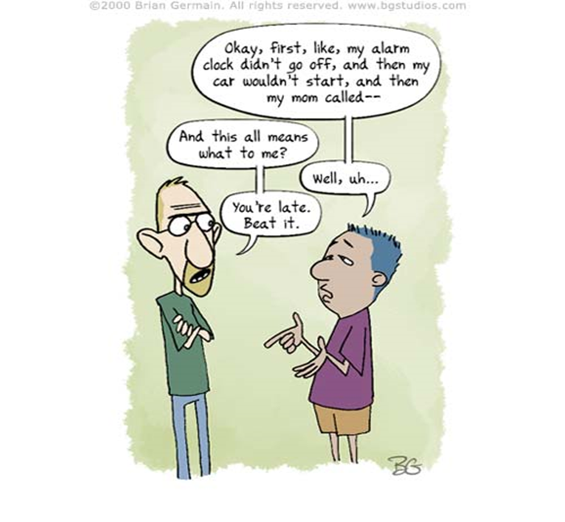
Final preparation for the Interview
Arrive early but not too early
Find out any specific site requirements for access to the site/building and build in enough time
Bring a copy of your resume, references, examples of your work
Avoid discussing salary requirements until the right time
Be prepared with questions, check the company website
Ask others what they know about the company and the job
Avoid interviewing for a job you know you would not take

Slide 17
Dos and Don’ts from Recruiters

Slide 18
Hiring Perspectives - Dos
Understand who is looking for people, hiring manager, locations
Address the company and or hiring manager specifically in all correspondence
Prepare correspondence to link to the position description
Research!!!!
Understand the company products or services
Know what job you would like to do
Spell/Grammar check everything
Get it in writing!!

Slide 19
Hiring Perspectives – Don'ts
Don’t send out blanket resumes
One size does not fit all, short and sweet, searchable
Review your skeletons, Facebook, LinkedIn, Twitter, social media
You may only get one chance
Don’t be late!!
Tell the truth, they will find out quickly
Don’t expect all companies to be the same or looking for the same skill set

Slide 20
Wrapping Up
Write down one tip you learned in this session
Notes:
Mary Ellen

Slide 21
Summary
Use every resource available, network, colleagues, professional organizations, etc.
Prepare a specific resume, searchable to the job description
Prepare for the interview
Do a mock interview with a friend
Prepare questions, anticipate questions
Don’t be late
Thank the interviewer
Send a follow up letter, email, note, etc.

Slide 22
Co-Collaborators
Thomas L. Blank, CIH, CSP, FAIHA
Semi-Retired Professional
Franky Spangler, PHR, SHRM-SCP
Director of Human Resources
AIHA

Slide 23
AIHA Career and Employment Services Committee
Career and Employment Services Committee | AIHA
Services Offered by Committee Members Year-Round and at Conference:
Mock Interviews
Career Counseling
Resume Reviews
How to build a career portfolio
Trainings for Local Sections
Reserve your slot today by contacting Wanda Barbour (wbarbour@aiha.org)to schedule your own personal session with one of the committee members

Slide 24
Thank You
Brandi Kissel
bekissel@gmail.com
brandi.kissel@Mosaicco.com
“You have influenced my life in such a positive way words cannot express my appreciation. You are truly an inspiration.” – Catherine Pulsifer

Slide 25
Networking

Slide 26
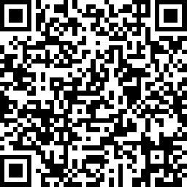
Speaker Review
Virtual and In Person Interviewing
https://www.surveymonkey.com/r/5CYZWKM

