Slide 1
Surface Sampling And
Interpretation
Matthew Parker, MS, CIH, CSP, ARM
OSHAlliance, LLC
mparkerofpcb@gmail.com

Slide 2
How Clean is Clean?
Evaluating Indoor Surface Contamination
Introduction to Surface Contamination
Review Surface Contamination Scenarios
Approaches to Evaluating Surface Contamination
Review of Regulatory Issues
Hazardous Waste Issues
Sampling and Sampling Strategy
Report Writing and Documentation

Slide 3

Learning Outcomes
Upon completion, participants will be able to:
  Know various surface sampling needs/opportunities
  Develop an appropriate sampling strategy.
  Describe a facility decontamination process.
  Establish clean-up levels and prepare a work plan.
  Evaluate decontamination activities.
  Prepare a report that accurately summarizes facility decontamination activities
Notes:
How Much Experience Do You Have with facility decontamination?
I do not have any professional experience with facility decontamination.
I have a little experience with facility decontamination .
I have some experience, but I'm not an expert.
I have extensive experience evaluating and managing indoor contamination and facility decontamination.
What are some contaminants you have worked with?
Metals
Lead
Cadmium
Hexavalent Chromium
Beryllium
Toxic Dust
Asbestos
9/11 World Trade Center
Drugs
Methamphetamine
Fentanyl
Pharmaceutical
IAQ
Mold
Bacteria
Others
PAH’s
PCB’s
Dioxins
Unknowns
Mystery dusts

Slide 4

The Challenge
Why should you consider surface sampling?
When should you consider surface sampling?
Where should you conduct surface sampling?
What surface sampling should you do?
How should you do the surface sampling?
Who should get the results?
What should the report say?

Slide 5
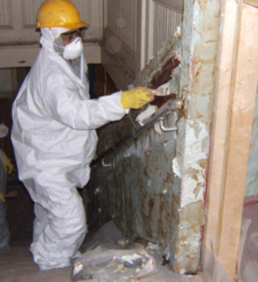
Lead Surface Sampling
Why are you sampling?
  HUD Lead Safe Housing Rule
    Regulation for specific properties but broadly applied to all abatement projects.
    Lead Abatement Clearance
    Lead Hazard Identification
  Renovation Repair and Painting
  Lead contamination from an industrial process
    Battery Smelter/Battery Manufacturer
    Adjacent Properties

Slide 6
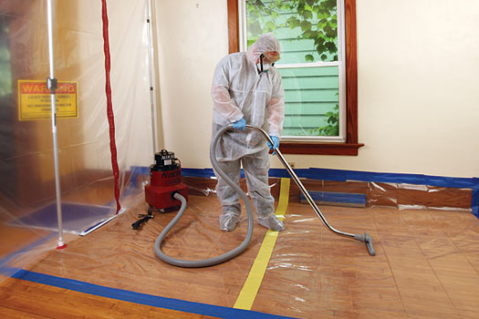
Lead Surface Sampling
Lead Safe Renovation – RRP
  Disturbing Paint in building built before 1978. Typically temporary. Fixing a Problem. Work not due to Lead.
  Lead Dust Sampling Technicians
  One-8 hour class (5 year expiration)
  EPA/HUD - 14 states have EPA approval (AL, DE, GA IA KS, MA, MS, NC, OR, RI, UT, WA, WI, OK, Indian Territory)
  Thorough clean up followed by a verification procedure to minimize exposure to lead-based paint hazards.
Lead Abatement (40 CFR 745.227(e)(8))
  Permanent and complete removal or enclosure (not encapsulation). Removal. Typically entire property involved
  Lead Based Paint Inspector / Lead Risk Assessor
  4 day class (1 year expiration)
  Typically a State Certification.

Slide 7
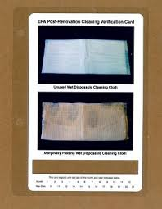
Lead RRP Cleaning Verification
Certified renovator must perform a visual inspection. Is dust, debris or residue present?
Does the contract, or another federal, state, territorial, tribal, or local regulation, require clearance testing at the conclusion of the renovation?
Certified renovator must wipe all uncarpeted floors, countertops, and windowsills within the work area with a wet disposable cleaning cloth. Is the cloth used for any area darker than the cleaning verification card?
Re-clean the areas that failed using the procedures from Flow Chart 5, then use a new wet disposable cleaning cloth to wipe those areas again. Is the cloth used for any area darker than the cleaning verification card?
Notes:
Visual Inspection
Deteriorated paint • Chips or debris • Visible dust

Slide 8
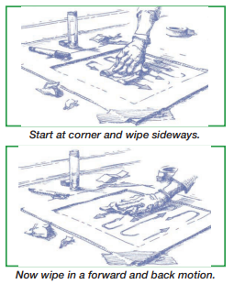
Lead Abatement Clearance
Must be a Certified/Licensed Lead Inspector or Lead Risk Assessor
Standard Surface Sampling Procedure
  Put on disposable shoe covers and lay out the sample area. Prepare the sample tubes
  Put on clean gloves
  Wipe sample area and place wipe in sample tube
  Measure the sample area
  Clean up
  Analyze and Report
Notes:
Lay out the sample area: Clean template with a new wipe. • Tape template to surface. • If no template, outline with tape. • Using tape to lay out the sample area, make sure that on floors the tape is laid in a square. On sills and troughs, the tape should be laid perpendicular to the sill. • DO NOT touch the area inside the template
Prepare the sample tubes: Use clean tubes. • Label tube with ID number. • Record ID number on sample collection form and chain-of-custody form. • Partially unscrew tube cap. • Place tube near sample area.
Put on clean gloves: Use disposable gloves. • Use new gloves for each sample. • DO NOT touch anything except the wipe after putting on the gloves.
Do not touch other objects. • Press the wipe down firmly at an upper corner of the sample area. • Make as many “S”-like motions as needed to wipe the entire sample area, moving from side to side. Do not cross the outer border of the tape or template. • Fold the wipe in half, keeping the dirty side in, and repeat the wiping procedure in the original direction in a forward and back motion. • Fold the wipe again and repeat the wiping procedure, concetrating on collecting dust from the edges and corners of the sample area • Fold the wipe again with the sample side folded in, and place the folded wipe into the sample tube. • Cap the container. Discard the gloves into a trash bag. • Label the centrifuge tube and record the dimensions of the sampling area
Measure width and length (unless template was used). – Length of sill or trough between edges of tape – Width of sill or trough, measure at tape • Measure to 1/8 inch. • Do not remove tape until after measurements are taken. Calculate the sample area and record on sample collection form and laboratory chain-of-custody form.
Clean up Clean template with a clean wipe; place in a plastic bag for storage. • Remove materials from site: – Gloves, tape from floors and windows, and used shoe covers – Put items in trash bag, NOT in client’s trash containers • Clean face and hands with warm, soapy water. – Use sanitary wipes if you do not have access to warm, soapy water •
Analyze and Report: Send the samples to a laboratory recognized by the National Lead Laboratory Accreditation Program (NLLAP) as being proficient in lead in dust analysis. For information on locating EPA-accredited labs, visit http://www.epa.gov/lead/pubs/nllaplist.pdf.

Slide 9
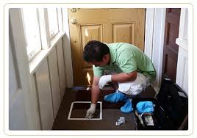
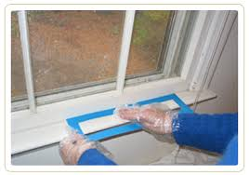
Clearance
Compare the laboratory results to the EPA clearance standards for residual lead dust:
  Floors: 10 micrograms per square foot (µg/ft2)
  Interior windowsills: 100 µg/ft2
  Window troughs: 400 µg/ft2
  These may look different to you, they were updated in March 2021. The previous ones were
    Floors: 40 micrograms per square foot (µg/ft2)
    Interior windowsills: 250 µg/ft2
  Just FYI 100 cm2 = 0.11 ft2
    Multiply results by 9???.
Notes:
What are some of the limitations you will encounter:
Does the wipe sampling really collect all of the material on the surface
Can you exclude outliers.

Slide 10
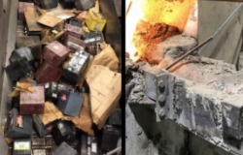
Lead on surfaces
Other Applications
  Industrial Lead Operations (Clean Rooms, Break rooms, Etc.
    Maintain surfaces “as free as practicable” of lead accumulation
    Intent is to prevent resuspension creating an airborne hazard.
    2011 Letter Of Interpretation suggests 200 ug/ft2
      In situations where employees are in direct contact with lead-contaminated surfaces, such as working surfaces or floors in change rooms, storage facilities and, of course, lunchroom and eating facilities, OSHA has stated that the Agency would not expect surfaces to be any cleaner than the 200-ug/ft HUD level.
    But the OSHA Technical Manual IH method calculates to 500 ug/100 cm2
      That would be approximately 4500 ug/ft2. I wouldn’t use this number.
      We’ll discuss this later
  Adjacent administrative areas ??
  Reuse of a former industrial occupancy ??

Slide 11

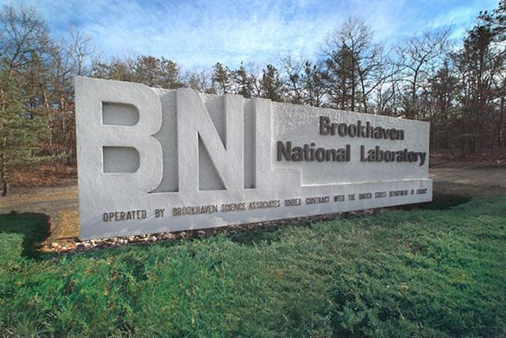
Lead on surfaces
World Trade Center Values
  World Trade Center (WTC) Screening Value
    25 ug/ft2 or 3 ug/100cm2
  2017 Brookhaven National Labs (BNL) IH75190
    Surface Wipe Sampling for Metals
    Sometimes referred to as DOE levels
    Housekeeping = 500 ug/100cm2
    Free Release = 4.3 ug/100cm2
  SEMI S12
    Oral - NA
    Dermal - NA
Notes:
The BNL levels have not been approved for DOE use complex wide.
Semiconductor Equipment and Materials International
SEMI S12 - Environmental, Health and Safety Guideline for Manufacturing Equipment Decontamination

Slide 12

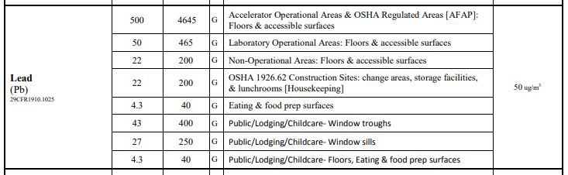
Lead – BNL
Notes:
The BNL levels have not been approved for DOE use complex wide.
Semiconductor Equipment and Materials International
SEMI S12 - Environmental, Health and Safety Guideline for Manufacturing Equipment Decontamination

Slide 13
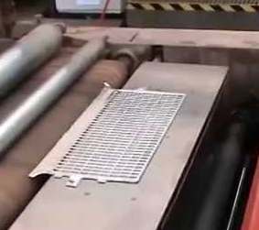
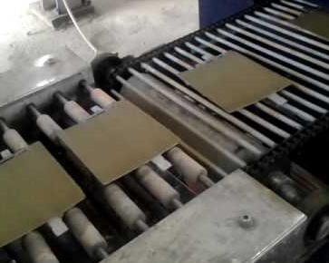
XYZ Battery Manufacturer
200,000 sf building constructed in 1960
  Lead oxide generating mill, lead paste mixing
  Lead grid casting, Pasting grids
  Cut and Brush grids, Cast bundle lugs
  Assemble Battery, Fill with electrolyte, and charge.
  Reclaim and Manual assembly areas
What are we concerned about?
What do we need to do?
Who is we?
What guidelines do we have? Are they applicable?
Notes:
What other questions would you ask?
What is the intended usage?
Sulfuric Acid?
Asbestos?
PCBs?
Anything else?

Slide 14
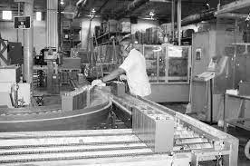
XYZ Battery Manufacturer
Why do we care?
  Protect General Public?
  Protect Current Workers?
  Protect Future Workers?
  Protect Property Owner?
How do different stakeholders affect our decisions?
What sort of clean-up standard are we looking for?

Slide 15
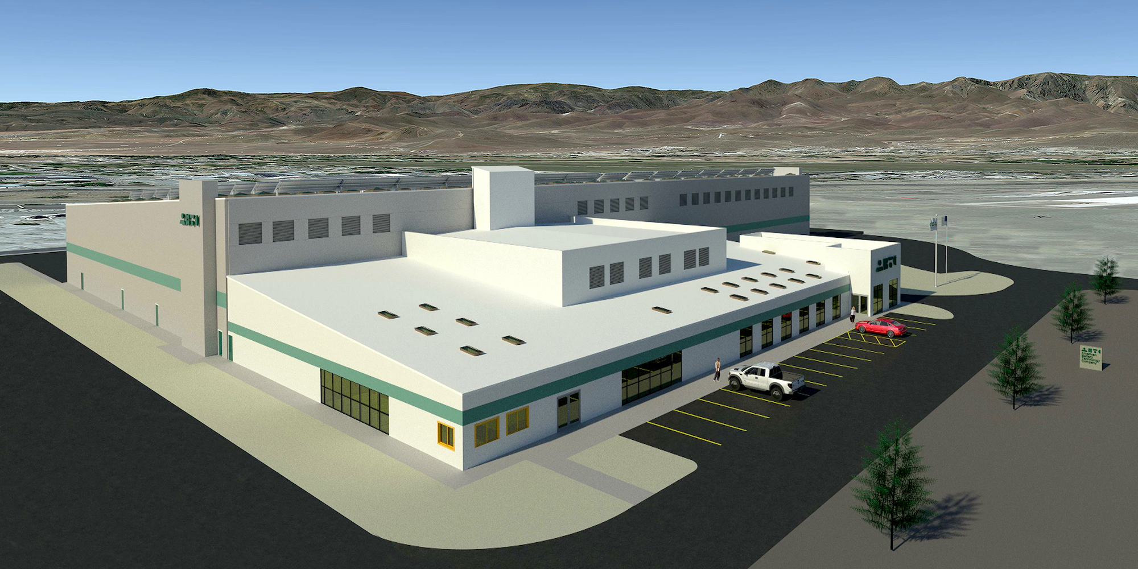
XYZ Battery Manufacturer
What other questions would you ask?
  Sulfuric Acid?
  Asbestos?
  PCBs?
Anything else?
  Facility Layout?
  Prior Occupancy?
  Dates of operations
Are these your duty to ask?
  It depends!
Notes:
Ask about a Phase I Environmental site Assessment
This can quickly turn into a PDC on building decontamination.
Maybe next year

Slide 16
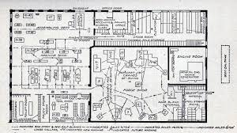
XYZ Battery Manufacturer
So the good news IS the bad news
  There is no standard sampling plan.
  You have to customize it to the history and future use of the facility.
  Random sampling may not be best.
  You may need pre and post sampling to identify hotspots.
  Analytes will vary.
  Use your lab to help you select methods and know your LODs and LOQs early.
ARECC

Slide 17
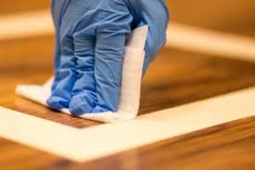
XYZ Battery Manufacturer
One approach
  Conduct standard surface sampling using Method 9100.
  Samples were randomized throughout the facility, but also concentrated where high dust levels were known to occur.
    Lead Oxide Mill
    Lead Pasting Line
    Cut and Brush Area
    Reclaim Area
  Compared all results against the EPA/HUD levels per the clients request

Slide 18

How about you?
Please share personal experiences with indoor surface contaminations
Are there any potential or likely scenarios based on current work activities
Would anyone like to share an experience with typical surface contamination “bad actors” – metals, potent compiounds, etc.?
Would anyone like to share any experience with regulators or agencies regarding indoor surface contamination?

Slide 19


Notes:
Ask about a Phase I Environmental site Assessment
This can quickly turn into a PDC on building decontamination.
Maybe next year

Slide 20
What are we protecting from?
  Flammability
  Reactivity
  Corrosivity
  Toxicity
    Metals
    Pesticides
    Hazardous Drugs
    PBTs and vPvB
  Toxicity is the typical concern, but the other properties can come into play.

Slide 21
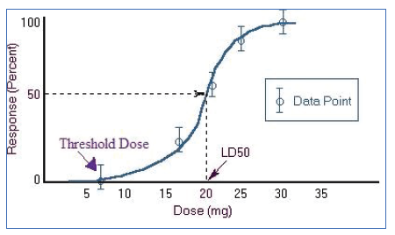
Toxicity
  "All substances are poisons ... the right dose differentiates a poison from a remedy
  Routes of Exposure
    Inhalation
    Dermal
    Ingestion
    Degree:
      Acute toxicity
      Chronic toxicity
  Can a surface contaminant use these routes of entry?

Slide 22
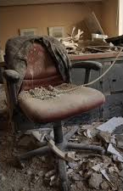
Items to Consider at Contaminated Facilities
  What are the chemicals of concern?
  Who is likely to be affected
  What action (if any) need to be taken to characterize contamination?
  What actions (if any) should be taken to remove contamination (clean, demo, etc.)
  What actions (if any) should be taken to evaluate decontamination effectiveness?
  What regulations (if any) apply?
  HOW CLEAN IS CLEAN???
    there are several different approaches!)
Notes:
lease share personal experiences with indoor surface

Slide 23
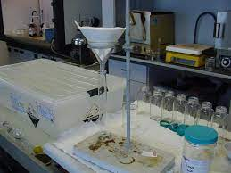
Hazardous Waste Approach
  Apply regulatory hazardous waste values to measured levels of surface contamination.
    TTLC, STLC
    RCRA TCLP
    RCRA Listed (F003)
  The Good News
    We know these numbers
    We have a clear regulatory framework (or do we?).
    Decon activities are frequently driven by environmental regulators
Notes:
Total Threshold Limit. Concentration (TTLC)
Soluble Threshold Limit Concentration (STLC)
Toxicity characteristic Leachate Protocol (TCLP)
F003 Spent non-halogenated solvents

Slide 24

Hazardous Waste Approach

Slide 25
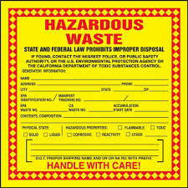
Hazardous Waste Approach
  Unfortunately
    Haz waste standards do not apply!
    Is it waste! Is entire item contaminated, or just the surface?
    Haz Waste standards can only be used for haz waste determination
  • Cannot convert µg/wipe to µg/kg!
    Mass per unit area cannot convert to mass per unit volume (or mass) without more assumptions!
    Weight% of contaminant on wipe is NOT representative of weight% on substrate!

Slide 26
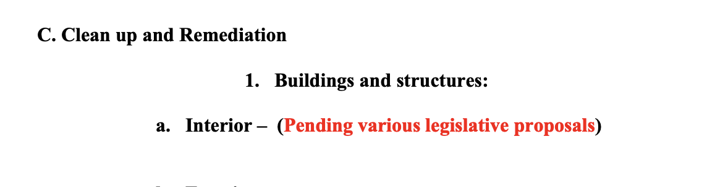
Zero Tolerance Approach
Methamphetamine Contaminated Property Cleanup
  Florida Limit?
  Various state laws may apply
  Many states use a re-occupancy level of 0.1 µg/100cm2
    Based on LOO
    No background considered
    Not "natural”
Theoretically the limit will go down as the technology improves

Slide 27
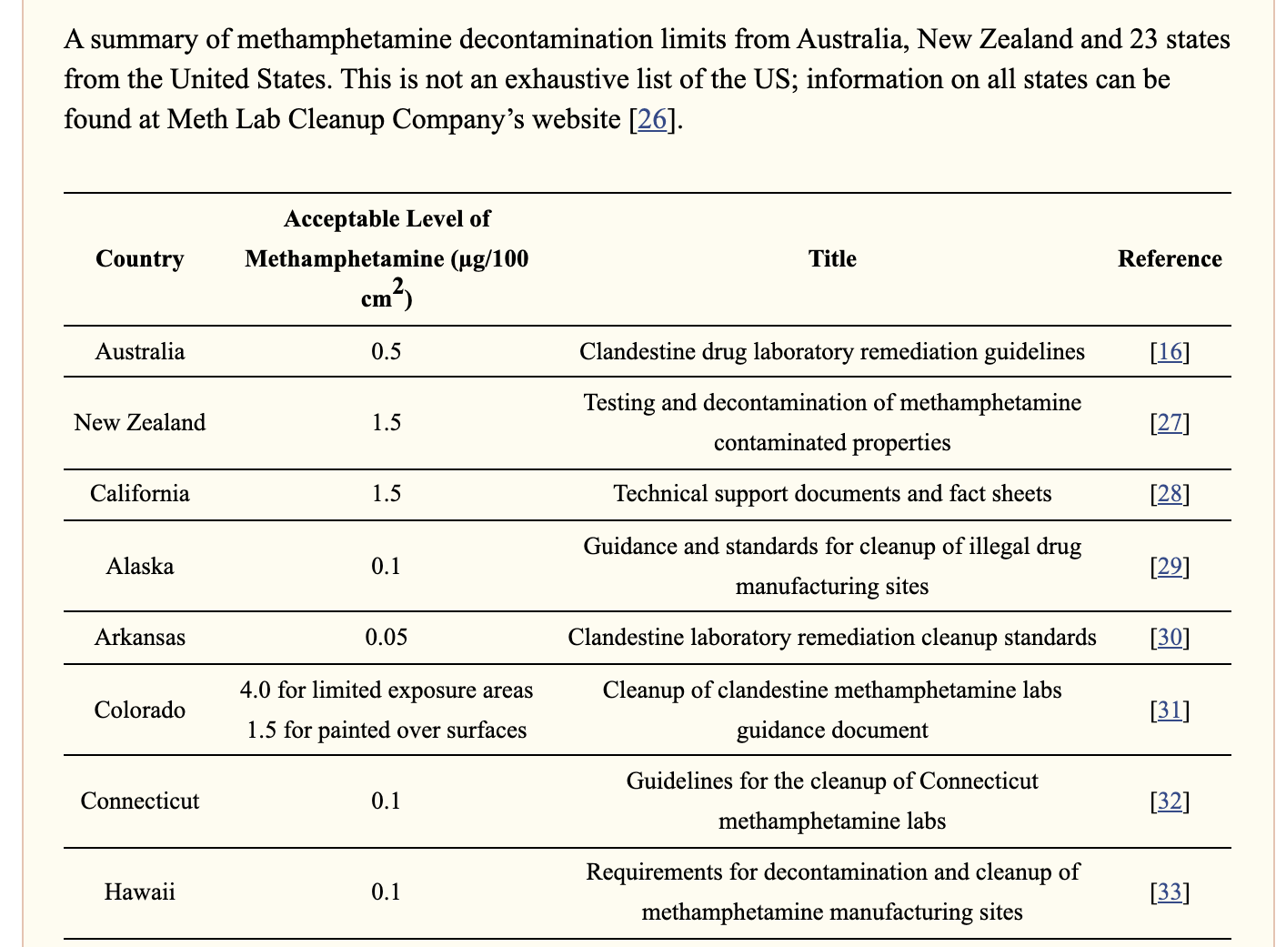
Zero Tolerance Approach
Some states are researching and considering health risk based limits for clandestine labs.
But the illicit drug industry is going faster than the regulators
Methamphetamine LD50
  55 mg/kg
Fentanyl LD50
  2 mg/kg
Zero tolerance can be a very difficult standard to achieve or consider.

Slide 28

Comparative Approach
“All surfaces shall be maintained as free as practicable of accumulations of lead”
the Compliance Directive for the Interim Standard for Lead in Construction, CPL 2-2.58, OSHA recommends the use of HUD's acceptable decontamination level of 200 ug/ft² for floors in evaluating the cleanliness of change areas, storage facilities, and lunchrooms/eating areas.
The term "practicable" was used in the standard, as each workplace will have to address different challenges to ensure that lead-surface contamination is kept to a minimum.
Notes:
Intended to protect workers in clean rooms and eating areas.
How would you apply this to the QA lab?
How would you apply this to the Administrative Offices?

Slide 29

Comparative Approach
It is OSHA's view that a housekeeping program which is as rigorous as "practicable" is necessary in many jobs to keep airborne lead levels below permissible exposure conditions at a particular site.
The intent of the standard was that this be accomplished primarily by vacuuming floors, rafters, and other surfaces, or by methods equally effective in preventing the dispersal of lead into the workplace.
Re-entrainment of lead dust is an additional source of exposure and one that engineering controls are not generally designed to control. Clean-up is an exceptionally important provision of the standard as it minimizes the re-entrainment of lead dust into the air.

Slide 30
Comparative Approach
Hexavalent Chromium
29 CFR 1910.1026, at paragraph (i)(4)(i), provides that whenever an employer allows employees to consume food or drinks at a worksite where chromium (VI) is present, the employer must "ensure that eating and drinking areas and surfaces are maintained as free as practicable of chromium (VI).
A violation of this particular hygiene provision in the Chromium (VI) standard is based on evidence that the employer has not implemented feasible or practicable hygiene practices. OSHA's collection of a dust wipe to confirm Cr(VI) contamination during an inspection serves only to establish that the Chromium (VI) standard applies.
OSHA does not look for a threshold amount of Cr(VI) on a dust wipe sample to determine if a hygiene violation exists. While employers may consider the DOE's recommended acceptable level when evaluating the efficacy of its hygiene practices, a dust wipe sample showing an amount of Cr(VI) above or below the DOE acceptable level is not determinative for OSHA citation purposes.
Notes:
I recommend the sampling because, well, I’m an industrial hygienist.
But I do recommend it as a tool to indicate the efficacy of your cleaning procedures.
I’d suggest annually unless you are troubleshooting a problem or need to evaluate a new cleaning contractor or procedure.

Slide 31

Comparative Approach
Problems with Occurrence Standards
  Can be poorly defined
  What is the "dose"?
  Can be overly protective
  May not be protective enough?
  "Occurrence" approaches focus on Hazard
  Is this a risk-based approach?

Slide 32
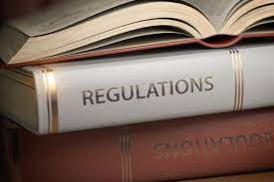
Regulatory approach
We already mentioned the OSHA standards and learned they are comparative standards.
  Lead
  Hexavalent Chromium
Are there any others in OSHA?
  Asbestos
  Cadmium
  Silica
Notes:
Asbestos
1910.1001 (k)(1) – Same basic language
Cadmium
1910.1027 (k)(1) – ditto
Silica
1910.1053(h)(2) - The employer shall not allow compressed air to be used to clean clothing or surfaces where such activity could contribute to employee exposure to respirable crystalline silica unless:

Slide 33

Other Regulations
DOE 10 CFR Part 850 CBD Prevention
  "housekeeping" (internal) level = 3 µg/100cm2
  "release" (public) level= 0.2µg/100cm2
"Empirical" levels
  Achievable; didn't seem to cause problems at relevant facilities
No exposure scenario or modeling or similar.
It only applies if it applies.
  17 DOE Labs
  28 DOE Defense Nuclear Sites
  DOE Contractors

Slide 34

Other Regulations
Department of Defense
  OPNAVINST 5100.23B
  Army Regulation 385-10
  AFMAN 91-202
It only applies if it applies.
  Wording is similar to OSHA standards, when it exists at all.
  Executive Order requires OSHA compliance where service guidance is not available.
Notes:
Does NASA have its own guidance?

Slide 35
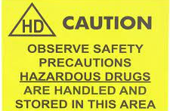
Other Regulations
USP 800 Anyone?
  Hazardous Drugs - Handling in Healthcare Settings
Again this is mostly a comparative standard
  But due to the toxicity is often a zero tolerance approach
Most pharmacies establish three categories for sampling
  below the limit of detection;
  above the LOD, but below the level defined as warranting additional cleaning;
  levels above a defined cleaning criteria level.
Who does this apply to?
Notes:
Bueler? Bueler?
Technically nobody. It was scheduled for 2019, but was delayed.
But many pharmacies and compounding labs are following the draft document.

Slide 36
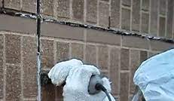
Other Regulations
TSCA PCB surface contamination limits
  Under TSCA, for the purposes of defining applicable regulatory requirements, PCBs refers to PCB items containing > 500 ppm PCBs or having non-porous surface contamination >100 µg/100 cm2
  Be careful if you suspect this. Once you find it, it creates a lot of required actions because it may be an unauthorized use.
Notes:
PCB Caulks, Glazing, paints, etc.
Another PDC topic!!!

Slide 37

Other Regulations
Anything Else???
We need to go back to where we started.
HUD Lead Levels
  Guidelines for the Evaluation and Control of Lead-Based Paint Hazards in Housing
  Bare floor = 10 µg/ft2 = 1.1 µg/100cm2
  Explicitly residential
  Only applicable to Pb
  Based on blood lead levels of exposed children
  "Kind of" risk-based
Notes:
There are likely some others that I have missed.

Slide 38
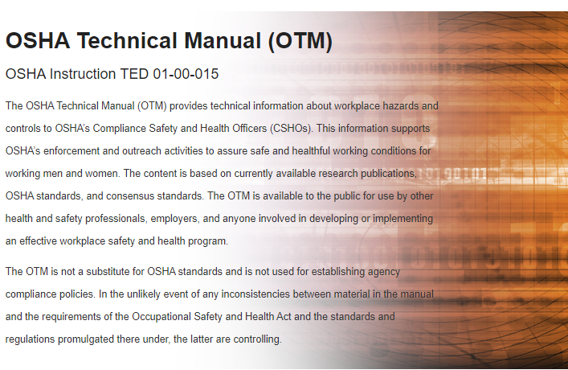
OEL Based Approach
OSHA Technical Manual (OTM)
  https://www.osha.gov/otm/section-2-health-hazards/chapter-2
A common rule of thumb is to use the maximum allowable dose (based on the chemical's airborne exposure limit in units of μg/m³) and the approximate area of a worker's hand (100 cm²) to arrive at an acceptable value for surface contamination in work areas (i.e., a housekeeping standard).
Notes:
PCB Caulks, Glazing, paints, etc.
Another PDC topic!!!

Slide 39
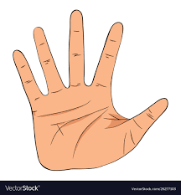
OEL Based Approach
If the eight-hour TWA exposure limit for a chemical is 1 μg/m³, the maximum allowable dose for that chemical is 10 μg.
  The airborne exposure limit is multiplied by 10 m³, the volume of air inhaled by an average worker in an eight-hour workday,
The maximum acceptable dose is then divided by the area of a worker's hand to determine the acceptable surface limit of 10 μg/100 cm² or 0.1 μg/cm².
  By this rule of thumb, the amount of contaminant picked up by one hand contacting the contaminated surface is equivalent to the toxic dose allowed by the eight-hour TWA airborne exposure limit.
Notes:
PCB Caulks, Glazing, paints, etc.
Another PDC topic!!!

Slide 40

OEL Based Approach
Perplexed?
  What is the likelihood of resuspension of this material into the worker breathing zone
  What is the likelihood of inhaling this material and receiving the dose.
But this is the convention that is used.
  Adopted by the 2017 revision of the BNL policy
Can you be cited for it?
  It depends?
What does this do for crystalline silica?
Notes:
Any students in the group? Sounds like a good subject of a research paper.
Where was the sample taken?
Silica PEL is 50 ug/m3, Total dose would be 500ug. Surface Limit would be 5ug/cm2.
I don’t know if a construction office or concrete project that can achieve this.

Slide 41

CAL/OSHA
MBOCA (Methylenebis(2-chloroanaline
8 CCR 5215(c)(2)(C)
  "Accessible surfaces which employees are likely to contact ... shall not exceed 100 µg MBOCA per 100 cm2 of surface."
  " ... the average of at least five wipe samples shall be used; if one sample exceeds the mean by a factor of 10 or more, it will be rejected as not being representative.“
  Allegedly the 100 µg/100 cm2 derived from PEL (10 µg/m3) * 10 m3
  Same Same

Slide 42

Acceptable Surface Limits (ASL)
Pharmaceutical Industry Approach
Based on Occupational "Acceptible Daily Intake)
  Similar to EPA RfD (reference dose)
  ADI = NOAEL * Body Weight / (uncertainty Factor * Absorption Factor)
  ASL = ADI/Surface Area * Absorption Factor
    Semi Quantitative approach
    But where do you get these values?

Slide 43
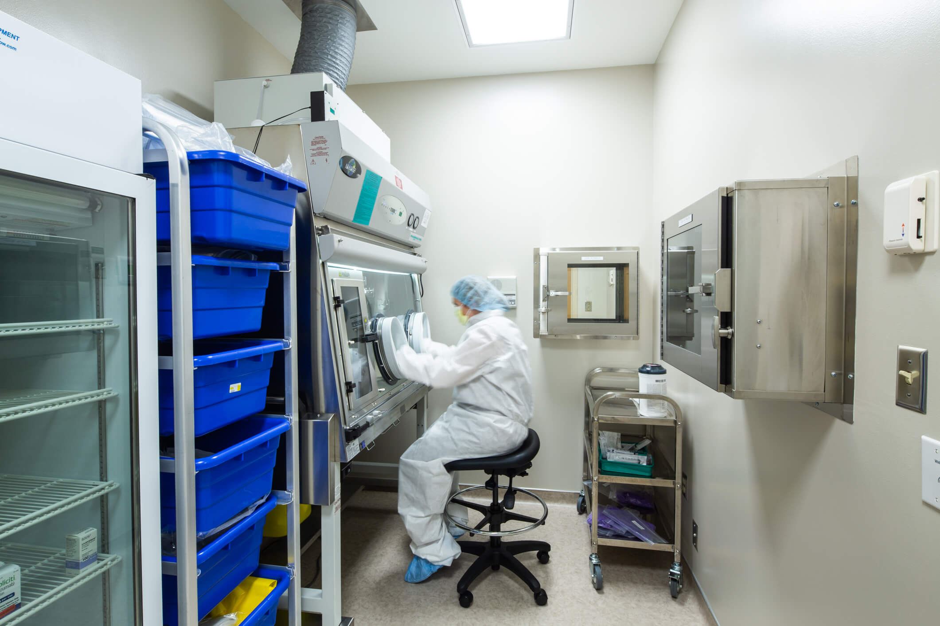
USP 800
United States Pharmacopeial Convention General Chapter 800(USP 800) Hazardous Drugs-Handling in Healthcare Settings
Guidelines for management of hazardous drugs (chemotherapy agents), Section 6
"Environmental wipe sampling for HD surface residue should be performed routinely
"There is currently no standard for acceptabl contamination ... "
Recommended -not required
Supported by professional guidance

Slide 44
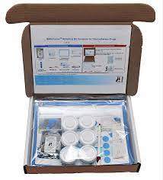
USP 800
It is reasonable to interpret wipe sample results as indicative of the presence of a specific drug on the day the wipe sampling was conducted, affirming the potential for dermal exposure.
In interpreting the results for stakeholders, it is helpful to understand the scope of contamination.
  Widespread surface contamination or the contamination of many surfaces suggests a different issue compared to when one or a subset of surfaces is found to be contaminated.
  An isolated event resulting in widespread contamination could indicate specific work practices that need improvement or an unplanned event such as a spill.
  A more formal statistical analysis of the geometric standard deviation of the wipe sample dataset is helpful in evaluating whether a work process is “out of control
Notes:
But conducting such an analysis can require advanced statistical skills when the dataset includes results that are below the LOD.

Slide 45
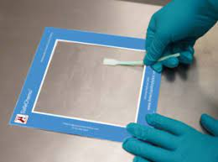
USP 800
Comparing which drugs were detected with the compounding records is useful for identifying potential persistent residual contamination.
Documenting information about work conditions on the day of sampling (for example, which drugs were handled, the number of doses prepared and treatments completed) is critical to accurately interpreting the results.
Unplanned events such as spills can significantly skew results, so it’s important to document their occurrence, location, surfaces, and the drug involved, as well as the half-life of the drugs in question.
Taking photos of specific locations helps prevent inconsistency from vacations, staff turnover, and unanticipated absences.
Notes:
Can get expensive
Possible select a surrogate EHD to represent the rest. Do procedures/skills vary between drugs.
Injectable vs tablet??

Slide 46
Risk Based Approach
Used for the World Trade Center Clean-Up
Based on EPA Risk Assessment Guidance for Superfund Sites
  Residential Exposure assumptions
  EPA guidance for residential pesticide exposure used for settled dust assessment
  Based on ingestion, dermal contact with dust
  Established for 22 contaminants(metals and others)
  Be careful what you ask for though!
Dose Rate=[(EThard*FTSShard*CSLhard)+(ETsoft*FTSSsoft*CSLsoft)]*SA*FQ*SE/BW)/RfD
ET = Exposure Time (hr/d)
FTSS = Fraction Transferred from Surface to Skin
CSL= Contaminant Surface Load (:g/cm2 )
SA= Surface Area (cm2 /event)
FQ = Frequency of hand to mouth events (events/hr)
SE= Saliva Extraction factor (unitless fraction)
ET = Exposure Time (hr/d}
BW = Body Weight (kg)
RfD - Reference Dose

Slide 47
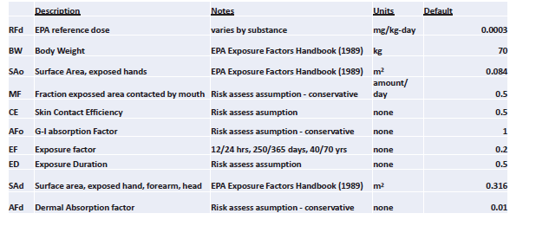
Risk Based Approach

Slide 48
Risk Based Approach
SEMI S12 - Environmental, Health and Safety Guideline for Manufacturing Equipment Decontamination
  Health-Based Clean-up Level (oral)
    = (RfD*BW)/(SAo*MF*CE*Afo*EF)
  Health Based Cleanup Level (dermal)
    = (RfD*BW*ED)/(SAd*CE*Afd*EF)
  Calculate both values, choose the lowest
Similar approach used by OEHHA to update meth clearance level to 1.5 ug/100cm2 (a 15x increase)
All those assumptions
  Dermal uptake models, transfer efficiency, skin pH, non-depleting source, other assumptions
  Based on different exposure scenarios (children in contaminated house)

Slide 49

Notes:
Ask about a Phase I Environmental site Assessment
This can quickly turn into a PDC on building decontamination.
Maybe next year

Slide 50

Scenario Discussions
What are the chemicals of concern with respect to facility decontamination?
Who is likely to be affected
What action (if any} needs to be taken to characterize contamination?
What actions (if any) should be taken to remove contamination (clean, demo, etc.)
What actions (if any} should be taken to evaluate decontamination effectiveness?
What regulations (if any) apply?
HOW CLEAN IS CLEAN???
Notes:
Should clearance sampling be conducted as part of the response?
If clearance sampling is needed, what should we sample for?
If clearance sampling is needed, what is the best approach to use for this situation?
Hazardous Waste
Zero Tolerance
Comparative
Regulatory
OEL/ASL
BNL
WTC Screening Level
SEMI Screening Level

Slide 51

Scenario Discussions
Points to Consider
Potential Receptors:
  General Public?
  Sensitive Receptors?
  Industrial Workers?
  Office/ Adm in Workers?
Anticipated Use
  Unrestricted?
  Residential?
  Industrial?
  Non­industrial?
Health Effects:
Unknown, Highly Toxic (acute), Moderately Toxic (acute), Chronic Toxin
• Reservoir of contaminant?
• Exposure Info - OELs? RfD?
• Regulatory Requirements?

Slide 52

Scenario # 1 - Apple Pharmaceutical
Pharmaceutical Research and Development - organic chemical synthesis
5,000 ft2 dedicated lab space - single pass ventilation, 8 chemical fume hoods, 5 Biosafety Cabinets
1 large lab suite with small anterooms on perimeter
Intensive use of solvents and various organic compounds in hoods
General use of organic compounds, acids, buffers etc. on lab benches, no metals, no potent compounds, no hazardous powders
Company is re-locating and needs to return facility in a "safe" condition and address landlord concerns

Slide 53
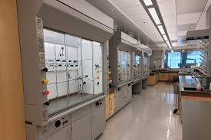
Scenario # 2 – Bravo Pharmaceutical
Pharmaceutical Research and Development - "Antibody-Drug Conjugate"
5,000 ft2 dedicated lab space - single pass ventilation, 8 chemical fume hoods, 1 "isolator" (glove box), 2 ventilated weigh stations
2 lab suites - "Chemistry" and "Biology“
Moderate use of solvents and various organic compounds in hoods in both suites
General use of organic compounds, acids, buffers etc. on lab benches in both suites
Use of "Highly potent compound" powders in Chemistry suite (MMAE, OEL = 30 ng/m3) in isolator and also in weigh stations. Small (µg) quantities on open benchtop.
Use of "Highly potent compound" in DMSO solution in Biology suite
Company is re-locating and needs to return facility in a "safe" condition and address landlord concerns

Slide 54
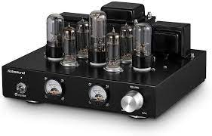
Scenario # 3 – Louder Company
Manufactures reproduction vacuum tubes for use in vintage amplifiers
High vacuum (10-9 mbar) is produced by mechanical "roughing pump" and mercury diffusion pump (Hg diffusion pumps use heated Hg to create high vacuum - maybe they are taking historical authenticity too far!)
Vacuum pump case has cracked, releasing Hg vapors, resulting in deposition of volatilized Hg across production area
Area needs to be cleaned to a level appropriate for continued production amplifiers

Slide 55
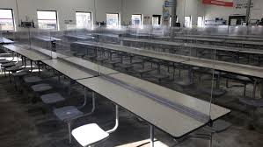
Scenario # 4 - Design Fabrication
Company has been in business in the same facility for 100 yrs
5,000 ft2 shop floor and 2,000 ft2 associated admin and break room areas
Historical activities used lead, chromium as well as a variety of ferrous and non-ferrous metals
Lead and chromium no longer used, however historical activities resulted ) measurable, residual contamination of occupied areas production, admin) due to settlement of contamination dust from roof.
Employees have expressed concerns regarding their exposures.
Notes:
What if - Company is selling entire property and needs the building to be in a "safe" condition

Slide 56

Scenario # 5 - Foxtrot Semiconductors
Company uses a variety of semiconductor fabrication tools that can lead to surface contamination with arsenic.
2 ion implanters are being relocated to a new facility. Each tool is approximately 10' long
Tools need to be clean enough to be safe for non-facility technicians and movers to handle.

Slide 57
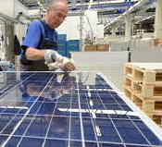
Scenario # 6 – Golf Technologies
Company has a proprietary process to deposit cadmium telluride on glass plates as part of photovoltaic cell manufacture
Glass plates move on a conveyer through a vacuum-oven for gas-phase deposition.
The oven is 4'tall x 5' deep x 100' long, with 1.5" stainless steel walls (ignore other associated equipment)
Ovens are to be disposed of as scrap steel
1.5"stainless steel plate weighs 27.6 kg/ft2, Cd weighs 8.65 g/cm3
Notes:
Is there a hazardous waste issue here?
• "Total amount of contaminant
• Steel plate (36"x36nx1 ") contaminated with Cadmium
o Wipe test results= 100 µg/100cm2
o Cadmium TTLC = 100 mg/kg (equivalent to1/10,000)
• 1" (25 mm) plate weighs 196 kg/m2
o 196 kg/10000 = 19.6 g
o (So 19.6 g Cd would exceed TTLC)
• 1 m2 = 10,000 cm2
o 10,000 cm2 /100 cm2/wipe = 100 wipes
o 100 wipes x 100 µg/wipe = 10,000 µg = 10 mg= 0.01 g
• 0.01g Cd< 19.6g Cd.., Not Hazardous Waste based on ·total" levels
o Can also evaluate for TCLP

Slide 58
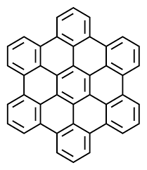
Scenario # 7 – India Consulting
Company has offices located directly adjacent to a government­ regulated clean-up site
Soil is contaminated with polyaromatic hydrocarbons (PAHs) including benzo-a-pyrene. A soil screening level of 0.038 mg/kg (0 - 5' BGS) has been established for the site
Active excavation of contaminated soil is being conducted at the site, and
Workers at Hercules Consulting believe that exposure to PAH ­contaminated settled dust is a contributing factor to illness experienced by multiple workers.

Slide 59
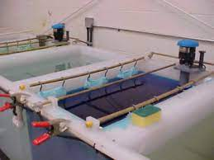
Scenario # 8 – Juliet Family
Juliet family conducts chromium bumper electro-plating activities in their garage.
Parts are cleaned and degreased using a methylene chloride parts cleaner then placed in an electroplating plating bath containing a chrome sulfate (trivalent) solution.
There is visible discoloration of the garage floor and adjacent areas of the house
The family wants to be sure the house is safe for continued occupancy.

Slide 60

Scenario # 9 – Parker Medical Center
The Medical Center still uses wall-mounted mercury manometers to measure blood pressure due to concerns about accuracy and calibration of aneroid manometers
One manometer broke, releasing approximately 50 ml of liquid mercury in a carpeted medical office area (approximately 100 ft2)
The area has been closed and carpet has been removed for disposal. Medical center needs to determine if area can be used for patient care.
Notes:
Has anybody ever used the mercury detection surface wipes?
EPA/ATSDR “recommends” head space vapor sampling

Slide 61
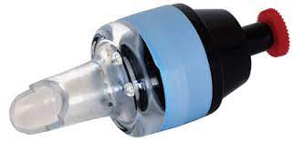
Some Other Stuff
Asbestos Vacuum Sampling
  ASTM D5755 - Dust samples are collected using a vacuum sampling technique and analyzed by TEM,
  This method is often used to determine the presence of asbestos dust on surfaces, and some asbestos professionals use it to evaluate relative levels of contamination.
  The method determines the concentration of fibers collected on a filter from a 100 cm² area.
  The standard detection limit for the method is about 1,000 fibers/cm² based upon seeing four (4) asbestos fibers in a specified number of TEM grid openings.
  Cannot be used as a substitute for initial monitoring or a negative exposure assessment under OSHA's Asbestos standards

Slide 62
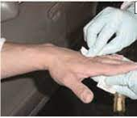
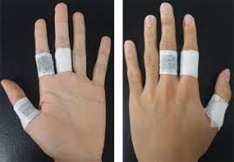
Some Other Stuff
Dermal Sampling
Skin sampling is used to estimate the amount of material which contacts the skin and is relevant both for materials that affect the skin, such as corrosive materials, and for materials which absorb through the skin and have systemic effects.
Dermal exposure may be assessed through either direct or indirect methods.
  Direct methods measure the amount of material which contacts the skin, for example, through wipe tests which remove and recover the material from exposed skin, or use of sorbent patches (dosimeters) which are placed over the skin and capture material which would have contaminated the skin.
  Indirect methods measure the amount of contaminant that enters the body. Indirect methods are also known as biological monitoring.
  Skin-perm is an AIIH Exposure Modeling tool to assess estimated absorbed dose from skin contact.

Slide 63
Some Other Stuff
Sampling Strategy
  Where to sample,
  How to Sample
  Sampling Strategy & Number of samples
    Random?
    Authoritative or targeted sampling??
  Level of confidence needed or scrutiny
  Degree of hazard

Slide 64
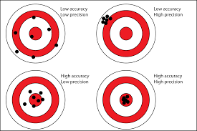
Sampling Strategy
Lack of Clear Guidance on Sampling Strategy
Back to Basics (lets define our terms):
  "Sample" - portion of population, used to make inferences about the population
  Validity of inferences assumes samples represent population
  Accuracy & Precision require adequate# of "representative samples“
  "Population" must have well-defined physical and/or temporal boundaries.
Does the level of indoor surface contamination constitute a "population"?

Slide 65
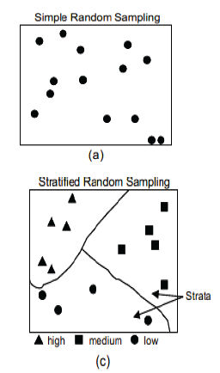
Sampling Strategy
Should you use SEG approach?
Is surface contamination a “population“?
Larger "process" contamination
  Maybe
Small-scale "task" contamination?
  Maybe
EPA SW 846 Chapter 9
  Simple random sampling adequate for randomly heterogeneous populations
  Stratified random sampling used for non­random heterogeneity
Systematic Grid Sampling
Random Sampling w/in Grid
Notes:
Which works for us?

Slide 66
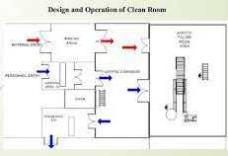
Sampling Strategy
Sampling locations to consider
Work areas where contaminant is handled
Exterior of work area of containment equipment
Floor of work area
Access to work area
Surfaces (Counter tops) and equipment in work area
"Clean" area - e.g adjacent office or break rooms Storage Areas
Notes:
Which works for us?

Slide 67
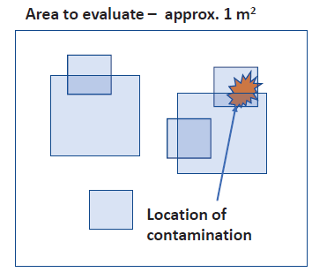
Sampling Strategy
Size of the sampling area (100 cm2, 1 ft2)
Location of the sampling (where they are taken)
Number of samples (1-4)
Small Sample areas may "miss" contamination
Larger samples areas (or higher#) increase likelihood of finding contamination
HUD Guidelines - for common areas, one floor sample for every 2,000 ft2 and one floor sample outside
Notes:
Which works for us?

Slide 68
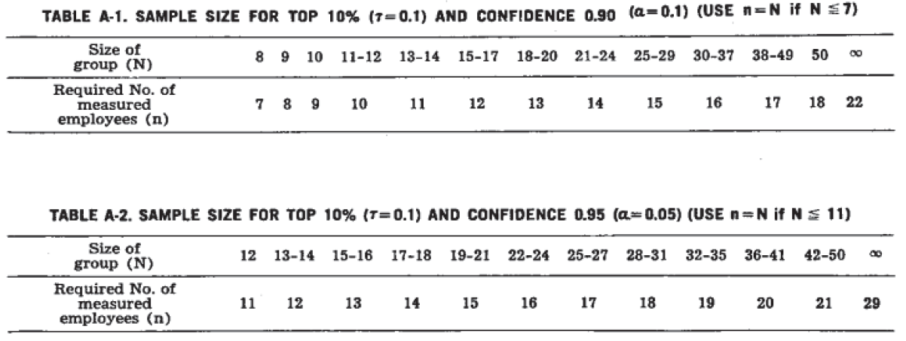
Sampling Strategy
NIOSH Occupational Exposure Sampling Strategy Manual (Leidel & Busch, 1977
"Maximum Risk Worker" in homogenous population
# of samples (n) to collect to be confident that at least 1 sample in xx% are included
  = log a/log (1 - t)
  = fraction%, a = Cl (0.1, 0.05)
Is there anything wrong with "professional judgment" to identify potentially contaminated areas?
Notes:
Which works for us?

Slide 69
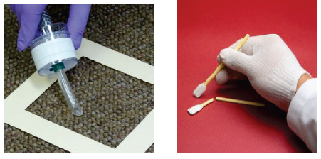
Sampling Strategy
And All This Assumes Good Data!
Wipe sampling
  NIOSH Method 9100, Lead in Surface Wipe Samples,
  Chapter 2, Appendix 11:2-1 of the OSHA Technical Manual and
  Residential Sampling for Lead: Protocols for Dust and Soil Sampling, EPA 747-R-95-001 (March 1995).
Swab Sampling
Micro-Vac Sampling
Variability poorly characterized
  Inter-personal Differences
  Differences between surfaces
Notes:
Which works for us?

Slide 70

Sampling Strategy
Other Sampling Issues
Solubility of contaminant in extraction solvent
Type of wipe sampling material
Recovery efficiency of contaminant from surface material and sampling materials
Recovery efficiency of drug from sampling material
Analytical capabilities (especially for exotic organics)
So What to Do?!?
Notes:
Which works for us?

Slide 71

Well, that’s the ART of Industrial Hygiene

