Slide 1

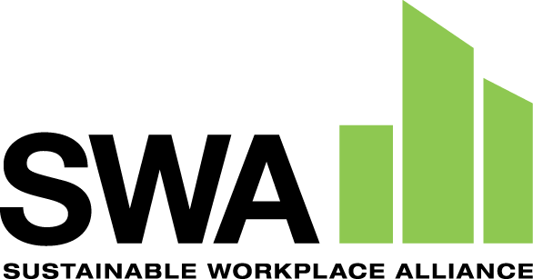

“Environmental Justice in Action”
Panelists: Krystal Pree Hepburn, Ph.D., Principal Investigator, SWA
David Casavant, CEO/Founder, SWA
Miles Ballogg, Senior Principal – Brownfields, Cardno
American Industrial Hygiene Association Conference - Treasure Island, FL
October 15, 2021

Slide 2
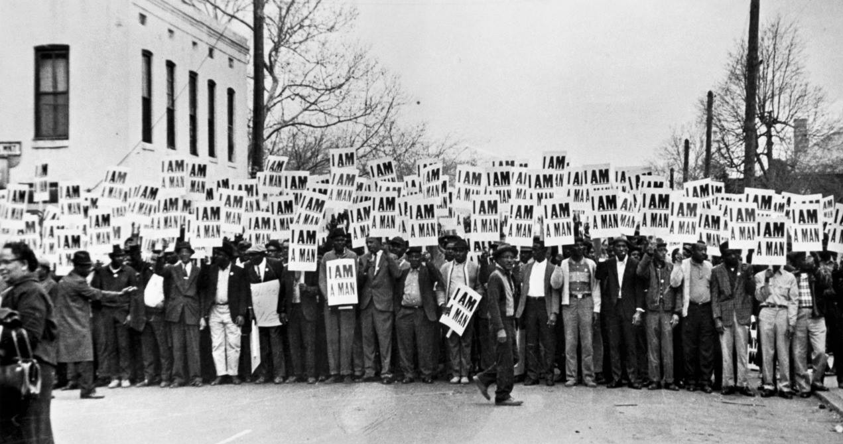
What is Environmental Justice (EJ)?
“…. The fair treatment and meaningful involvement of all people regardless of race, color, national origin, or income, with respect to the development, implementation, and enforcement of environmental laws, regulations, and policies.” - U.S. EPA
Memphis Sanitation Strike (Memphis, TN, 1968)
Notes:
According to the U.S. EPA, EJ – is defined as “…. The fair treatment and meaningful involvement of all people regardless of race, color, national origin, or income, with respect to the development, implementation, and enforcement of environmental laws, regulations, and policies.”
In other words:
ALL Communities, especially those of color, need the same degree of protection from environmental and health hazards, and equal access to the decision-making process to have a healthy environment in which to live, learn, and work
What is the “justice” in Environmental Justice? is supported by decent paying and secure jobs; quality schools and recreation; decent housing and adequate health care; democratic decision-making; and finally, personal empowerment.
EJ movement – really arose from the Civil Rights Movement of the 1960s, which sounded the alarm about the public health dangers for their families, their communities, and themselves; started by people of color who needed to address the inequity of environmental protection services in their communities.
In 1968 – The Memphis Sanitation Strike (pictured) was an action taken against unfair treatment and environmental justice concerns in Memphis, Tennessee. The incident was investigated by activist Rev. Dr. Martin Luther King, Jr., a major leader in the Civil Rights Movement. The strike advocated for fair pay and better working conditions for Memphis garbage workers. It was the first time African Americans mobilized a national, broad-based group to oppose environmental injustices.

Slide 3
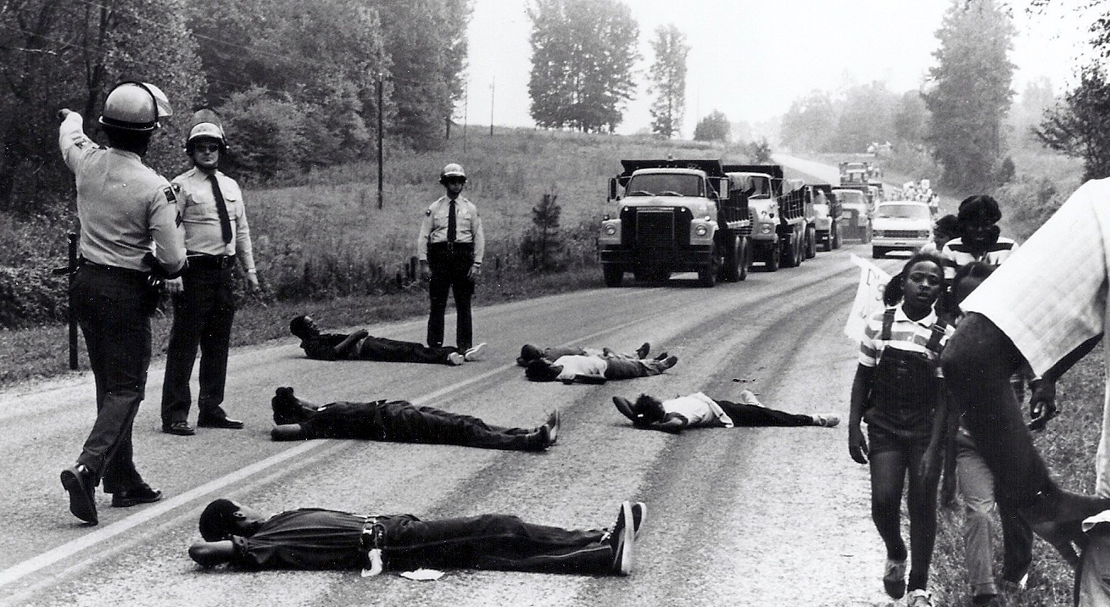
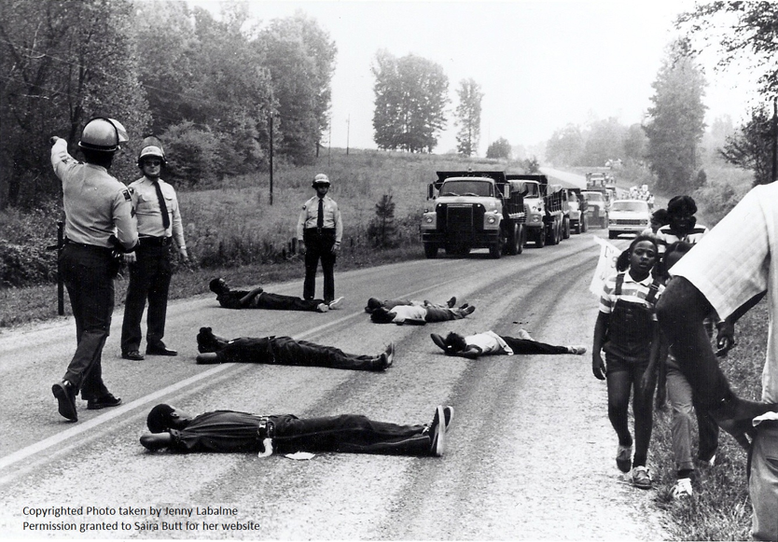
Warren County, NC Landfill Protests, 1982
Notes:
There are several milestones that contributed to the whole EJ movement:
Another major milestone was in 1982 – when a small, low-income, predominately African-American community in Warren County, NC silently protested against the State of NC. A transformer company (Ward PCB Transformer Company) used PCBs in its transformers and workers (Ward, Burns and sons) were supposed to take the PCB-contaminated oil to a facility to be recycled, but instead tried to save money and bypass EPA regulations, so at midnight they illegally sprayed the PCB waste along the sides of the roads, which stretched 210 miles into several counties. EPA approved a landfill to be constructed in Warren County, NC, so that when were to have that soil removed, the contaminated soil would be placed into that landfill. This was the second time African Americans mobilized a national, broad-based group and was a nonviolent sit-in protest, which was to stop the construction of a landfill. As you can see in the picture, people laid in the roadways in an attempt to block those dump trucks which had the PCB in them from entering the landfill.
Numerous demonstrations were staged, which resulted not only in the arrest of more than 500 environmentalist/civil rights activists but became a rallying point for the emerging EJ Movement.

Slide 4
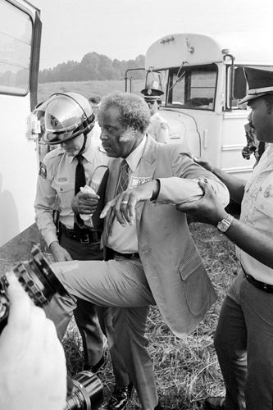
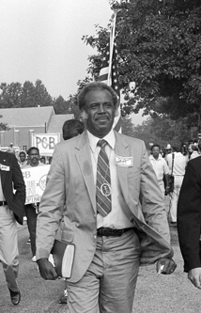
1987 – toxic waste study by the United Church of Christ Commission (UCC)
Notes:
Another major milestone was in 1987 – There was a toxic waste study (Toxic Waste and Race in the United States) conducted by the United Church of Christ Commission on Racial Justice (UCC). In this document, the UCC examined the statistical relationship between the location of a hazardous waste site and the racial/socioeconomic composition of host communities nationwide.
The study found that over 15 million African Americans, 8 million Hispanics, and half of all Asian/Pacific Islanders and Native Americans resided in communities with at least one abandoned or uncontrolled toxic waste site.
- The UCC study was the first of its kind to address the issues of race, class, and the environment on a national level. The study noted that although the socioeconomic status of residents appeared to play an important role in the location of hazardous waste sites, the residents' race was the most significant factor among the variables analyzed.

Slide 5
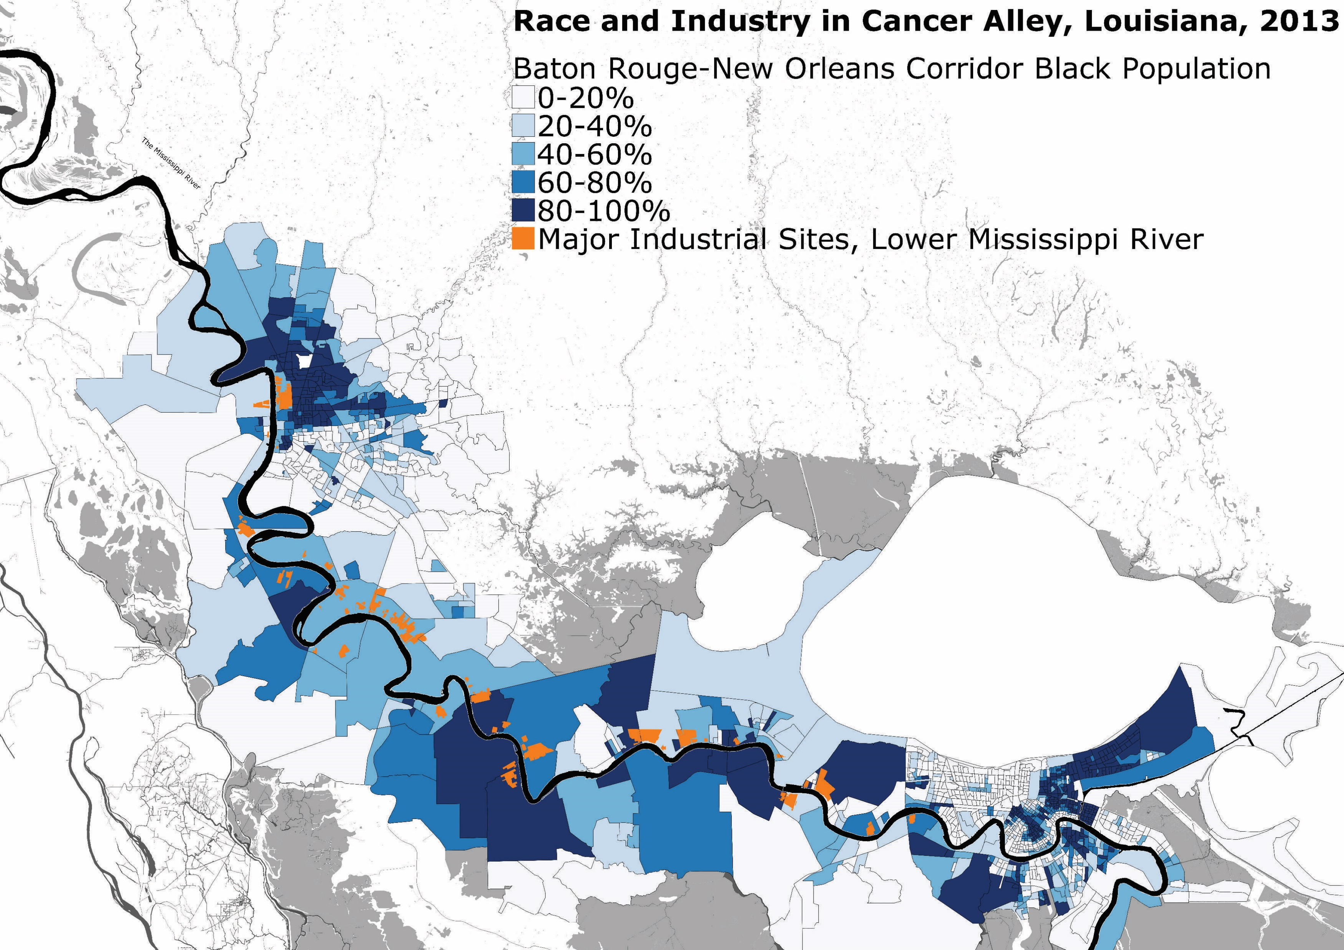
Cancer Alley, LA, 1987
Baton Rouge, LA
New Orleans, LA
Notes:
Here’s one example of environmental injustice that you may be familiar with:
Also, in 1987, there were residents in communities along the Mississippi River in LA began to discover that a lot of people were being diagnosed with cancer – known as Cancer Alley: an 85-mile stretch of the Mississippi River between Baton Rouge and New Orleans, LA; one of the highest rates of cancer in the U.S.
It was home to 125 petrochemical companies (African Americans were disproportionately harmed because the state and local government gave permits for the companies to pollute; as well as their low socioeconomic status and limited political influence);
As you can see for example in this map created by Michael Stepniak in 2013 (even though it’s years later), you can see that the orange areas are major industrial sites along the Lower Mississippi River; and shades of Blue represent the density of the Black Population – the darker the shade, the higher the percentage of African Americans that occupy that area.
Most industrial sites are located in areas where the Black population is 40% and higher.
http://due-parsons.github.io/methods3-fall2015/projects/industry-infrastructure-cancer-alley-la-and-detroit-mi/

Slide 6

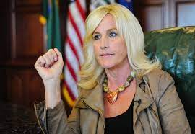
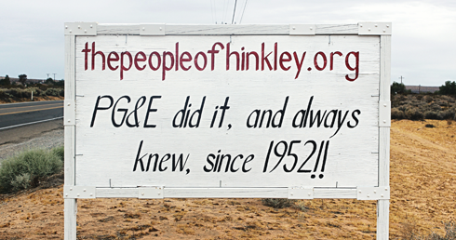
Hinkley, CA (Erin Brockovich)
Notes:
Another example is:
*Hinkley, CA (Anyone see the Movie Erin Brockovich?? – played by Julia Roberts) – Pacific Gas and Electric company used Chromium 6 to fight corrosion in cooling tower water; which was discharged to unlined ponds at the site and it leaked into the groundwater for 3 decades, affecting health of residents there.

Slide 7
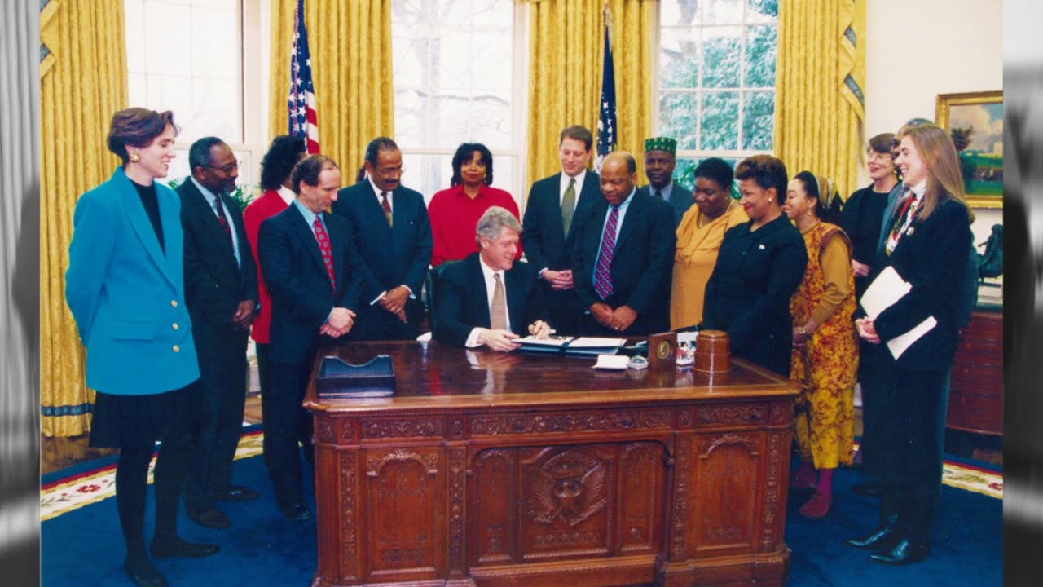
Executive Order 12898 (1994):
Federal Actions To Address Environmental Justice in Minority Populations and Low-Income Populations
Notes:
There were several other milestones that contributed to the EJ Movement over the years, including:
1993 – EPA Administrator Carol M. Browner created the National Environmental Justice Advisory Council (NEJAC). NEJAC is a federal advisory council that holds public meetings on environmental justice issues across the nation – which we still have TODAY!
1994 – President Bill Clinton signed Executive Order 12898: Federal Actions to Address Environmental Justice in Minority Populations and Low-Income Populations. This action was made to focus federal attention on the environmental and human health conditions of minority and low-income populations with the goal of achieving environmental protection for all communities.
Small Grants Program provides financial assistance to eligible organizations to build collaborative partnerships, to identify/SOLVE the local environmental and/or public health issues, and empower the community through education, training, and outreach.
E.O. 12898 directs federal agencies to:
identify and address the disproportionately high and adverse human health or environmental effects of their actions on minority and low-income populations, to the greatest extent practicable and permitted by law.
develop a strategy for implementing environmental justice
In addition, this E.O. established an Interagency Working Group (IWG) on environmental justice chaired by the EPA Administrator and comprised of the heads of 11 departments or agencies and several White House offices.
A year later in 1995, the Brownfields program was established – brownfield is essentially a property that may have a hazardous substance(s), pollutants or contaminants, that is being expanded, redeveloped, or reused; the brownfield program was established to prevent, assess, safely clean up, and sustainably reuse those properties.

Slide 8
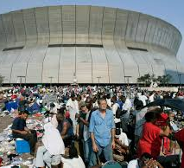
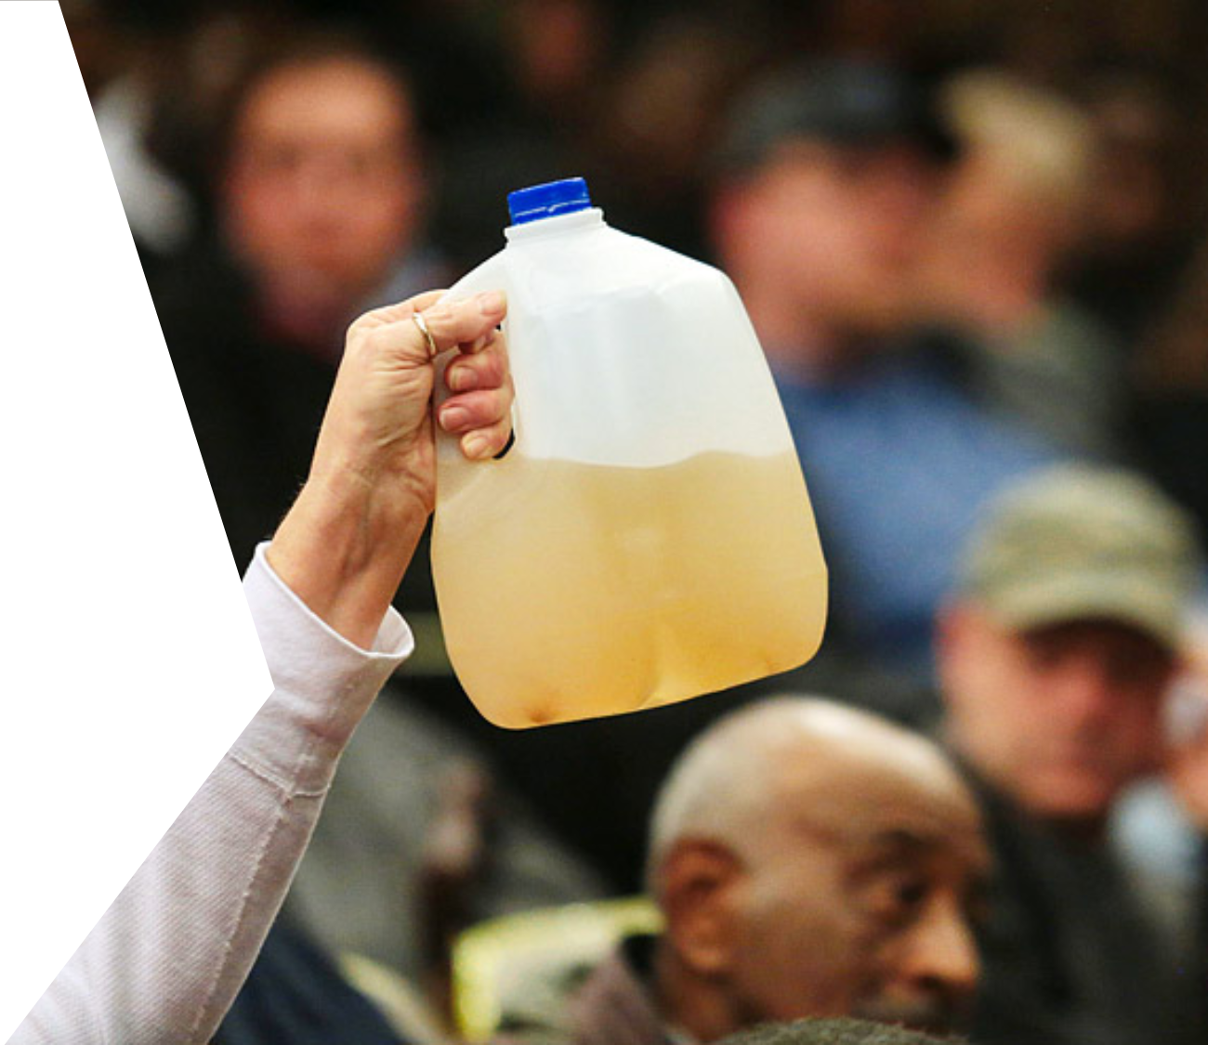
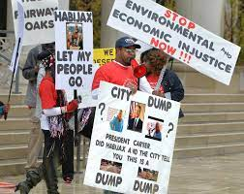
Additional EJ Examples
New Orleans, LA (2005)
Flint, Michigan (2014)
Jacksonville, FL (2020)
Notes:
Hurricane Katrina (New Orleans) 2005 - Hurricane Katrina hit New Orleans as a Cat 5 on August 29, 2005, which caused over $125 billion in damages as neighborhoods were destroyed and was flooded (most areas – at least 10 ft deep), over 1,800 people died
People of color were displaced, thousands left homeless (popn – 60.5% African American many of whom lived in neighborhoods that were susceptible to flooding, racial inequalities already existed, so the hurricane further exacerbated the existing issues
Flint Michigan Water Crisis - 2014 – Flint water crisis – city switched drinking water supply from Detroit’s system to Flint River to save money – elevated levels of lead (elevated blood lead levels in children – can cause neurological issues, impair fetal development, hearing, physical growth, IQ, and cause cardiovascular disease and behavioral problems; high blood pressure, heart/kidney disease and reduced fertility);
Inadequate treatment and testing of the water resulted in a series of major water quality and health issues for Flint residents—issues that were chronically ignored, overlooked, and discounted by government officials even as complaints mounted that the foul-smelling, discolored, and off-tasting water piped into Flint homes for 18 months was causing skin rashes, hair loss, and itchy skin.
The city’s switch also coincided with an outbreak of Legionnaires’ disease (a severe form of pneumonia) that killed 12 and sickened at least 87 people between June 2014 and October 2015. The third-largest outbreak of Legionnaires’ disease recorded in U.S. history—as well as the discovery in 2014 of fecal coliform bacteria in city water—was likely a result of the city’s failure to maintain sufficient chlorine in its water mains to disinfect the water. Ironically, the city’s corrective measure—adding more chlorine without addressing other underlying issues—created a new problem: elevated levels of total trihalomethanes (TTHM), cancer-causing chemicals that are by-products of the chlorination of water. (https://www.nrdc.org/stories/flint-water-crisis-everything-you-need-know)
EJ in Jacksonville, FL - 2020 – Jacksonville, FL -- Local leaders shift from a laid-back approach that allowed polluters to contaminate Black neighborhoods to working with and advocating for Black residents; A Climate action advocacy group looks to diversify their committee
-He said the city allowed polluting industries in Black communities, where land was cheap and citizens’ well-being was largely overlooked by the political and business establishment
-some of Jacksonville’s factories are gone and others have changed their ways. But the legacy remains: industrial pollutants – among them, major contributors to the climate crisis – persist in the neighborhoods’ soil, water and air.
There has been a series of action steps/policies/programs that have been implemented since then (including the ECWTP)
EJ Movement – about raising awareness of the plights of vulnerable populations; tightening environmental laws

Slide 9
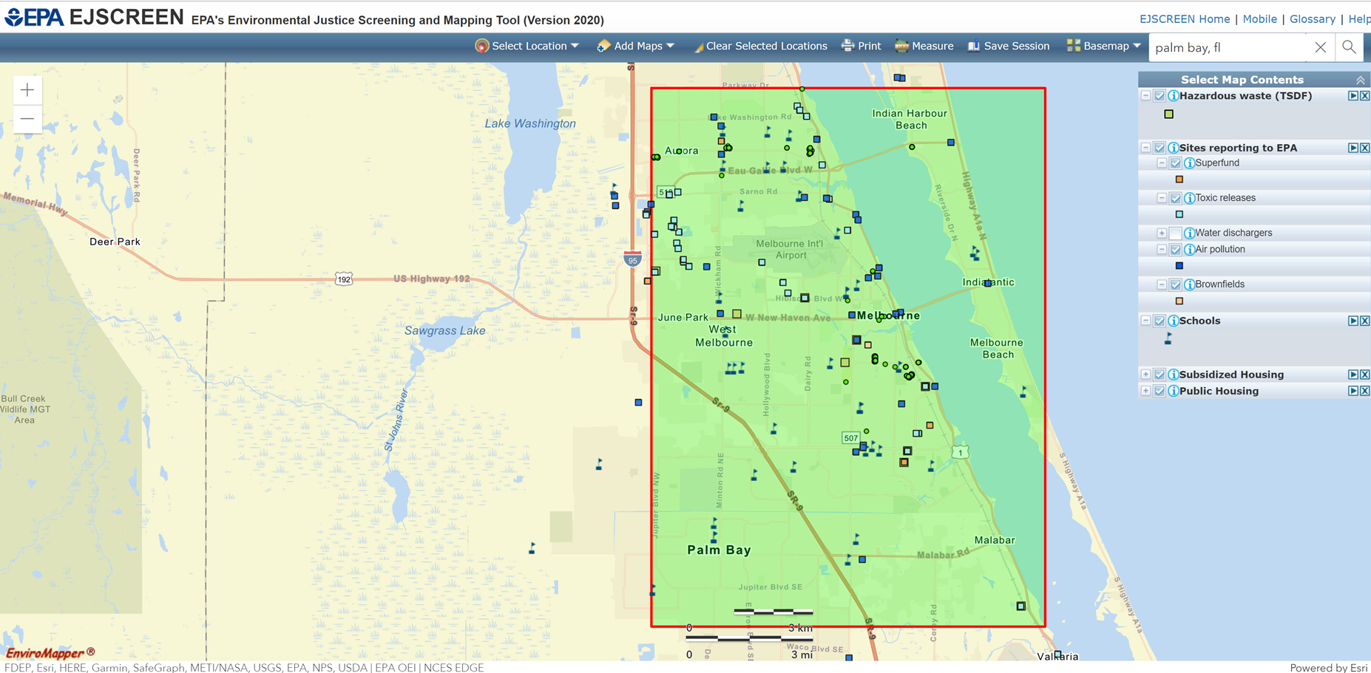
EJ Screening & Mapping Tool
EJSCREEN
Notes:
So, I just wanted to give you a very brief walk through history, denoting some of the major milestones within the EJ Movement, but I also would like for you to see what environmental risks that may be posed to you according to where you may live, work, and play.
The Environmental Protection Agency (EPA) has a tool called EJScreening & Mapping Tool to essentially find out demographic and environmental information for various areas throughout the nation.
This tool is FREE and anyone can use it anytime – I encourage you to go on there and get even more specific to your neighborhood.
For example, I mapped the Melbourne/Palm Bay area (which is where we are currently hosting one of our training programs – that David will speak about shortly), to see what types of potential environmental hazards they may have in their backyard. You can see the Legend on the right (and there’s loads of information on here that you view, but I just chose a few to demonstrate this tool).
Hazardous waste sites – green squares
Superfund sites – orange squares: Superfund (also known as Comprehensive Environmental Response, Compensation, and Liability Act (CERCLA)) is the federal government's program to clean up the nation's uncontrolled hazardous waste sites.
Toxic releases – light blue squares: The Toxics Release Inventory (TRI) is a publicly available EPA database that contains information on toxic chemical releases and waste management activities reported annually by certain industries as well as federal facilities.
Air pollution – dark blue squares: Air pollution data (ICIS-AIR) contains compliance and permit data for stationary sources of air pollution (such as electric power plants, steel mills, factories, and universities) regulated by EPA, state and local air pollution agencies
Brownfields – light orange: The Assessment, Cleanup and Redevelopment Exchange System (ACRES) captures grantee reported data on environmental activities and accomplishments (assessment, cleanup and redevelopment), funding, job training, and details on cooperative partners and leveraging efforts
Schools – flags with post (dark blue): you can see the proximity of where HAZ waste sites/Superfund sites might be to schools
Subsidized housing – green dots: HUD’s Multifamily Housing property portfolio consist primarily of rental housing properties with five or more dwelling units such as apartments or town houses, but can also include nursing homes, hospitals, elderly housing, mobile home parks, retirement service centers, and occasionally vacant land;
Public housing (low-income) – green dots: HUD administers Federal aid to local Housing Agencies (HAs) that manage housing for low-income residents at rents they can afford. Likewise, HUD furnishes technical and professional assistance in planning, developing, and managing the buildings that comprise low-income housing development

Slide 10
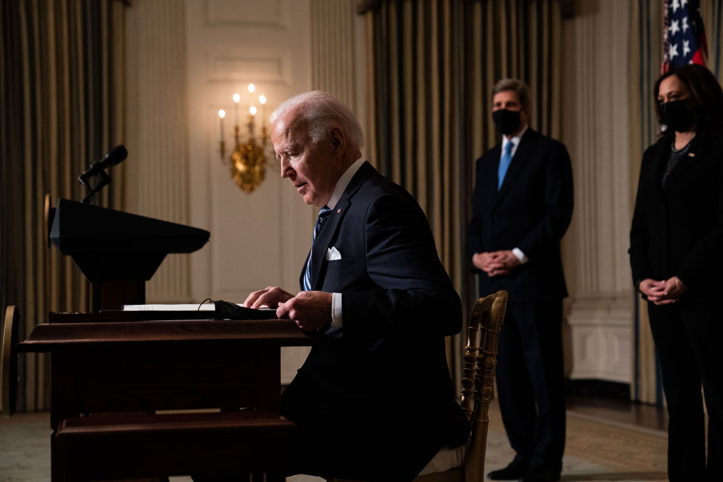
Biden Administration’s J40 Initiative
Notes:
2021 – Biden’s EJ 40 Initiative – goal of delivering 40 percent of the overall benefits of relevant federal investments to disadvantaged communities and tracks performance toward that goal through the establishment of an Environmental Justice Scorecard.
-make environmental justice a part of the mission of every agency by directing federal agencies to develop programs, policies, and activities to address the disproportionate health, environmental, economic, and climate impacts on disadvantaged communities.
-establishes a White House Environmental Justice Interagency Council and a White House Environmental Justice Advisory Council to prioritize environmental justice; addressing current and historical environmental injustices, including strengthening environmental justice monitoring and enforcement
-climate and Environmental Justice Screening Tool, building off EPA’s EJSCREEN, to identify disadvantaged communities, support the Justice40 Initiative, and inform equitable decision making across the federal government
So, we are expecting to see more programs, projects and potential job opportunities to further advance environmental justice.

Slide 11
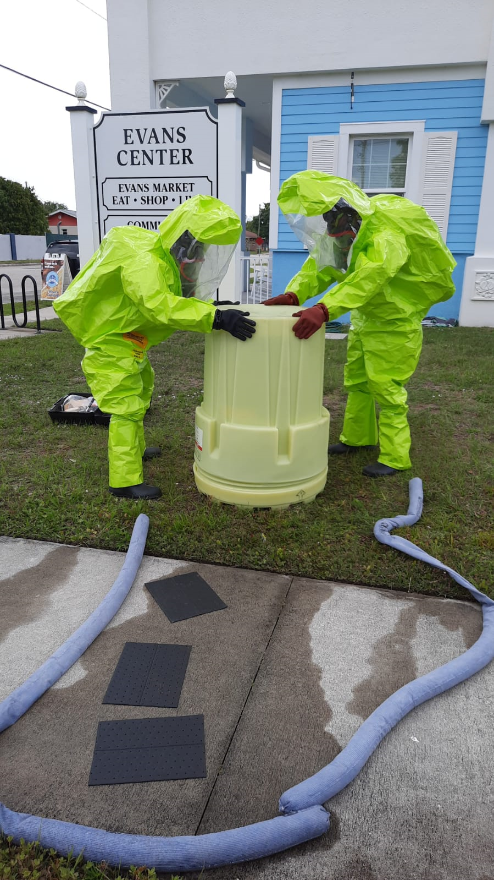
Advancing Environmental Justice:
Environmental Career Worker Training Program (ECWTP)
Notes:
Because low-income, minorities are the most overburdened with environmental pollutions and struggle more with recovering from natural disasters, one of the ways in which we are advancing environmental justice is via our Environmental Career Worker Training Program (ECWTP), which is a part of a 5-yr grant that we were awarded by the National Institutes of Environmental Health Sciences (NIEHS):
In this program, we train disadvantaged (overburdened/vulnerable) populations (unemployed or underemployed) for careers in environmental health and safety (students receive 3.5 weeks or 138 hrs of training and obtain 7 federally-recognized certifications) and then we place them into jobs upon (i.e., remediation contractors, site demolition workers, debris removal and post-emergency cleanup workers; contractors who work with mold, asbestos, and lead-based paint; and abatement workers performing work at Superfund or brownfield sites.
We were able to effectively recruit from our target populations in Brevard County, Florida, conducting 2 cohorts in our 1st yr.
We chose The Evans Center in Palm Bay, FL (Brevard County) as our training center for the 2 cohorts in Year 1. The Evans Center is located directly in an underserved community with high poverty and unemployment rates. The Evans Center features a small healthcare office and a food market, which is notable as this neighborhood was previously considered a food desert.
The Evans Center supports the community by hosting job fairs, nutritional cooking classes, apprenticeship programs and bible study meetings.
We worked with our alliance partners, conducted door-to-door canvassing, partnered with community groups, worked with our local CareerSource Center, and stopped by community hangouts including barbershops and laundromats to talk with people about the cohort opportunity.
We conducted Cohort 1 from March 22, 2021, through April 14, 2021, then quickly followed it with Cohort 2 from April 19, 2021, through May 12, 2021. The students were either unemployed or underemployed (i.e. fast-food workers, temp/day workers).

Slide 12
ECWTP: Summary
Course Name | Trainees that Completed this Course | Contact Hours per Course | Total Contact Hours
HAZWOPER Site Worker 40 Hour | 8 | 40 | 320
OSHA Certification 10 Hour (Construction) | 9 | 10 | 90
Powered Industrial Truck (Forklift) | 10 | 8 | 80
Certified Lead, Asbestos and Mold Remediation (CLAM) Worker | 10 | 16 | 160
Water Sampling | 9 | 16 | 144
First Aid, CPR & BB Pathogens | 10 | 8 | 80
Environmental Technician | 9 | 4 | 36
OSHA Disaster Site Worker (#7600) | 7 | 15 | 105
Life Skills and Goal Setting | 10 | 6 | 60
HazMat Chemistry | 7 | 8 | 56
Mentoring/Career Guidance | 10 | 4 | 40
Intro to Environmental Justice | 10 | 3 | 30
ECWTP Cohort 1 Totals | 8* | 138 | 1,201
HAZWOPER Site Worker 40 Hour | 10 | 40 | 400
OSHA Certification 10 Hour (Construction) | 10 | 10 | 100
Powered Industrial Truck (Forklift) | 11 | 8 | 88
Certified Lead, Asbestos and Mold Remediation (CLAM) Worker | 8 | 16 | 128
Water Sampling | 9 | 16 | 144
First Aid, CPR & BB Pathogens | 11 | 8 | 88
Environmental Technician | 11 | 4 | 44
OSHA Disaster Site Worker (#7600) | 10 | 15 | 150
Life Skills and Goal Setting | 9 | 6 | 54
HazMat Chemistry | 10 | 8 | 80
Mentoring/Career Guidance | 11 | 4 | 44
Intro to Environmental Justice | 11 | 3 | 33
ECWTP Cohort 2 Totals | 10* | 138 | 1,353
*completed tryout
Notes:
Here’s the summary table of accomplishments for the ECWTP, where the course name is on the left, followed by the number trainees that completed each course, the number of contact hours per course, and the total contact hours per course. You will also see that the table is divided by the 2 cohorts and their individual totals
We projected to conduct 2 cohorts. Each cohort was projected to cover 3.5 weeks or 138 instructional hours serving 13 students, resulting in over 1,794 contact hours.
Due to the COVID pandemic, we limited our cohort to 11 students versus the planned 13 students to allow for appropriate social distancing and to safely conduct hands-on training for each student.
Students, Graduates and Contact Hours:
For Cohort 1, we started with 10 students and 8 of those students completed our tryout period, denoted by asterisk (means that they attended training through the HAZWOPER portion) and graduated. These students logged 1,201 total contact hours. Out of the 8 graduates, we have placed 7 in jobs. The remaining student has put her job search on hold due to a medical condition.
For Cohort 2, we started with 11 students and 10 of those students completed our tryout period and graduated. These students logged 1,353 total contact hours. Out of the 10 gradates, we have placed 5 in jobs. The remaining students are still actively applying for jobs and sitting for interviews.
After appropriate classroom instruction, students participated in the following hands-on activities:
Visited a local monitoring well and practiced taking water samples and completing necessary chain-of-custody paperwork for the lab
Perform surface sampling using a mold test kit
Built a containment structure for the simulated abatement of asbestos
Practiced first aid, CPR and use of an AED on manikins
Operated a forklift, including pre-use inspections and maneuvering through an obstacle course
Performed respirator fit testing, don & doffing, seal check and maintenance
Used a Self-Contained Breathing Apparatus (SCBA)
Dressed out in HAZMAT Protection Level A – C gear
Corrected a simulated drum leak
Performed decontamination exercises
Students received 7 federally-recognized certifications.

Slide 13
ECWTP: Job Placement / Occupation
Type of Employment | Hourly Wage / Salary | Type of Work
Clerk | $9.00 | Office Assistant
Laborer | $10.00 | Cleaner
Clerk | $12.00 | Account Executive
Laborer | $13.00 | Production Technician
Other | $14.00 | Technician
Other | $15.00 | Remediation Training Admin
Other | $15.00 | Mover
Environmental | $16.00 | Field Services Technician
Environmental | $16.00 | Line Maintenance Technician
Environmental | $17.00 | Field Technician
Engineer | $28.00 | Engineer
Laborer | $30.00 | Remodeling
Notes:
Over the course of their training, we bring in environmental employers during the students’ lunch hour – in a format of a Lunch and Learn (FDOT, Terracon, SGS Engineering, Eau Gallie Electric, etc) - to talk to the students about their companies, what they do day-to-day, and jobs they are looking to fill (provides motivation for students and allows employers to meet students and for students asks questions – which has resulted in students getting hired); and then upon graduation, we sought to place them into jobs of their interest preferably within the environmental health and safety field (a few of them had jobs lined up prior to graduation)
Placement Rate:
In the first year of the ECWT Program, we placed 67% of the graduates. This is slightly lower than our goal of a 70% placement rate and we attribute this to COVID-19. Our second cohort in particular had lower placement rates than desired.
The table you see displays the type of employment, the hourly wage/salary, and they type of work that they are engaged in.
The average hourly pay rate for the 12 employed graduates is $16.25, which is greater than our goal of a starting wage of $14.00 per hour.
A few of the cohort graduates desired to wait out the additional COVID unemployment benefits prior to looking for a job, and when that benefit concludes, we expect they will enter the job market and become employed. We will continue to monitor their situation and will assist them with job placement services when they are ready to work.

Slide 14
ECWTP: Demographics
Occupations
Age Groups
Notes:
To further describe our trainees - the pie chart on the left displays the types of occupations in which our students have gained employment.
As I previously mentioned, 67% of our students were placed into jobs, so you can see the types of occupations in how it breaks out (which is everything other than that 33% - students who have not yet been placed);
most of our students gained employment in the environmental field (17%) such as emergency response clean-up; city water line maintenance tech; as well as other types of jobs (17%) – consisting of phone surveyor (one student had a sales background and wanted to remain in that type of field), production tech (dealing with fiberglass and boats); and one students works as an admin assistant for an environmental training company
Other students gained employment as laborers and clerks (11%); and one gained employment as an engineer (she had a master’s degree, but didn’t have any luck when applying for jobs prior to our program), while another student became a stocker at a store (so, although some didn’t gain employment directly in the env health/safety field, our training opened up the opportunity for them to gain employment – which is a start).
The pie chart on the right represents age groups of our students, you will see that the majority of our students (28%) tend to range in ages from 20-25 years old, followed by ages 31-40 (17%)….while the least dominated age group ranged between 51 and 60.

Slide 15
ECWTP: Demographics
Notes:
This graph describes the demographics of our trainees and is comprised of different categories (represented as %):
The data you see here consists of the 2 cohorts – which represents a total of 18 students: where, 61% of the students were male; 44% were Black/African American and 50% were Caucasian/Other
Almost all of our students had at least a high school diploma (at 94%)
We currently have a 67% job placement rate, while the remaining 33% are still actively applying for jobs of their interests and are receiving interviews
Before starting our program, 72% of the students stated that they were unemployed and 28% stated that they were underemployed (working, but jobs are lower-paid and doesn’t meet their actual training or financial needs or have a limited amount of hours)
The majority of our students graduated our program (89%)

Slide 16
ECWTP: Success Stories
Stephanie Mikan
Vincent Wade
Notes:
At the conclusion of our environmental cohorts we like to identify a few “star students” and tell their story in the form of a “graduate profile”. So many of the students had to overcome serious life hurdles to reach their current level of success. These profiles are used as marketing collateral to promote the effectiveness of the ECWT Program to potential cohort students and hiring employers.
Stephanie – migrated to the U.S. in 2019; she settled in Los Angeles and was newly married – everything seemed to be going well until COVID – she lost her job, and then she and her husband moved to Florida. But, the lost income, the relocation, and COVID-related stress led to her being involved in an abusive relationship and she ended up in a homeless shelter, filled with discouragement (no home, no job, no money, no relatives here in the U.S.); while at the shelter, she saw the SWA ECWTP flyer and knew that she couldn’t miss the opportunity since she had been applying for a job for more than a year without receiving any offers.
A couple weeks into the cohort, David introduced Stephanie to a company called NORMI (National Organization of Mold Remediators and Inspectors), which was a great fit – offered her a full-time position in Ft. Lauderdale. She said she felt at peace again after so many dark days that she had and she stated “With the beautiful work that SWA is doing, they are not only helping people to be employable, but also helping our family members to enjoy a quality of life and to enjoy fair and dignified living conditions through economic stability.”
Vincent – grew up in the streets of St. Petersburg with the wrong crowd; been to jail 14 times and went to prison twice; he wanted to change his life and he knew he needed to leave St. Pete and leave his friends, so he and his wife and daughter relocated to Titusville 4 yrs ago (Brevard County); Now, at 32 yrs old, it’s been 8 yrs since his last conviction.
Vincent was working with CareerSource when a staff person suggested that he attend the cohort –he was in between his thoughts on doing so because he had tried so many different options before to find stable employment, but was not having much luck; he was actually working at a job at the time and decided to quit his job to attend the training, and within a week of graduating the class, he had 2 job offers from employers who were eager to hire him and he decided to take the job at an environmental company called ACT Environmental – emergency cleanups (spills, etc.);
Vincent stated that “I felt really fortunate to take the class. It helped my self-esteem. You meet a lot of great people who really want to see you succeed and it feels good to be a part of that. If they can help me, they can help anybody.”
His advice to future students was to “Don’t give up! The course work was difficult at times, but its worth it to stick with the program.” Vincent explained further, “The class goes by really fast, stick with it and don’t get discouraged because these people will help you and you’ll get that environmental job.”
So, as you can see, we are really making a difference in the lives of those who reside in low-income, overburdened communities by training them in environmental health and safety and placing them into jobs that can contribute to the mitigation of pollution and aftermath of natural disasters.

Slide 17
“Brownfields to Healthfields Transformations as an Equitable Development and Environmental Justice Catalyst”
Miles G. Ballogg
Senior Principal Brownfields Practice Leader – Cardno, Inc.
For: 2021 Fall Conference American Industrial Hygiene Association
Environmental Justice In Action
October 15, 2021

Slide 18
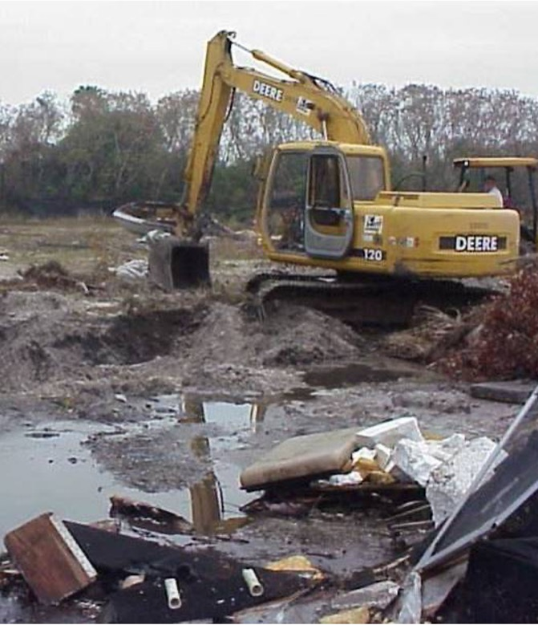
Agenda
Remove the Junkyard from the Backyard
What is a Brownfield/Heathfield Project
Environmental Justice and Equitable Development Concerns and Issues
Brownfields and Environmental Justice Grants and Resources
Successful Brownfields/Healthfields Projects

Slide 19
What is a Brownfield?

Slide 20

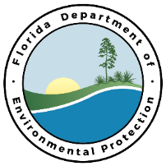
What is a Brownfield?
EPA – A brownfield site is defined as real property, the expansion, redevelopment, or reuse of which may be complicated by the presence or potential presence of hazardous substances, pollutants, contaminants, controlled substances, petroleum or petroleum products, or is mine-scarred land.
FDEP – "Brownfield site" means real property, the expansion, redevelopment, or reuse of which may be complicated by actual or perceived environmental contamination.
FDEP – “Brownfield area” means a contiguous area of one or more brownfield sites, some of which may not be contaminated, and which has been designated by a local government by resolution.
AIHA – Pursuing redevelopment opportunities that result in viable economic and community development, residential and open-space/green-space, affordable and workforce housing , mixed-use projects and other community driven projects that provide direct community benefit through redevelopment .

Slide 21
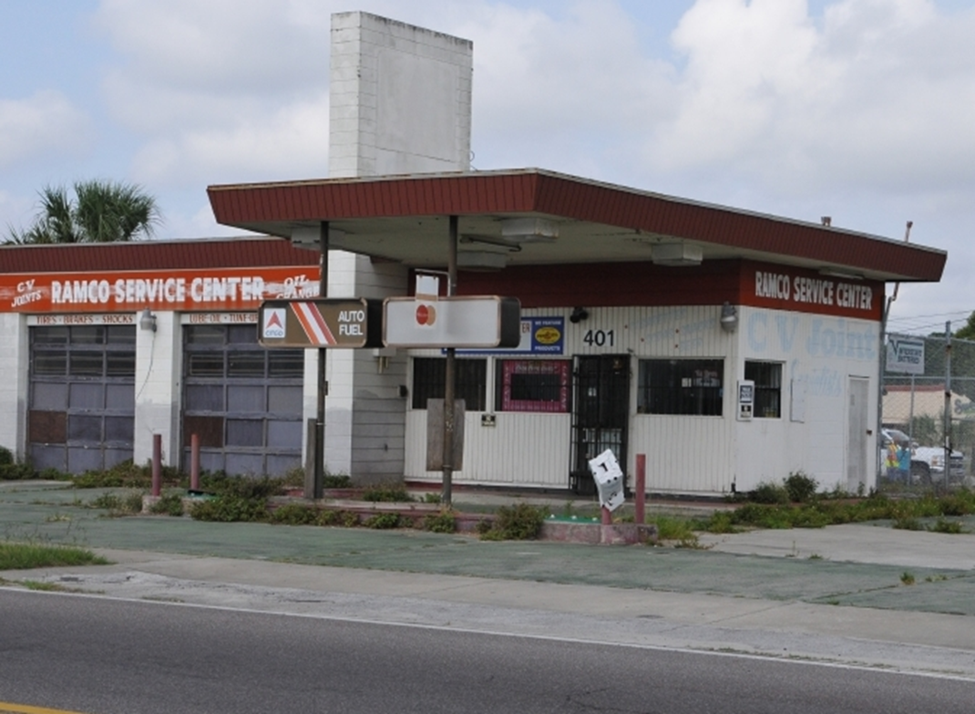
What is a Brownfield – Community Perspective ?
EPA – A brownfield site is defined as real property, the expansion, redevelopment, or reuse of which may be complicated by the presence or potential presence of hazardous substances, pollutants, contaminants, controlled substances, petroleum or petroleum products, or is mine-scarred land.
Communities Perspective – Redevelopment that can result in removing Environmental Contamination and provide end uses that the Community needs from a Health, Economic and Community Development Perspective. Projects that make a visible difference !
  Projects that lead to wholistic improvements to the natural and built environments and can begin to reverse years and years of environmental injustice and resulting health disparities .
Transformation of Environmentally Stigmatized Properties that results in viable and visible economic and community development, residential and open-space/green-space, affordable and workforce housing , mixed-use projects and other community driven projects that provide direct community benefit through redevelopment .

Slide 22


Understanding Opportunities for Redevelopment
Former Gas Stations / Auto Repair - “Tanks a Lot”

Slide 23
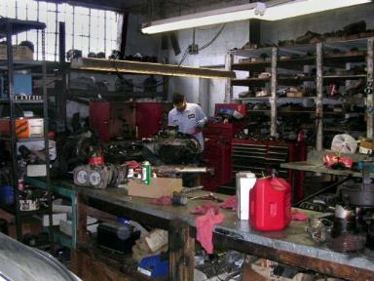
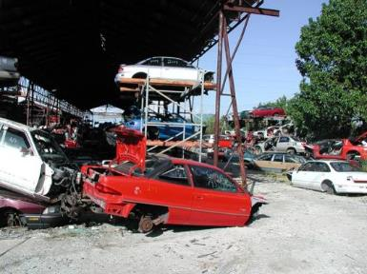
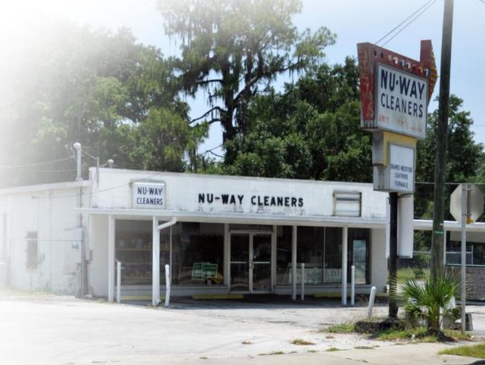
Understanding Opportunities for Redevelopment
Petroleum and Solvent Contamination Sources
Printers
Dry-cleaners
Auto repair

Slide 24
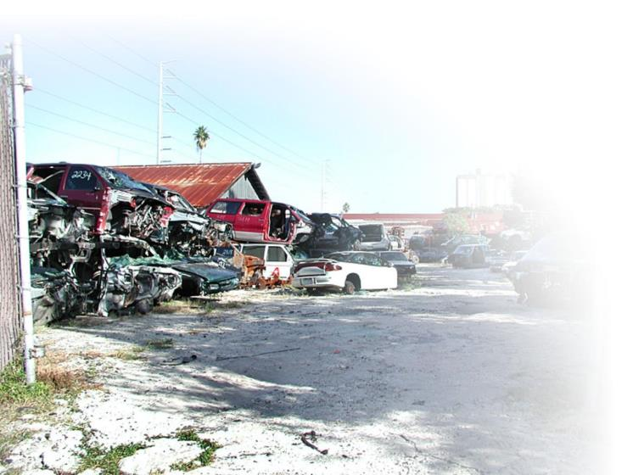
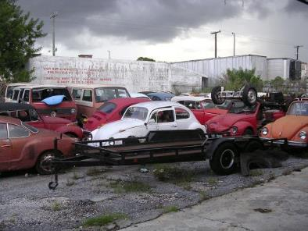
Understanding Opportunities for Redevelopment
Junkyards or Salvage Yards

Slide 25
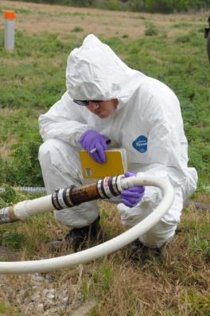
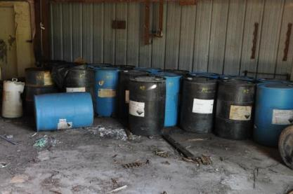
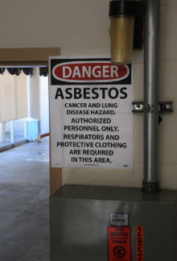
Understanding Opportunities for Redevelopment
Hazardous Substances / Waste Sites – Includes Lead and Asbestos

Slide 26
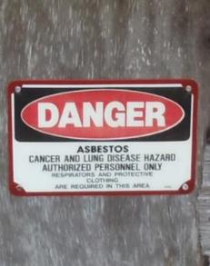
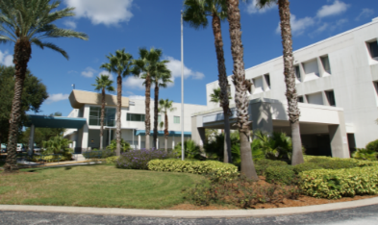
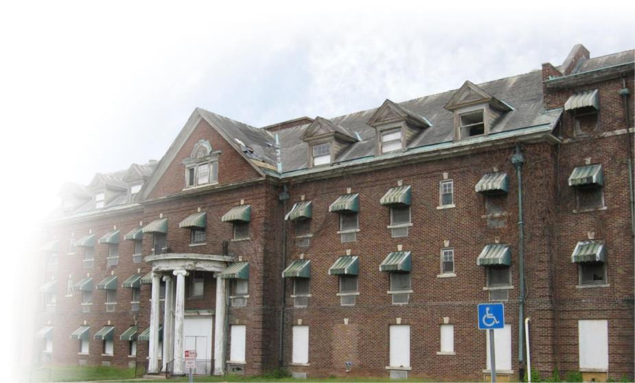
Understanding Opportunities for Redevelopment
Former Hospitals, Schools, Obsolete Buildings – Lead and Asbestos

Slide 27
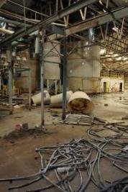
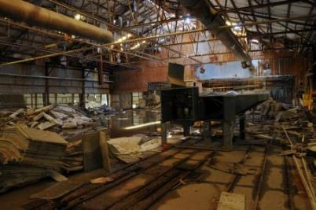
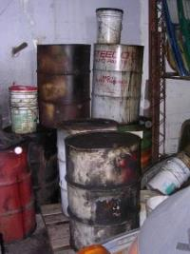
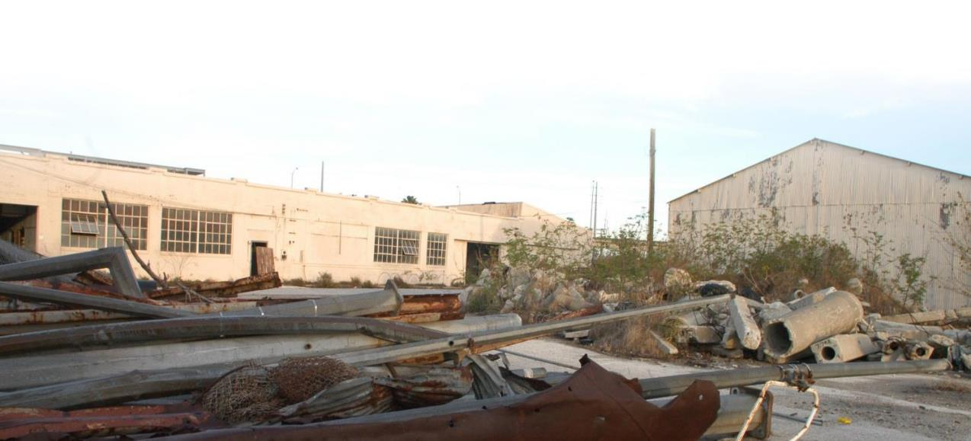
Understanding Opportunities for Redevelopment
Former Industrial, Municipal & Abandoned Properties

Slide 28
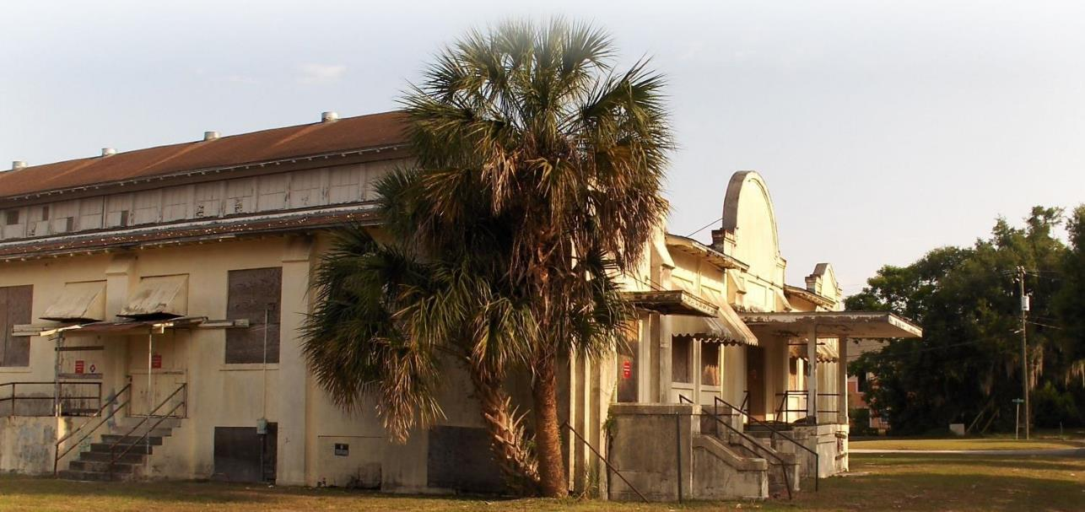
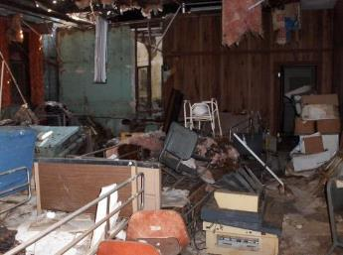
Understanding Opportunities for Redevelopment
Unexpected and Adjacent Uses
Former Bartow, FL Historic Cigar Factory

Slide 29
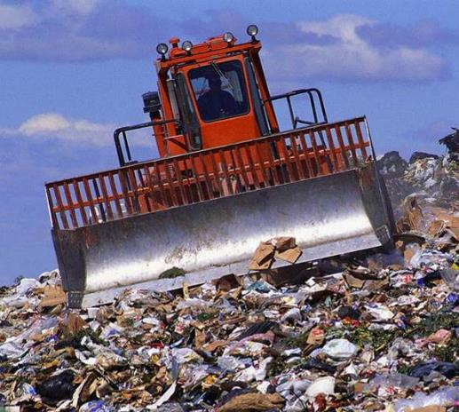
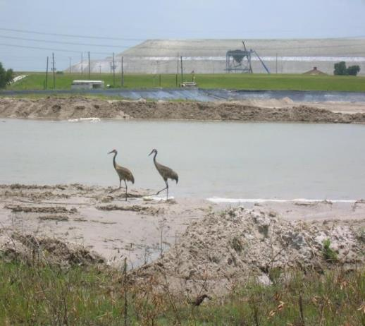
Understanding Opportunities for Redevelopment
Landfills and Mine-Scarred Lands
Former Landfills
Mined Scarred Lands

Slide 30
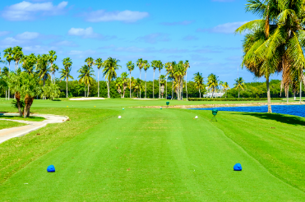

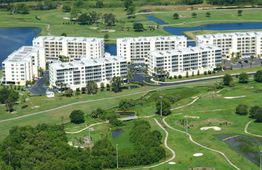
Understanding Opportunities for Redevelopment
Agricultural Land and Golf Courses

Slide 31

Types of EPA Brownfields Funding
EPA Grant | Amount and Application
Community-wide assessment grant | $500 k – assessing properties, conducting redevelopment planning, and engaging in community outreach activities - Due December 1, 2021
Cleanup grant | $650k – funding for cleanup activities / multiple sites - Due December 1, 2021
Coalition assessment grant | $1 M – funding to three or more entities to conduct assessment grant activities within their defined area (Cant be lead by a Non- Profit) - Next Round Fall 2022
Multi-purpose grant | Up to $800k – provide funding to conduct a range of eligible activities (planning/assessment/remediation) at one or more brownfield sites -Next Round Fall 2022
Revolving loan fund | Up to $1 million – enable recipients to make subgrants and low interest loans for cleanup activities - Due December 1, 2021
Job Training | $200k – funding for the recruitment, training, and placement of local residents in environmental technician occupations. Next Round Fall 2022

Slide 32
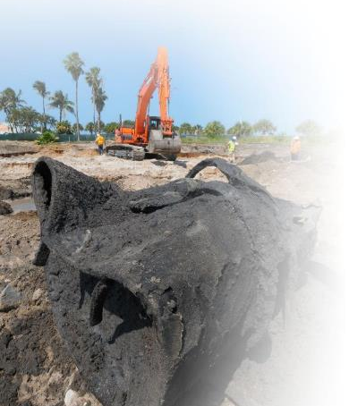
Assessment, Cleanup, and Redevelopment Process Pulling it all together – Environmental Due Diligence/Remediation

Slide 33

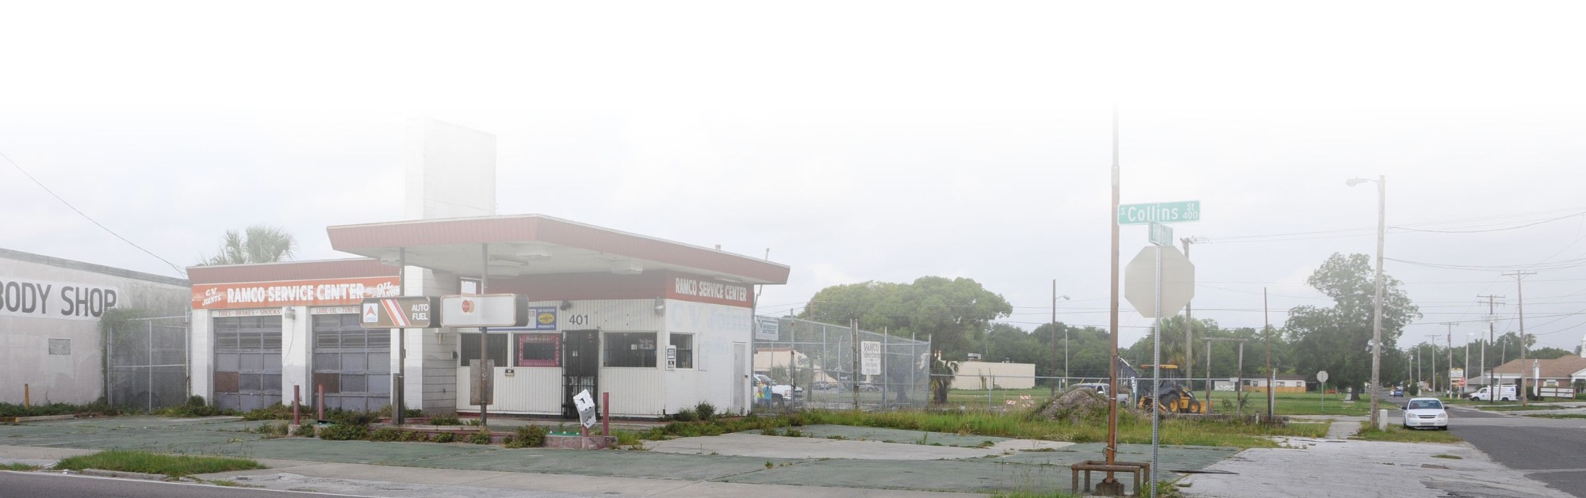
What are Healthfields ?
“Brownfields to Healthfields B2H” - refers to the transformation of Brownfields sites into viable projects that improve access to health and healthcare of the community through brownfields redevelopment, principals, tools, and resources.
Healthfields Redevelopment has the potential to improve local access to care and reduce health disparities through redevelopment.
Healthfields is the broader strategy of improving access to health and healthcare through brownfields redevelopment

Slide 34
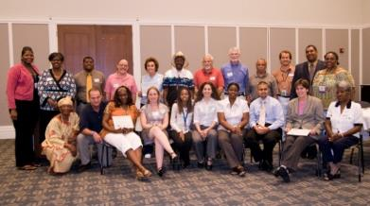
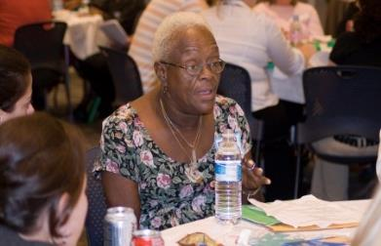
Successful Brownfields/Healthfields Projects Address
Environmental Justice Concerns
Environmental Justice
  Environmental Justice is the fair treatment and meaningful involvement of all people regardless of race, color, culture, national origin, income, and educational levels with respect to the development, implementation, and enforcement of protective environmental laws, regulations, and policies....
    Disproportionate Negative Environmental Impacts
    Disproportionate Health Disparities
    End Uses not found in more affluent Communities
  Brownfields and Healthfields Redevelopment are tools to reverse negative environmental impacts and provide positive steps to provide access to Health and Health Care and to remove Contamination in Environmentally Overburdened communities….
  Removes contamination and provide health-related end uses to improve access and reduce health disparities.
  Brownfields/Environmental Justice/Healthfields Grants, Incentives and Strategies are a powerful Equitable development tool.

Slide 35
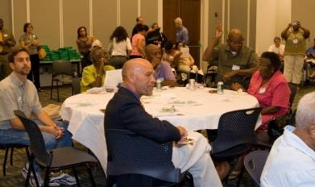
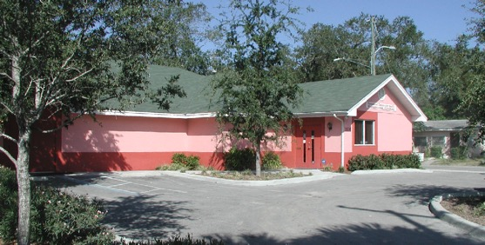
Equitable Development Concerns
Equitable Development Concerns
  Equitable development is an approach for meeting the needs of underserved communities through policies and programs that reduce disparities while fostering places that are healthy and vibrant. It is increasingly considered an effective placed-based action for creating strong and livable communities.
  ‘Gentrification commonly refers to 'the process of neighborhood change that occurs as places of lower real estate value are transformed into places of higher real estate value.’
  What does Equitable development look like –
    Projects that are “Beyond Buy-In” and are Community Lead or Driven
    Project extends to beyond the usual players
    Project Provides direct and peripheral benefits to the community
    Projects that are community driven and do not lead to displacement .
    Projects that lead to wholistic improvements to the natural and built environments and can begin to reverse years and years of environmental injustice and resulting health disparities .
    Community Benefit Agreement
    “If you are not at the table you are on the menu ”

Slide 36
Types of EPA Environmental Justice Funding
EPA Grant/Federal Programs | Amount and Application
Environmental Justice Collaborative Problem-Solving (EJCPS) Cooperative Agreement Program | $200k – Funds will be awarded to local community-based organizations, US territories, tribes, and tribal organizations seeking to address environmental and public health concerns in local underserved communities through collaboration with other stakeholders (Next Round 2022).
State Environmental Justice Cooperative Agreement Program | $200k – funding to eligible entities to work collaboratively with underserved communities to understand, promote and integrate approaches to provide meaningful and measurable improvements to public health and/or the environment in under served communities (Next Round 2022) .
Environmental Justice Small Grants Program | $75K – Program supports and empowers communities working on solutions to local environmental and public health issues. The program is designed to help communities understand and address exposure to multiple environmental harms and risks. (Next Round 2022) .
Justice 40 | 40% of Federal Investments - A whole-of-government effort to ensure that Federal agencies work with states and local communities to make good on President Biden's promise to deliver at least 40% of Federal Investments in climate and clean energy to disadvantaged communities (Monitor Regular Funding Sources and Announcements).

Slide 37

Why Healthfields Redevelopment ?
Disparities in Access are Common, Especially Among African Americans, Hispanics, and Low-Income Communities
Many Brownfields Communities
Suffer Disproportionate Numbers of
Health Disparities
High number of food deserts in
brownfields communities
Many environmentally overburdened communities of color
Lack of basic services – healthcare, dental, pharmacy, grocery
Provides an opportunity to quantify and remove contamination and replace with end uses that can reduce health disparities
Economic opportunities resulting from health-related redevelopment
“Your Zip Code Shouldn’t predict how long you live but it does.”
Improving Access to Health and Healthcare can assist in Addressing/Reducing Health Disparities
Notes:
37

Slide 38
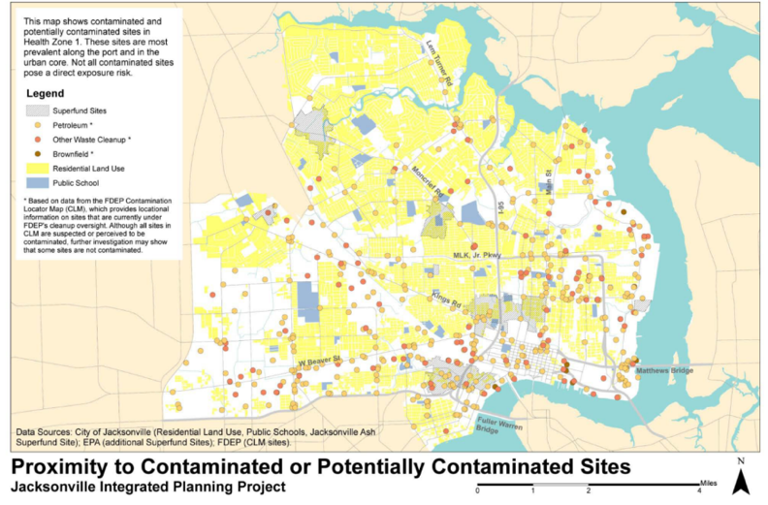
Why Healthfields?
Address Health Disparities and Provide Acess to Health & Healthcare in Underserved Communities
Health Zone 1, City of Jacksonville
Many Brownfields Communities Suffer Disproportionate Numbers of Health Disparities
Health Zone 1 has the highest rates of:
  Infant mortality
  Heart disease mortality
  Asthma-related emergency room visits
  Uncontrolled diabetes emergency room visits
  Need for fresh food and health care is paramount
  COVID 19 highlights the need to address health disparities
Gulf County Florida – North Port St. Joe
  Major Health Disparities throughout the County
** Information provided by SKEO Solutions

Slide 39
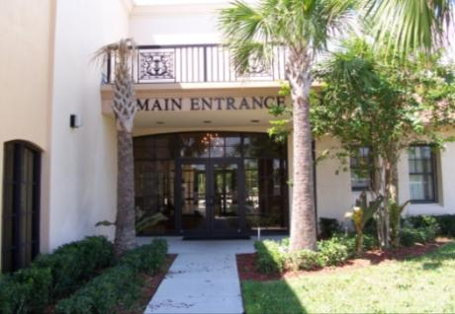
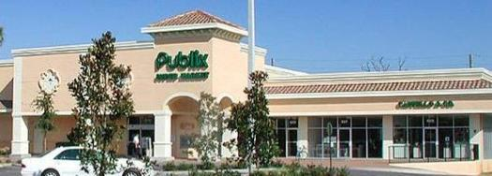

Healthfields Redevelopment Opportunities / Benefits
Healthy Housing
Healthcare
  Community-based health clinics
  Federally qualified health centers
  Hospitals
  Vision care
  Dental care
  Urgent care
  Health-related industry
Open-space / green-space
Access to healthy food choices to address
  Food desert issues
  Grocery
  Community gardens (on safe sites / safe practices)
  Farmers markets
  Healthy food choices
Health In the Built Environment

Slide 40
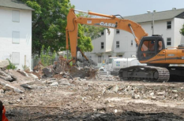



Encore Redevelopment -Tampa, FL
Healthy Housing and Major Economic Driver – Public Housing Brownfields Transformation
Challenges
  BOA & Tampa Housing Authority partnership
  on former “Central Park Village Housing Project”
  Asbestos abatement required
  Obsolete / sub-standard housing
Tools
  FDEP Brownfields designation
  Brownfields Building Materials Tax Refund
  VCTC Program eligible
  EPA $400,000 Multi-Purpose Site Specific Brownfields Grant
  ($28M NSP Grant), state (OTTED, LIHTC, etc.) & local grant funding
Results
  28 acre mixed-Use, TOD development in downtown Tampa
  1,200 multi-family residential units (700 affordable)
  60K SF of neighborhood commercial
  50K SF of office, 30K SF grocery, 200 hotel units
  Public gathering space, middle school
  Historic church revitalized as an African-American museum

Slide 41


Pennsylvania Ave /Single Family Holmes - Clearwater, FL
Community Driven / Healthy Housing-Brownfields Transformation
Brownfields challenges
  Mini junkyard in residential neighborhood
  Inappropriate land use – junkyard in residential community
  Environmental injustice – junkyard next to infill housing
  Hazardous waste / petroleum / waste oil / arsenic in soil
Tools
  Clearwater Neighborhood Housing Services
  CDBG – demo / city liens
  State brownfields designation
  FDEP targeted site assessment
  Clearwater Neighborhood Housing Services – Deeded property after clean up
Brownfields transformation
  2 quality, affordable single-family units
  Install environmental justice
  Restore fabric of the neighborhood
    Consistent with other infill housing
Bunting Property – Mini Junkyard Next to Infill Housing
CNHS Housing – Clearwater, Florida

Slide 42


Greenwood to Palmetto Park Apartments - Clearwater, FL
Healthy Housing Project – Community Driven / Housing-Brownfields Transformation
Brownfields challenges
  Unhealthy Housing - Asbestos Lead Based Paint and IAQ Issues
  Slum Lord – Absentee Ownership
  High Crime – Hundreds of Police Responses
  Environmental injustice – Lead High Hazard Area, Transformer Stations, Multiple Bulk Fuel Facilities, Solid Waste Facilities, Incinerator, Junk Yards
  Economic Hardship – Rental of AC Units…
Tools
  Brownfields Assessment Grant – Asbestos and Lead Based Surveys
  Redevelopment Partnership - City of Clearwater Community Development, Bank of America CDC, Clearwater Neighborhood Housing Services
  $14.3 million public/private partnership.
  Local Partner Clearwater Neighborhood Housing Services trusted by the Community
Brownfields transformation
  192 Affordable Redeveloped Rental Units
  Removal of Asbestos and Lead Based Paint
  Beginning of North Greenwood Renaissance
  Reduction in Crime
Greenwood Apartments – Asbestos / Lead Based Paint and IAQ Issues
Palmetto Park / Greenwood Apartments
Clearwater, Florida

Slide 43




Willa Carson Health Resource Center - Clearwater, FL
Petroleum Brownfields Transformation to Public Health Success – Free Clinic (2001)
Challenges
  Lack of Trusted Healthcare
  Abandoned Gas Station Site in Heart of the Community
  Underground Storage Tanks
  Hydraulic Lifts
  Contaminated Soil
  Crime Hot Spot
  Contiguous Finding
Tools
  Ms. Willa Carson's Vision – North Greenwood Community
  Community / City and Legislative Partnership
  Florida Legislature Appropriations for Clean Up and Construction
  Tobacco Settlement Funds for Operation
  CDBG Funds for Acquisition
Results
  Community-based Free Clinic
  Walkable Health Care
Ms. Willa Carson the Pioneer of the Healthfields Movement
Willa Carson Health Resource Center – Clearwater, Florida
Community Partners
Willa Carson Health Resource Center
City of Clearwater Housing and Economic Development
Ms.
Notes:
43

Slide 44




Central Florida Healthcare - Mulberry, FL
Brownfields to Public Health Success (2015)
Challenges
  Medically underserved community in Polk County, Florida to healthcare on brownfields sites
  Numerous abandoned petroleum sites and mined lands within the city
  Funding for assessment remediation and redevelopment
  Nearest hospitals or clinics 9.8 miles and 12.01 miles
Tools
  USDA community visioning
  CFRPC – Brownfields Assessment Grant
  Donation of city land
  HHS - HRSA Planning Grant
  EPA – Brownfields Assessment Grant – outreach, reuse
  planning, & Phase I & II ESA
  HHS – HRSA School-Based Grant
  HHS – HRSA New Access Point Results
Results
  Community-based healthcare in
  rural underserved community
Health Center Grand Opening 4/8/2015
Community Partners
Ann Claussen – Central Florida Health Care
Jennifer Codo-Salisbury – Central Florida Regional Planning Council
Rick Johnson – City of Mulberry

Slide 45





Lacoochee Community Center/Health Care Center - Pasco County, FL
Brownfields to Public Health Success (2015)
Challenges
  No access to healthcare
  Former borrow pit / sinkhole geology
  Former dump area
  Metals and petroleum contamination
  Environmental justice – highest concentration of Hispanic and African-American population
Tools
  Community partnership
  Withlacoochee Regional Electric Cooperative
  Nearly $2M in state appropriations and private funding
  Pasco County Brownfields Assessment Grant
    Phase I & II ESAs, geotechnical reports
  HRSA change in scope
  Health Impact Assessment – demonstrating need
Results
  12,800 sq. ft. building
  Premier Healthcare FQHC
  Nutrition and job training programs
  Gymnasium
  Boys & Girls Club
  Officer-friendly program in the center / violence prevention
  Public Housing Authority involvement
Community Partners
Melanie Kendrick – Pasco County
Cheryl A. Pollock – Premier Community HealthCare Group, Inc.
Sandra Whitehead – NACCHO
Health Center Grand Opening 3/25/2015

Slide 46


Why Healthfields?
Provide Fresh Foods to Combat Health Disparities
Low-income neighborhoods frequently lack full-service grocery stores and farmers’ markets where residents can buy a variety of fruits, vegetables, whole grains, and low-fat dairy products
Obesity is a risk factor for a variety of chronic conditions, including diabetes, hypertension, high cholesterol, stroke, heart disease, certain cancers, and arthritis.
....the more impoverished a neighborhood, the fewer the number of independent or chain supermarkets and the less access to fresh fruits, vegetables, low-fat milk, high-fiber foods, and other healthy meal and snack options.
“Many Brownfields Communities are low income and minority communities with lack of access to fresh food and healthcare and have properties that can be used to improve access to fresh foods .”

Slide 47


Harbor Oaks Shopping Center - Clearwater, FL
Healthfields Transformation – Improved Access to Fresh Food
Challenges
  Former Automobile Dealership for 45 Years
  Blighted Buildings
  Market Uncertainty – Third Time is the Charm
  Underground Storage Tanks
  17 Hydraulic Lifts
  Environmental Stigma
  Need for a Community Grocery Store
Tools
  State Brownfields Appropriation
  State Brownfields Loan Guarantee
  Developer Investment
Results
  44,287 sq. ft. Shopping Center
  125 New Jobs
  Catalyst for Infill Redevelopment
  $12,000,000 Capital Investment
  Catalytic Town Home and Commercial Developments
Community Partners
South Clearwater Citizens for Progressive Action
Diane Hufford – City of Clearwater
Jim White – White Development Company

Slide 48




Northeast Florida Health Care – Health Zone 1, Jacksonville, FL
School-Based Community Gardens
Challenges
  Disproportionately high incidences of health issues
  Numerous Brownfield sites adjacent to residential areas including a Superfund site
  Lack of fresh food
  Healthcare access impacted by transportation / location of health care facilities
  Large, urban area – limited resources & support
Tools
  Designation as EPA EJ Showcase Community – increases visibility – focuses resources
  Grants, Public – private partnerships
  ATSDR $150,000 community health projects related to contamination at brownfield / land reuse sites
Results
  Potential fresh foods in desert area school-based gardens at
  7 schools
  Increased access to affordable healthcare through St. Vincent’s mobile health outreach
  Decrease in health disparities – increase in wellness
  Community market
Community Partners
St. Vincent's Mobile Health Outreach Ministry
Tina Anderson – East Side Environmental Council
Wynetta Wright / Ken Pinnix – East Side Environmental Council
Teena Anderson – School Farms & Urban Ag Initiative
Grazyna Pawlowicz – Duval County Health Department

Slide 49




Robert L. Cole Community Lake & Park
Brownfields to Open Space Green Space (2009)
Challenges
  Former landfill site
  Need for community open / green-space
Tools
  Community support
    Project named after community legend, Robert L. Cole
  $1.1 tax increment funding
  (East Tampa Community Redevelopment Agency)
  Designs provided by University of South Florida
  School of Architecture
Results
  Multi-use community park / lake
  Opportunity for open / green space in underserved community
  Recreational opportunities
    Boardwalk, walking trail, exercise stations
  Observation tower, pier
  University of South Florida and local elementary schools partner on water quality research project
  Public art/culture – historic African-American quotes engraved in walking trail
Open Space / Green Space Address Health Issues through Opportunities for Physical Activity

Slide 50




University Area CDC Harvest Hope Park - Hillsborough County, FL
Holistic Catalyst Project to Improve Community Health and Environment (2020)
Challenges
  Underserved community
  Obsolete unhealthy housing stock
  Multiple brownfields sites
  Lack of access to fresh food
  Lack of economic opportunities
  Need for recreational opportunities
Tools
  $300,000 EPA Community Wide Assessment Grant
  $200,000 EPA Brownfields Planning Grant
  UACDC – Amazing work >>>>>>>
  Strong community partnerships
Results
  Community garden and fresh food kitchen
  Proposed – healthy and attainable housing
  Increased access to health care =
  increased access to economic activities
  attainable and 125 new jobs
  Catalyst for infill redevelopment
Key Partners
University of South Florida
Florida Brownfields Association
University Area Community Development Corporation
Mort Elementary School
Environmental Protection Commission of Hillsborough County
Florida Department of Health-Hillsborough County
Hillsborough County Economic Development
Hillsborough County City-County Planning Commission
Vistra
BGW Associates

Slide 51







Northwest Fire Station #51- Clearwater, FL
Brownfields Transformation (Junkyard to Public Safety - Fire Station) – 2004
Historic Junkyard next to Low Income Minority Community
Former Junkyard
Contaminated Site
Demolition & Remediation
Redevelopment
Brownfields Assessment Funds + City General Funds = A Healthfields Project that Saves Lives !

Slide 52

Conclusion & Questions
Healthfields redevelopment projects can result in potential opportunities to improve health and healthcare, install environmental justice and health equity, and promote economic development in underserved communities.
“Healthfields – Reducing Health Disparities through Redevelopment”

Slide 53
Contact:
Miles Ballogg
Senior Principal
Brownfields & Economic Development Practice Leader
Cardno
727.423.1587
miles.ballogg@cardno.com

