Slide 1
COVID Return to Work Strategies
Notes:
Instructor notes:
Explain: “Chapter 2 is Understanding Stress”

Slide 2
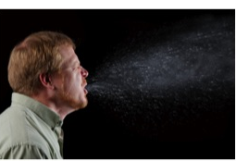
Transmission
COVID-19 is spread from person to person mainly through coughing, sneezing, and possibly talking, and breathing.
Droplet - respiratory secretions from coughing or sneezing landing on mucosal surfaces (nose, mouth, and eyes).
Aerosol - a solid particle or liquid droplet suspended in air.
Contact -Touching something with SARS CoV-2 virus on it and then touching mouth, nose or eyes.
Other possible routes: Through fecal matter.
Notes:
Instructor notes:
Spread of SARS-CoV-2, the virus that causes COVID-19, is thought to occur in the same way that seasonal flu spreads. Flu viruses are spread mainly from person to person through coughing or sneezing by people with influenza. We will not fully know how it is transmitted until later when scientists have had time to evaluate it.
Droplet transmission occurs when respiratory secretions from coughing or sneezing land on mucosal surfaces (nose, mouth, and eyes).
Contact transmission is touching something with COVID-19 virus on it and then touching your mouth, nose or eyes.
Aerosol transmission means breathing in infectious COVID-19 particles.
Keep in mind that the virus particles are not visible to the naked eye. The most harmful particles are sub micron, shorter than one millionth of a meter.
It is not likely that SARS CoV-2 is airborne like tuberculosis or measles, but there is strong evidence that it is spread by short range aerosols. See: CIDRAP: COMMENTARY: COVID-19 transmission messages should hinge on science https://www.cidrap.umn.edu/news-perspective/2020/03/commentary-covid-19-transmission-messages-should-hinge-science

Slide 3
Four-Step Approach to a Safe Workplace
Communication
Separation
Hygiene
PPE
Notes:
We use a four-step approach to create a safe workplace during COVID (or any pandemic).

Slide 4
Communication & Planning
Management leadership and employee participation.
Hazard identification and assessment.
Hazard prevention and control.
Education and training.
System evaluation and improvement.
Support for workers who are exposed.
Mental health support for workers and their families.
Notes:
Instructor notes:
Planning and preparation for COVID-19 should be integrated into existing safety and health systems and emergency plans. Elements of an effective program include but are not limited to those listed above.
Maintain flexibility so the COVID-19 plan can be modified based on the stage of the epidemic. Are the number of cases in the community increasing or decreasing? Have guidelines and standards for community and workplace safety changed?
System evaluation and improvement refers to organizational policies and procedures relevant to the COVID-19 workplace plan. For example, during an outbreak when a worker is absent due to respiratory illness, the employer’s absentee policy should be relaxed by not requiring a doctor’s note. The CDC has made this recommendation because they are advising people with low level symptoms NOT to go to the hospital emergency room unless they have severe symptoms.
CDC Interim Guidance for Businesses and Employers: https://www.cdc.gov/coronavirus/2019-ncov/community/guidance-business-response.html?CDC_AA_refVal=https%3A%2F%2Fwww.cdc.gov%2Fcoronavirus%2F2019-ncov%2Fspecific-groups%2Fguidance-business-response.html Note that these guidelines may change when people are in the “return to work” phase of the epidemic.
Family preparedness is instrumental to ensuring that a healthy staff is available and prepared to work during a pandemic. Organizations should try to identify and assess how the impact of school/daycare/ adult care closures and other employee needs may impact the availability of employees during a pandemic.
National Academy of Sciences, Engineering and Medicine: A Guide for Public Transportation Pandemic Planning and Response
http://nap.edu/22414

Slide 5


Do you have a process that…
Has clear decision makers?
Includes all key stakeholders?
Includes front line workers?
Has clear lines of responsibility, accountability, and timelines?
Notes:
Instructor notes:
A process is the first step to ensuring that all key workplace stakeholders have a voice in identifying the hazards and problem solving the solutions. Frontline workers have the most direct exposure and direct experience with job hazards and can play a key role in hazard identification and control.
Safety Culture: “Deeply held but often unspoken safety-related beliefs, attitudes, and values that interact with an organization’s systems, practices, people, and leadership to establish norms about how things are done in the organization. Safety culture is a subset of, and clearly influenced by, organizational culture.”
Key elements in a pro-active safety culture include:
Learning culture
Informed culture
Just culture
Flexible culture
Reporting culture
Source: Matt Gillen, Linda M. Goldenhar, Steve Hecker, Scott Schneider, Safety Culture and Climate in Construction:
Bridging the Gap Between Research and Practice, June 11-12, 2013, Washington, DC, Workshop Report

Slide 6
CDC recommended sick leave continued…
Employers who do not offer sick leave to employees should draft non-punitive “emergency sick leave” policies.
Employers should not require a positive COVID-19 test result or a health care provider’s note for employees who are sick/quarantined.
Tell workers who are ill to stay home without fear of reprisals or loss of pay or benefits.
Notes:
Instructor notes:
If employers do not offer sick leave, workers may come to work sick. This is a major risk factor for co-workers and customers. That is why CDC recommends establishing non-punitive emergency sick leave policies. Loss of pay is also a major issue for workers who don’t usually have access to paid sick leave.
The reason for suspending documentation for return-to-work from sick leave is because public health departments DO NOT want people with low level symptoms going to their person provider, the emergency room, or an outpatient clinic as that could result in spreading disease at those sites.
Source: Worker Safety & Health During COVID-19 Pandemic: Rights & Resources, National Employment Law Project, April 6, 2020 https://s27147.pcdn.co/wp-content/uploads/Policy-Brief-Independent-Contractors-COVID-19-Working-Without-Protections.pdf
https://www.cdc.gov/coronavirus/2019-ncov/community/guidance-business-response.html
Transition: The next batch of slides reviews OSHA standards for PPE and respiratory protection.

Slide 7

Separation
Avoid close contact with coworkers and customers (6 feet).
Avoid shaking hands/wash hands after physical contact with others.
Physical barriers
Staging of employees (i.e. shifts)
Limits on spacing (i.e. elevators)
Don’t share equipment
Identify choke points where workers are forced to stand together

Slide 8
Hygiene
Stay home when sick.
Wash hands or use sanitizer frequently and after coughing, sneezing, blowing nose, and using the restroom.
Avoid touching your nose, mouth, and eyes.
Cover coughs and sneezes with tissues or do it in your sleeve.
Dispose of tissues in no-touch bins.
Disinfectant and cleaning supplies are available to all employees.
Disinfecting all payment portals, pens, and styluses after each use.
Disinfecting all high-contact surfaces frequently.

Slide 9

Which is better: soap and water or hand sanitizer?
Soap and water are more effective!
Make sure sanitizer has at least 60% alcohol.
Notes:
Instructor notes:
Photo by FDA
Ask, which is better: soap and water or hand sanitizer? After you get the class responses, reveal the two bullets.
Soap and water is most effective at removing the virus. In the absence of soap and water, use sanitizer that contains at least 60% alcohol.
More info on this topic: https://www.sepsis.org/news/covid-19-infection-prevention-soap-and-water-or-hand-sanitizer/
https://www.cdc.gov/healthywater/hygiene/hand/handwashing.html
https://www.vox.com/science-and-health/2020/3/11/21173187/coronavirus-covid-19-hand-washing-sanitizer-compared-soap-is-dope

Slide 10
How long does SARS-CoV-2 survive outside of the body?
It is not clear yet how long the coronavirus can live on surfaces, but it seems to behave like other coronaviruses.
Virus may persist on surfaces for a few hours or up to several days, depending on conditions and the type of surface.
It is likely that it can be killed with simple disinfectant on the EPA registered list below.
https://www.epa.gov/pesticide-registration/list-n-disinfectants-use-against-sars-cov-2
There are ongoing investigations to learn more.
Notes:
Instructor notes:
Explain that contaminated objects, equipment, and surfaces are an important way people become infected. When you touch an object that is contaminated and then touch your eyes, nose, or mouth you may become infected. This is called “fomite” transmission. We will discuss more about cleaning and disinfecting later in the program.
It is not certain how long the virus that causes COVID-19 survives on surfaces, but it seems to behave like other coronaviruses. Studies suggest that coronaviruses, including preliminary information on the SARS CoV-2 virus, may persist on surfaces for a few hours or up to several days. This may vary under different conditions such as type of surface, temperature, and humidity of the environment. If you think a surface may be infected, clean it with simple disinfectant to kill the virus and protect yourself and others. Clean your hands with an alcohol-based hand rub or wash them with soap and water. Avoid touching your eyes, mouth, or nose.
Contact time is very important. This is the amount of time that the surface should remain wet with the product. All of the EPA listed products have different amounts of contact time; Peroxyacetic Acid has a 1-minute contact time. Many of these chemicals have caused negative health effects such as occupational asthma and dermatitis. It is important that proper safeguards are in place to prevent harm to people doing the cleaning and disinfecting.
The EPA list of registered disinfectants includes 200 products that have qualified for use against SARS-CoV-2. While disinfectant products on this list have not been tested specifically against SARS-CoV-2, they are expected to be effective against SARS-CoV-2 because they have been tested and proven effective on either a harder-to-kill virus or against another human coronavirus similar to SARS-CoV-2. The product list has also been updated to include the product’s active ingredient and the amount of time the surface should remain wet to be effective against the given pathogen.
EPA website: https://www.epa.gov/pesticide-registration/list-n-disinfectants-use-against-sars-cov-2
We have heard reports that it is difficult to find some of these products in local stores as their has been a rush of purchasing of them by the public.
https://www.who.int/news-room/q-a-detail/q-a-coronaviruses#
Air, Surface Environmental, and Personal Protective Equipment Contamination by Severe Acute Respiratory Syndrome Coronavirus 2 (SARS-CoV-2) From a Symptomatic Patient
https://jamanetwork.com/journals/jama/fullarticle/2762692
Persistence of coronaviruses on inanimate surfaces and their inactivation with biocidal agents
Human coronaviruses can remain infectious on inanimate surfaces for up to 9 days. Surface disinfection with 0.1% sodium hypochlorite or 62–71% ethanol significantly reduces coronavirus infectivity on surfaces within 1 min exposure time. We expect a similar effect against the SARS-CoV-2.
https://www.journalofhospitalinfection.com/article/S0195-6701(20)30046-3/fulltext
Fomite—An object, such as clothing, towels, and utensils that possibly harbor an infectious agent and are capable of transmitting it.

Slide 11
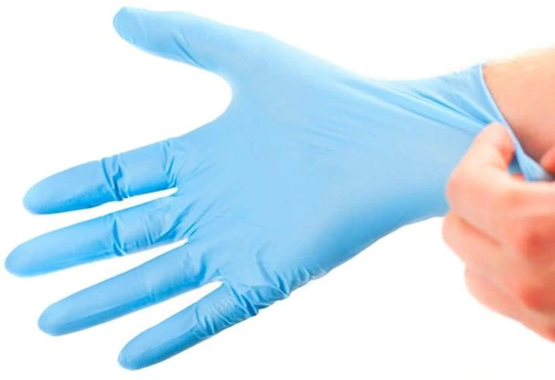
Personal Protective Equipment
Respirators
  Filtering Facepiece
  Half face / Full face Elastomeric
  SCBA
  Powered Air Purifying (PAPR)
Face masks
Gloves
Face Shields / Safety Glasses

Slide 12
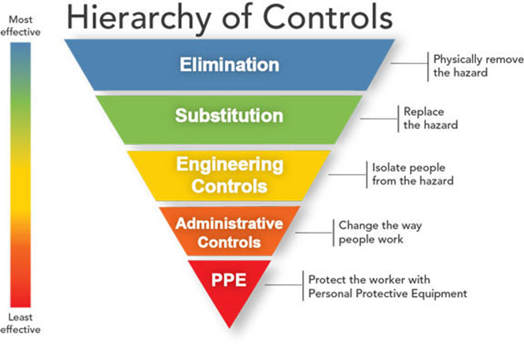
Protecting workers
Physically remove the hazard
Replace the hazard
Isolate people from the hazard
Change the way people work
Protect the worker with Personal Protective Equipment
Notes:
Instructor notes:
As with most any hazard, there are a variety of steps that can reduce or in some cases even eliminate workers’ exposure. A basic principle of workplace safety is to use a combination of strategies to protect workers, starting with the most effective. This approach of moving from most effective to least effective protective measures is called the ‘hierarchy of controls.’
The order of controls, from most effective to least effective is:
Elimination
Substitution
Engineering controls
Administrative Controls & Work practices
Personal protective equipment
Source: NIOSH/CDC https://www.cdc.gov/niosh/topics/hierarchy/default.html
This webpage also provides a more thorough definition of each type of control measure.
Transition: We will now review the overall process for selection and implementation of safeguards and review a few measures that should be used in all workplaces.

Slide 13
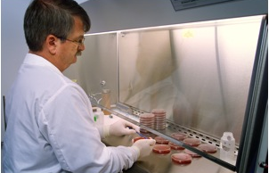
Engineering controls
Ventilation
Drive through service
Plastic shields and other barriers
Sneeze guards
Notes:
Instructor notes:
Engineering controls involve making changes to the work environment to reduce work-related hazards. These types of controls are at the top of the hierarchy because they make permanent changes that reduce exposure to hazards and do not rely on worker or customer behavior. By reducing a hazard in the workplace, engineering controls are not only the most effective, but can also be the most cost-effective solutions for employers to implement.
Examples of engineering controls include:
Using specialized ventilation to remove hazards from the air.
Installing physical barriers, such as clear plastic sneeze guards.
Installing a drive-through window for customer service.
A note about sneeze guards. There is no scientific evidence that they are effective and they DO NOT prevent sub-micron particles from entering into a worker’s breathing zone.

Slide 14
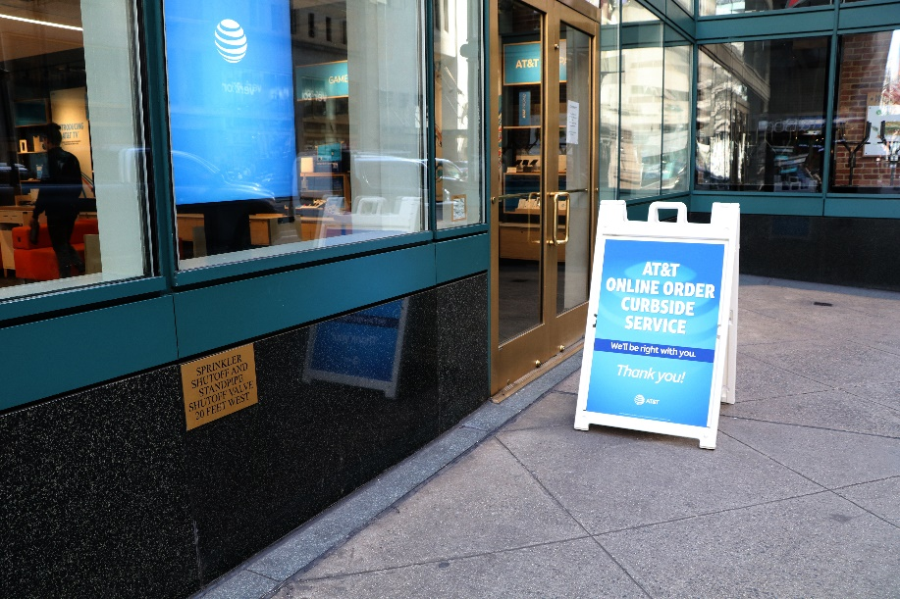
What are examples of engineering controls for COVID-19?
Desks or workstations are at least 6 feet apart.
Barriers are in place to achieve social distancing.
Increased general ventilation.
Electronic pre-payment of goods and services.
Notes:
Instructor notes:
Ask participants to list examples of engineering controls and then review the list.
Engineering controls should be selected based on the features of each specific workplace. They need to be tailored to workplace conditions.
Photo by Karen Berman. Online ordering with curbside service keeps customers out of the store.

Slide 15
HVAC System Checklist
Ensure all HVAC systems are fully functional, especially those shut down or operating at reduced capacity during the pandemic.
Remove or redirect personal fans to prevent blowing air from one worker to another.
Use HVAC system filters with a Minimum Efficiency Reporting Value (MERV) rating of 13 or higher, where feasible.
Increase the HVAC system’s outdoor air intake. Open windows or other sources of fresh air where possible.
Be sure exhaust air is not pulled back into the building from HVAC air intakes or open windows.

Slide 16
HVAC System Checklist
Consider using portable high-efficiency particulate air (HEPA) fan/filtration systems to increase clean air, especially in higher-risk areas.
When changing filters, wear appropriate personal protective equipment. ASHRAE recommends N95 respirators, eye protection (safety glasses, goggles, or face shields), and disposable gloves.
Make sure exhaust fans in restrooms are fully functional, operating at maximum capacity, and are set to remain on.

Slide 17

Administrative controls to reduce exposure
Written exposure control program.
The number of customers allowed entrance is limited.
Change hours of operation.
Switch to take out/delivery only.
Discontinue non-essential travel.
Limiting the number of staff present for high potential exposure tasks.
Training.
Notes:
Instructor notes:
Administrative controls include work practices and procedures to reduce the length, frequency or intensity of exposure to a hazard.
Ask participants to list administrative controls and work practices that can reduce exposures, then show the list to affirm their responses.
Employers should:
Provide resources and a work environment that promotes personal hygiene. For example, supply tissues, no-touch trash cans, hand soap, hand sanitizer, disinfectants and disposable towels for workers to clean their work surfaces.
Develop procedures to minimize contacts between workers and between workers and patients, clients or customers.
Limit the number of staff present for high exposure tasks such as aerosol generating procedures or entering patient room.
Provide workers with up-to-date education and training on coronavirus risk factors, and methods to prevent exposure.
Photo by Jonathan Rosen shows Home Depot sign limiting the number of customers to 50 people. This was enforced by having a single entrance and exit to the store with an employee facilitating entrance of people waiting in line, with markings to maintain 6 feet of social distancing.

Slide 18
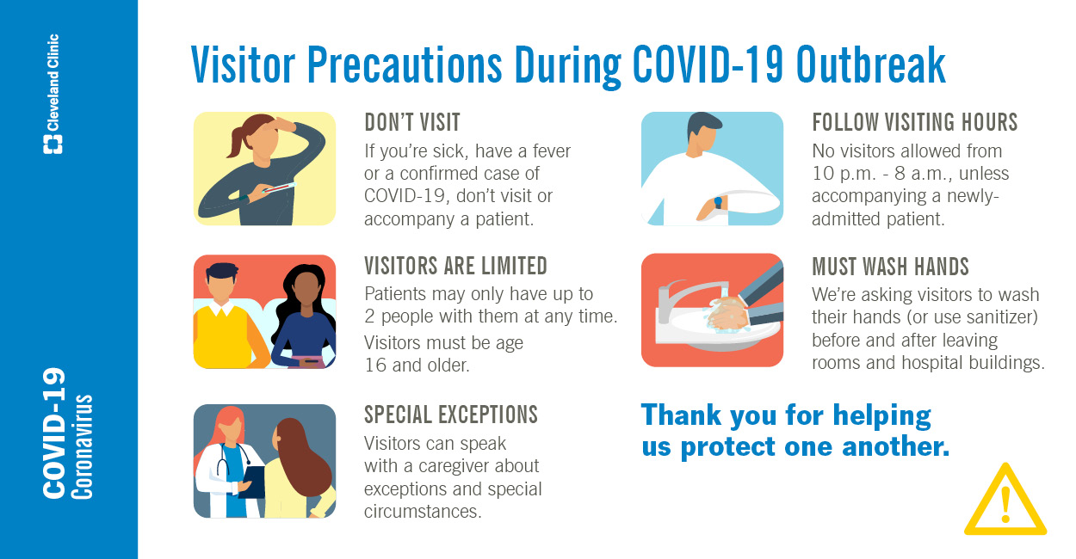
Additional administrative controls
Soft barriers include use of tables, ropes, signs, and floor markings to maintain social distancing.
Notes:
Instructor notes:
The signage lists visitor precautions. Other administrative control examples are use of table, ropes, and floor markings to maintain social distancing.

Slide 19
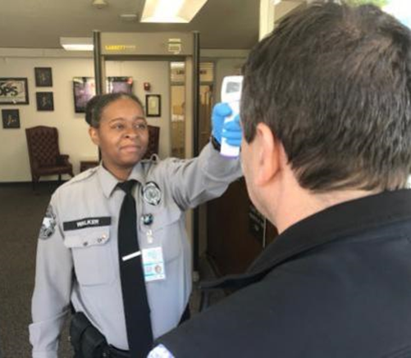
Adjust employer policies to reduce exposures
Use temperature/symptom checks before coming to work.
Use email, phone, teleconferences instead of face-to-face contact.
Notes:
Instructor notes:
Adjustments in workplace policies can also reduce exposures.
Enabling ill workers to stay at home without fear of any reprisals.
Discontinuing nonessential travel to locations having high prevalence of illness.
Using e-mail, websites and teleconferences to minimizing face-to-face contact between workers. Where possible, encourage flexible work arrangements such as telecommuting or flexible work hours to reduce the number of workers who must be at the work site at one time or in one specific location.
Relying on home delivery of goods and services to reduce the number of clients or customers who must visit your workplace.
Developing emergency communications plans. Maintain a forum for answering workers' concerns and develop Internet-based communications, if feasible.
Provide education and training materials in an easy to understand format and in the appropriate language and literacy level for all employees.

Slide 20
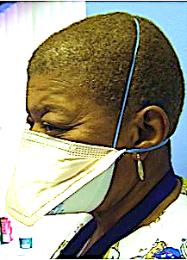
Respirators
Respirators are needed when there is a potential for aerosol transmission.
An N95 respirator is the minimum level of protection to prevent inhaling coronavirus.
Notes:
Instructor notes:
Respirators are used to prevent breathing in hazards that are in the air. Respirators protect the wearer by either filtering the air before it is inhaled by the worker, or by supplying air from a safe source. Most respirators that protect the worker by filtering the air are designed to fit tightly against the face, and thereby provide a seal between the respirator's edge and the face. When there is a proper seal, the air the worker breathes passes through the respirator’s filter, which captures contaminants. If there is not a tight seal, the air passes through the gaps between the face and the respirator and contaminants are not filtered from the air that the worker breathes.
NIOSH, part of the CDC, certifies air purifying respirators, sometimes called particulate respirators, in the following categories based on the resistance to oil, which can reduce efficiency:
N95, N99, N100 - Filters at least 95%, 99%, 99.97% of airborne particles. Not resistant to oil.
R95, R99, R100 - Filters at least 95%, 99%, 99.97% of airborne particles. Somewhat resistant to oil.
P95, P99, P100 - Filters at least 95%, 99%, 99.97% of airborne particles. Strongly resistant to oil.
NIOSH approved respirators will be marked “NIOSH” and the N, R, P categories.
With the current shortage of respirators worldwide, OSHA and NIOSH have published notices of respirators from other countries that have equivalent filtration certifications. See:
OSHA: Enforcement Guidance for Use of Respiratory Protection Equipment Certified under Standards of Other Countries or Jurisdictions During the Coronavirus Disease 2019 (COVID-19) Pandemic https://www.osha.gov/memos/2020-04-03/enforcement-guidance-use-respiratory-protection-equipment-certified-under
NIOSH: NPPTL Respirator Assessments to Support the COVID-19 Response https://www.cdc.gov/niosh/npptl/respirators/testing/NonNIOSH.html
Strategies for Optimizing the Supply of N95 Respirators https://www.cdc.gov/coronavirus/2019-ncov/hcp/respirators-strategy/index.html?CDC_AA_refVal=https%3A%2F%2Fwww.cdc.gov%2Fcoronavirus%2F2019-ncov%2Fhcp%2Frespirators-strategy%2Fcrisis-alternate-strategies.html
Warning: some of the N95s from other countries DO NOT come in multiple sizes and have deficient straps making a tight facial seal. Because there can be considerable leakage around the facial seal, these respirators will not provide the same level of protection as a properly sized, fit tested N95.

Slide 21

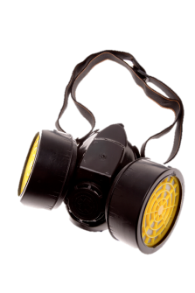
Protect Your Breathing
Employees need to be medically cleared to wear respirators before commencing use.
A physician or other licensed health care professional needs to medically evaluate employees to determine under what conditions they can safely wear respirators.
Notes:
The type of respirator you need to put on depends on what you don’t need to put in (your lungs).
There are two primary types of respirators and they are used for different purposes: an air purifying respirator and an atmosphere supplying respirator. Employees need to be medically cleared to wear respirators before commencing use. A physician or other licensed health care professional needs to medically evaluate employees to determine under what conditions they can safely wear respirators.
I will practice putting on a respirator and adjusting the fit to my face in a few minutes. I will also give you printed information from OSHA about using different types of respirators, like dust masks, half-face or full-face respirators, battery-powered fan respirators in a helmet or hood, and the type that has its own air tank.
[Show examples of different respirators and describe the type of uses for each. Demonstrate how to correctly wear, including how to perform fit checks. Also describe how to regularly inspect respirators and when to replace.]
Image source: Getty Images

Slide 22
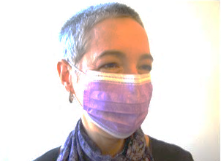
Respirators (continued)
Surgical masks are not respirators!
Surgical masks do not:
  Fit tightly against the skin to form a seal
  Filter tiny particles, such as viruses or bacteria that are in the air
Notes:
Instructor notes:
Surgical masks are not respirators. Surgical masks are not designed or certified to prevent the wearer from inhaling small airborne hazards, such as viruses, or virus particles. Surgical or procedure masks do not form a tight seal against the user's face. Therefore, when the wearer breathes in, much of the potentially infectious air passes through gaps between the face and the surgical mask. Second, many surgical masks are not made of a material that can filter microscopic particles. Only surgical masks that are cleared by the U.S. Food and Drug Administration and legally marketed in the United States have been tested for their ability to resist blood and body fluids can be used.
Surgical masks are used as a physical barrier to protect employees from hazards such as splashes of large droplets of blood or body fluids. Surgical masks also prevent contamination by trapping large particles of body fluids that may contain bacteria or viruses when they are expelled when the wearer coughs and sneezes.
Surgical/procedure masks are used for several different purposes, including:
Being placed on sick people to limit the spread of infectious respiratory secretions to others.
Worn by healthcare providers to prevent accidental contamination of patients' wounds by the organisms normally present in mucus and saliva
Worn by employees to protect themselves from splashes or sprays of blood or body fluids; they may also have the effect of keeping contaminated fingers/hands away from the mouth and nose.
Bandannas, neck gators, etc. are not respirators - their use DOES NOT afford any protection to inhalation of airborne droplets containing the virus. However using one of these items may reduce the frequency that people touch their face.

Slide 23

What about CDC’s recommendation to wear cloth masks in public settings?
They are not PPE
Most small particles go right through cloth increasing risk of infection. There is no seal to the face.
Factors like moisture on the cloth may concentrate droplets.
A concern is that people will touch their face more often to adjust mask, or that they will have a false sense of security with one on.
Notes:
Instructor notes:
https://www.cdc.gov/coronavirus/2019-ncov/prevent-getting-sick/cloth-face-cover.html#studies
There are a lot of questions about cloth masks. Some people are making their own because they feel that it’s “better than nothing.” Right now, the guidance from the CDC encourages the use of homemade masks by the public. In part, this is due to recognizing that a significant number of people who are infected with the virus have no symptoms. The thought is that wearing a mask will reduce asymptomatic people from spreading the virus as easily. This is called “source control”.

Slide 24
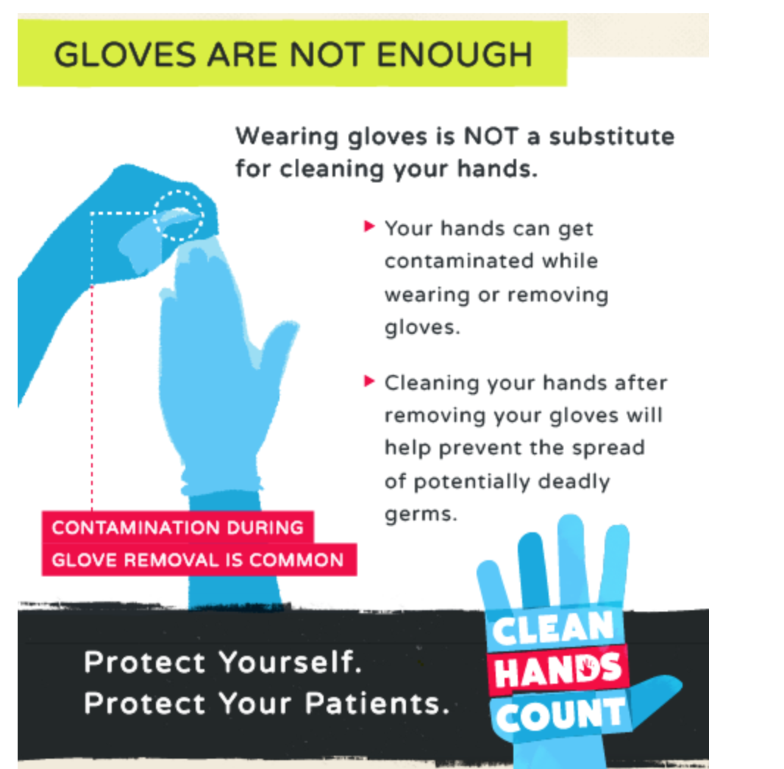

Gloves
Can be a reminder to avoid touching your face!
Assume they are contaminated; dispose of properly.
Wash hands right after removing
Non-latex is better because latex can trigger asthma and allergies
Notes:
Instructor notes:
Gloves can be helpful as a reminder not to touch your face, since most of us touch our face often without even realizing it. However, the virus does not enter your body through your hands or skin, only through the mucous membranes in your eyes, nose, and mouth. So if your gloves are contaminated and then you touch those areas with the gloves, it’s exactly the same as if you touched those areas with your hands.
Transition: We will now briefly review some of the key safety and health issues for healthcare workers who are on the frontline of responding to the pandemic.

Slide 25
What if a worker tests positive?
Close off areas used by the sick person.
Implement a 14-day self-quarantine, provide information on self-monitoring, and to watch for symptoms that warrant going to the emergency department.
Provide financial and emotional support.
Follow CDC and local guidelines for cleaning and disinfecting.
https://www.cdc.gov/coronavirus/2019-ncov/community/organizations/cleaning-disinfection.html
https://www.cdc.gov/coronavirus/2019-ncov/hcp/disposition-in-home-patients.html
Notes:
Instructor notes:
Employers should develop policies for decisive action when a worker tests positive for COVID-19. The CDC guidelines are at the links at the bottom of the slide and address the issues framed on the slide. Additionally, the employer should investigate if the positive test was a result of a work exposure or an inadequate prevention program. Workers who are infected at work may be entitled to workers’ compensation, state, or employer-based benefits.
The CDC language on discontinuing home isolation is below. The 14-day home isolation recommendation on the slide goes beyond the minimum recommendation in the CDC guidelines. The CDC recommendation is based on symptoms or testing and doesn’t consider the potential of asymptomatic people transmitting the virus. https://www.cdc.gov/coronavirus/2019-ncov/hcp/disposition-in-home-patients.html
For Persons with COVID-19 Under Isolation:
The decision to discontinue isolation* should be made in the context of local circumstances. Options now include both 1) a time-since-illness-onset and time-since-recovery (non-test-based) strategy, and 2) test-based strategy.
Persons with COVID-19 who have symptoms and were directed to care for themselves at home may discontinue isolation under the following conditions:
At least 3 days (72 hours) have passed since recovery defined as resolution of fever without the use of fever-reducing medications and
Improvement in respiratory symptoms (e.g., cough, shortness of breath); and,
At least 7 days have passed since symptoms first appeared.
Test-based strategy (simplified from initial protocol) Previous recommendations for a test-based strategy remain applicable; however, a test-based strategy is contingent on the availability of ample testing supplies and laboratory capacity as well as convenient access to testing. For jurisdictions that choose to use a test-based strategy, the recommended protocol has been simplified so that only one swab is needed at every sampling.
Persons who have COVID-19 who have symptoms and were directed to care for themselves at home may discontinue isolation under the following conditions:
Resolution of fever without the use of fever-reducing medications and
Improvement in respiratory symptoms (e.g., cough, shortness of breath) and
Negative results of an FDA Emergency Use Authorized molecular assay for COVID-19 from at least two consecutive nasopharyngeal swab specimens collected ≥24 hours apart*** (total of two negative specimens). See Interim Guidelines for Collecting, Handling, and Testing Clinical Specimens from Persons Under Investigation (PUIs) for 2019 Novel Coronavirus (2019-nCoV)for specimen collection guidance.
Persons with laboratory-confirmed COVID-19 who have not had any symptoms may discontinue isolation when at least 7 days have passed since the date of their first positive COVID-19 diagnostic test and have had no subsequent illness provided they remain asymptomatic. For 3 days following discontinuation of isolation, these persons should continue to limit contact (stay 6 feet away from others) and limit potential of dispersal of respiratory secretions by wearing a covering for their nose and mouth whenever they are in settings where other persons are present. In community settings, this covering may be a barrier mask, such as a bandana, scarf, or cloth mask. The covering does not refer to a medical mask or respirator.
The CDC guidelines “Criteria for Return to Work for Healthcare Personnel with Confirmed or Suspected COVID-19 (Interim Guidance)”: https://www.cdc.gov/coronavirus/2019-ncov/hcp/return-to-work.html
Transition: the next group of slides will review cleaning and decontamination.

Slide 26
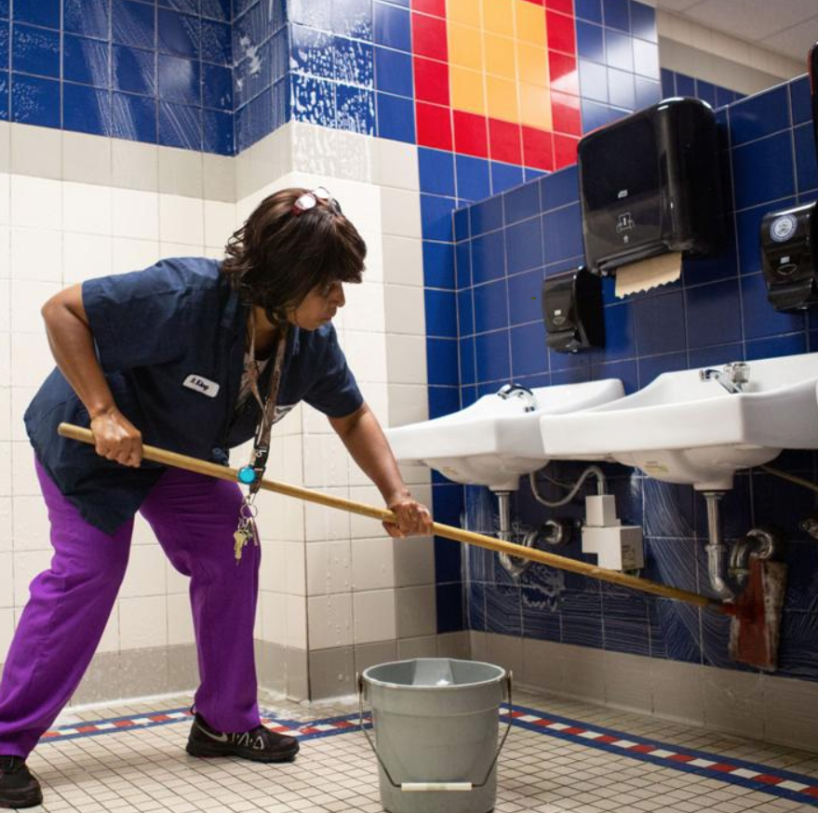





Cleaning Work Surfaces
Notes:
Instructor notes:
Ask the participants to describe high contact work surfaces in their work setting.
The photos show examples of high frequency touch items that need increased cleaning and disinfection. We know that the virus can remain viable on surfaces for hours or days, and there is a risk of touching surfaces with the virus and then touching your face, eyes, nose, and mouth.
Source: LOHP Webinar: Protecting Workers in the Service Industry During the Coronavirus Pandemic, April 2020
Transition: We will now review key topics in protecting worker mental health during the pandemic.

Slide 27
Cleaning and decontamination
Employers should develop site specific procedures.
May require consultation with health departments or use of a consultant specializing in environmental cleanup.
Use an EPA registered disinfectant effective against SARS CoV-2.
Consider worker and building occupant protection against adverse effects of the disinfectant.
EPA List: https://www.epa.gov/pesticide-registration/list-n-disinfectants-use-against-sars-cov-2
Notes:
Instructor notes:
The CDC guidelines for healthcare include disinfecting immediately any visibly contaminated PPE surfaces, equipment, or patient care area surfaces using an EPA-registered disinfectant wipe. They also recommend performing regular cleaning and disinfection of patient care area surfaces, even absent visible contamination. They state that this should be performed only by nurses or physicians as part of patient care activities in order to limit the number of additional healthcare workers who enter the room.
Decontamination procedures are specific to the industry, job task, and work site. Decontamination is critical because workers can become contaminated with infectious material while taking off PPE and respirators.
Use Products with Emerging Viral Pathogens AND Human Coronavirus claims for use against SARS-CoV-2. Although there is little info on the effectiveness of disinfectants on SARS Coronavirus 2; however, disinfectants effective against other coronaviruses should be effective for SARS Coronavirus 2 so use the appropriate EPA-registered disinfectants. See: https://www.epa.gov/pesticide-registration/list-n-disinfectants-use-against-sars-cov-2
CDC guidelines for household settings: https://www.cdc.gov/coronavirus/2019-ncov/community/home/cleaning-disinfection.html#routine-cleaning
Cleaning refers to the removal of germs, dirt, and impurities from surfaces. Cleaning does not kill germs, but by removing them, it lowers their numbers and the risk of spreading infection.
Disinfecting refers to using chemicals to kill germs on surfaces. This process does not necessarily clean dirty surfaces or remove germs, but by killing germs on a surface after cleaning, it can further lower the risk of spreading infection.
Chemical safety: Some chemicals on the EPA list have been associated with occupational asthma and dermatitis. You may find safe alternatives within the EPA list at the site below:
Safer Disinfectants on EPA’s List of Recommended Antimicrobial Products for Use Against Novel Human Corona Virus.
https://osha.washington.edu/sites/default/files/documents/Updated%20Safer%20Disinfectants%20List_March%2026%2C%202020.pdf
Washington State has also produced an excellent factsheet on this topic: Safer Cleaning, Sanitizing and Disinfecting Strategies to Reduce and
Prevent COVID-19 Transmission:
https://osha.washington.edu/sites/default/files/documents/Updated%20Safer%20Disinfectants%20List_March%2026%2C%202020.pdf

Slide 28
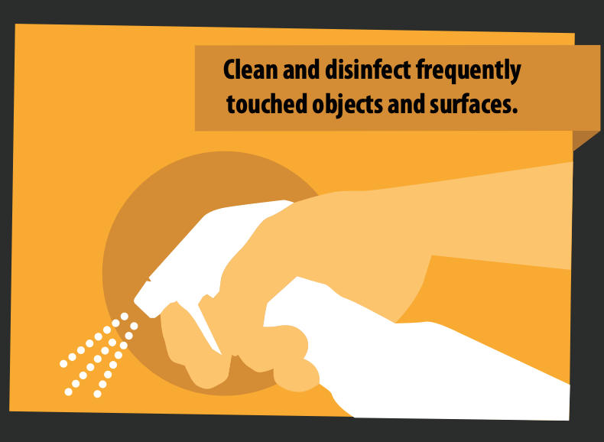
CDC cleaning guidelines (non-healthcare)
Cleaning: removal of dirt, including germs, from surfaces. Cleaning alone does not kill germs.
Disinfecting: works by using chemicals to kill germs on surfaces.
EPA List: https://www.epa.gov/pesticide-registration/list-n-disinfectants-use-against-sars-cov-2
Notes:
Instructor notes:
Workers who are assigned to cleaning and disinfection should be trained so that they understand key concepts as well as how to protect themselves.
https://www.cdc.gov/coronavirus/2019-ncov/community/organizations/cleaning-disinfection.html

Slide 29

Contact time for disinfection is important!
The EPA list and product labels include contact time.
Contact time is the time the product must remain wet to kill the virus.
Observe that the area is visibly wet for the entire contact time.
Check expiration dates!
Notes:
Instructor notes:
Contact time is sometimes referred to as “kill” time or “dwell” time.
It is important to note that disinfectants breakdown and expired disinfectants should not be used. Look at the expiration date and DO NOT use if expired because the active ingredients degrade over time.
Source: Richard Lowe, Lori Strazdas, et al, The importance of contact time and visible wetness to ensure effective disinfection, Clorox Healthcare - Friday, February 16th, 2018
https://www.beckershospitalreview.com/quality/the-importance-of-contact-time-and-visible-wetness-to-ensure-effective-disinfection.html

Slide 30
Tips and traps
Products are designed for
specific purposes.
Surfaces matter. What works on
fabric may not work on stainless steel.
Some disinfectants work on bacteria
but not viruses and vis a versa.
Many products
must be diluted.
Some products are sprayed, which makes it more
likely users will inhale the vapors.
Notes:
Instructor notes:
Bleach:
Understanding the concentration of your bleach solution is important for achieving effective disinfection. Bleach (usually 5.25% or 6.00%–6.15% sodium hypochlorite depending upon manufacturer) is usually diluted in water at 1:10 or 1:100. Approximate dilutions are 1-1/2 cups of bleach in a gallon of water for a 1:10 dilution (~6,000 ppm) or 1/4 cup of bleach in a gallon of water for a 1:100 dilution (~600 ppm).
It is important to know that different bleach products may have different concentrations of hypochlorite and that concentration degrades over time with storage, particularly at elevated temperatures.
Source: https://multimedia.3m.com/mws/media/735976O/disinfection-with-bleach-tech-talk.pdf

Slide 31
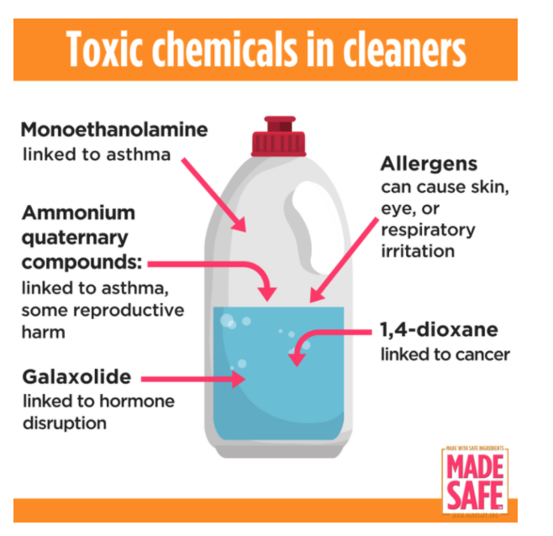
Health effects of disinfectants may include….
Skin rashes or dermatitis.
Irritation of the nose, eyes, mouth.
Occupational asthma:
  Sodium hypochlorite (bleach)
  Quaternary ammonium
  Glutaraldehyde
Remember to not mix products. That can be deadly!
Notes:
Instructor notes:
Disinfectants and Work-related Asthma: Information for Workers, California Department of Health, June 2017
https://www.cdph.ca.gov/Programs/CCDPHP/DEODC/OHB/WRAPP/CDPH%20Document%20Library/DisinfectantsWRAWorkers.pdf
https://www.cdph.ca.gov/Programs/CCDPHP/DEODC/OHB/WRAPP/CDPH%20Document%20Library/DisinfectantsWRATrabajadores-ESP.pdf
A common incompatible mix of disinfectants is bleach and ammonia - produces chlorine gas
Bleach + Vinegar = Toxic Chlorine Gas.

Slide 32
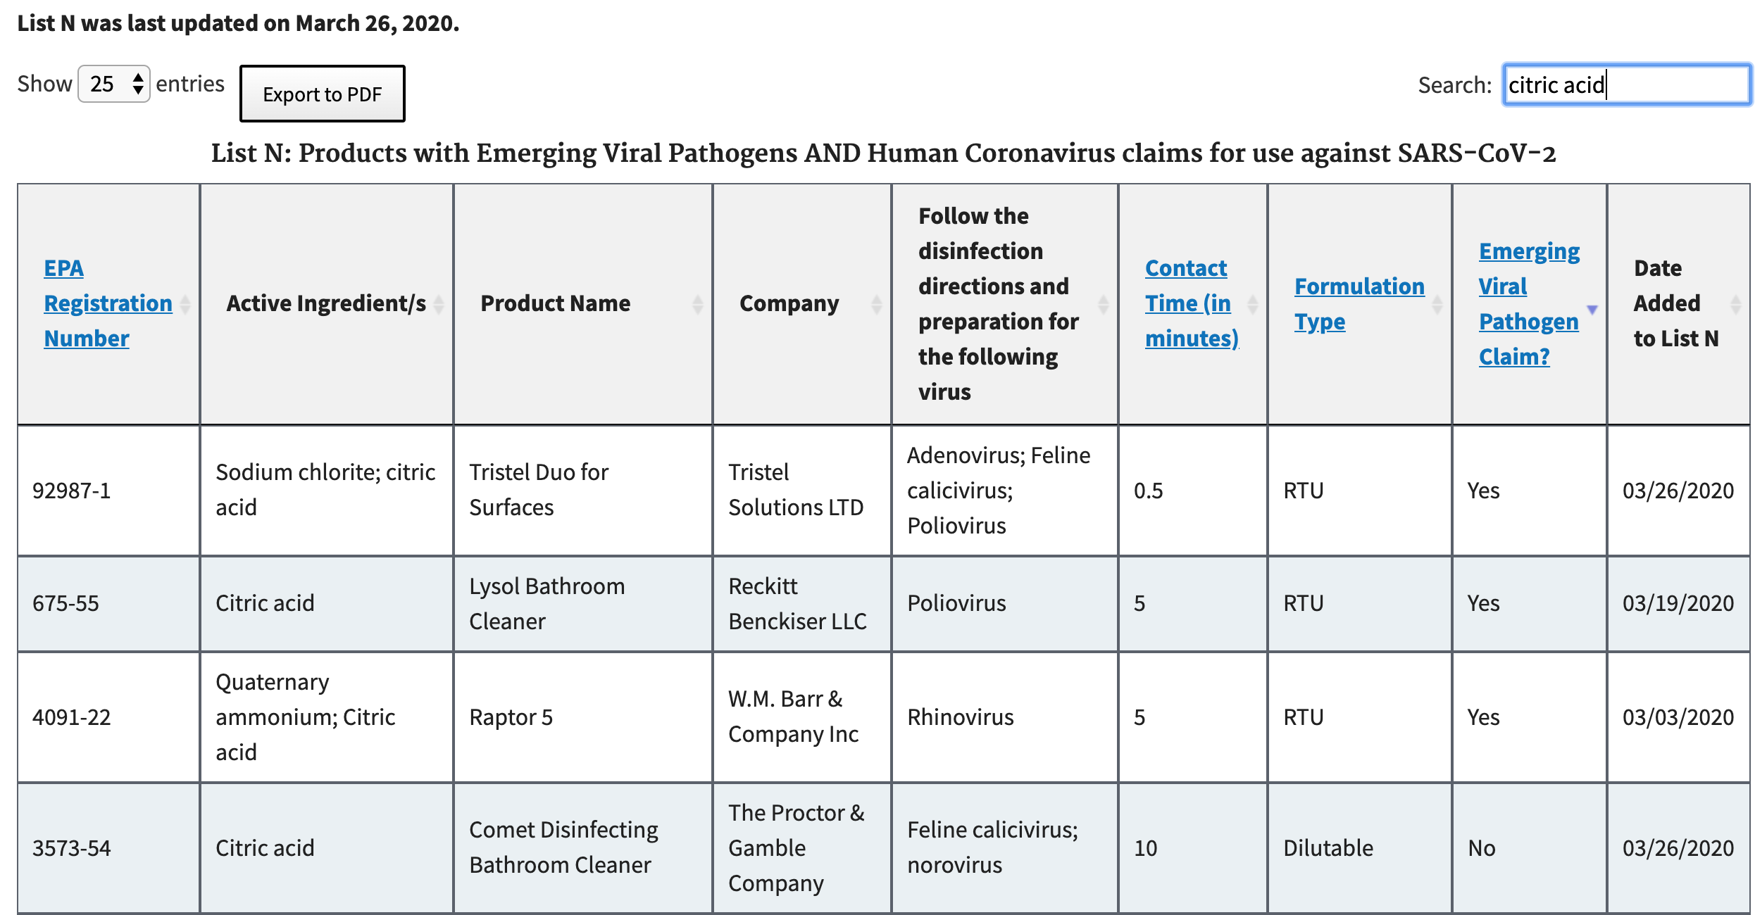
Safer chemicals are available
Use the search function on the EPA site
Notes:
Instructor notes:
You can search the EPA site for safer chemicals as indicated in the slide.
If possible, choose products that have these ingredients, as they are not known to cause asthma:
Hydrogen peroxide [but without Peroxyacetic acid (peracetic acid)]
Products with alcohol (ethanol, isopropanol)
Lactic acid
Citric acid
Bleach solution can be made by a adding 5 tablespoons bleach per gallon of water or 4 teaspoons bleach per quart of water.

Slide 33
OSHA Hazard Communication standard
The hazard communication standard, 29 CFR 1910.1200, establishes a worker’s right to know about chemicals in the workplace
Employers are required to provide:
A list of all hazardous chemicals in the workplace
Labels on containers
Chemical information (safety data sheets)
Training
A written program and worker access to information
These rights may be relevant to the cleaning and disinfecting chemicals
Notes:
Instructor notes:
Workers who use chemicals for cleaning and disinfection must understand the hazards of using these substances. OSHA’s Hazard Communication Standard, 1910.1200, requires employers to:
Maintain a list of all hazardous chemicals in the workplace.
Ensure all chemical containers are labeled.
Obtain and make available chemical information sheets (material safety data sheets) for all hazardous chemicals in the workplace.
Provide training to workers on hazardous chemicals, and
Develop and implement a written program on how to inform workers of hazardous chemicals in each of their workplaces.

Slide 34
When you use disinfectants:
Clean the area first to remove dirt and dust or you can use detergent or soap.
Open windows or use other ways to increase ventilation.
Avoid spraying and if you spray, put it on a sponge or rag so less goes into the air.
Notes:
Instructor notes:
Microfiber mops and cloths:
Eliminates the risk of cross contamination if used properly
Can reduce water and chemical waste
Surface contact time is increased
Can be laundered 400-500 times vs 250 times for a string mop
Flat mops are not effective for cleaning large spills
Surgical masks are not protective for these types of products. If a respirator is used, an elastomeric respirator with a P100 and multi gas combination cartridge is recommended.

Slide 35
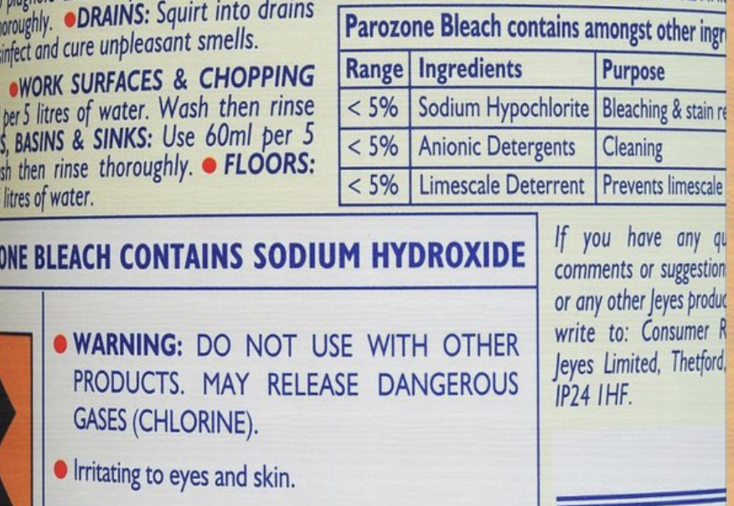
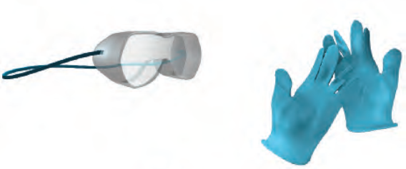
When you use these disinfectants:
Follow instructions on the product label exactly, including for diluting and for the “contact time”, how long the surface needs to stay wet.
Make sure all containers are labeled.
Use gloves (nitrile, non-latex) and eye protection and check label to see what PPE is recommended.
Notes:
Instructor notes:
Disinfectants typically release gases and vapors. N95 respirators protect against particles. "Masks" like surgical masks or cloth masks don't protect against gases and vapors. Avoid spraying disinfectants, use least toxic ones, and lots of ventilation. The solution to pollution is dilution!
The safety and PPE recommendations on the label may not be adequate.

Slide 36
For more information
Centers for Disease Control and Prevention (CDC)
http://www.cdc.gov
Occupational Safety and Health Administration (OSHA)
http://www.osha.gov
World Health Organization (WHO)
http://www.who.int/en/
National Institute for Occupational Safety and Health (NIOSH)
http://www.cdc.gov/NIOSH/
NIEHS Worker Training Program
https://tools.niehs.nih.gov/wetp/index.cfm?id=2554
Notes:
Instructor notes:

