Slide 1
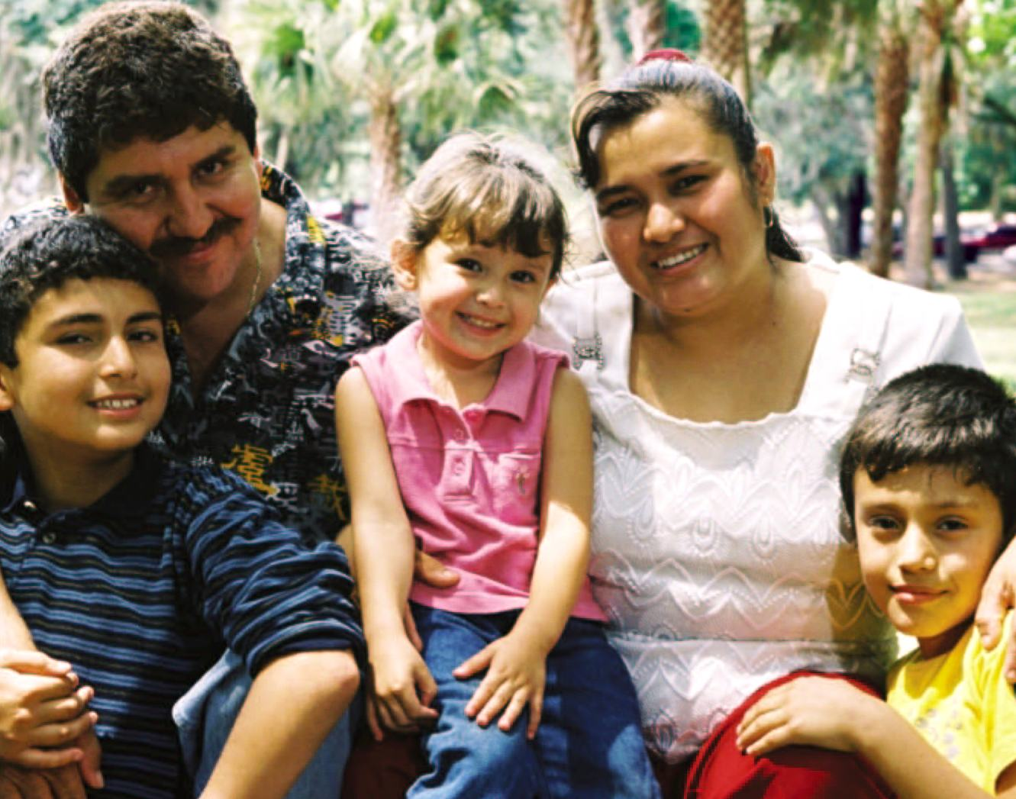
Occupational Pesticide Exposure and Pregnancy Health in Vulnerable Workers
Joan Flocks
Director, Social Policy Division
Center for Governmental Responsibility
University of Florida Levin College of Law
flocks@law.ufl.edu

Slide 2
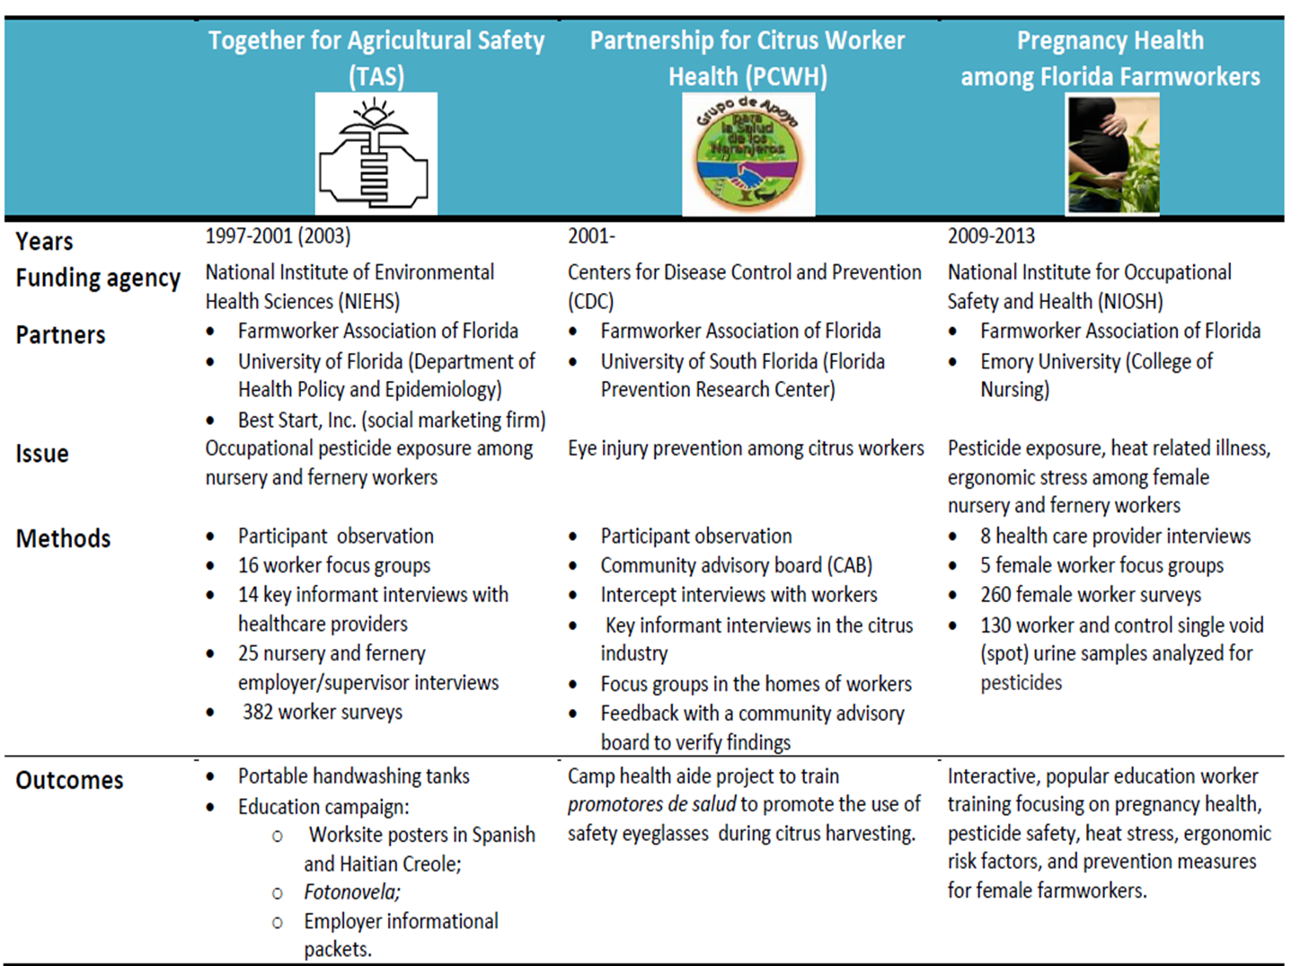
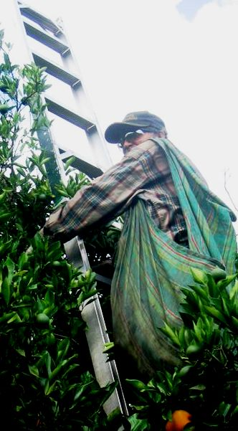
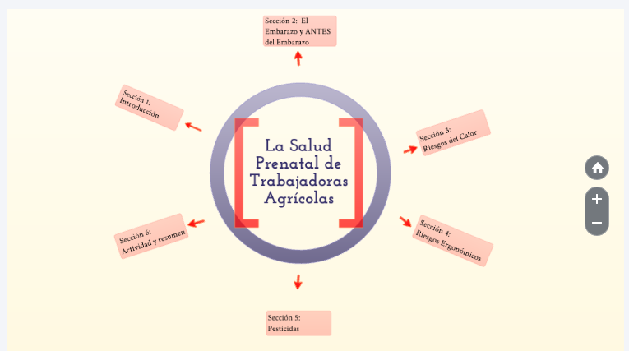
Collaborative Farmworker Safety and Health Projects, 1997-2013
Partners included: University of Florida, University of South Florida, Emory University, Farmworker Association of Florida.
Interventions included: Educational materials for employers and employees, handwashing tank, safety glasses campaign, interactive trainings.

Slide 3
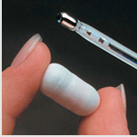
Collaborative Farmworker Safety and Health Projects, 2014-present
Southeastern Coastal Center for Agricultural Health and Safety (SCCAHS), 2016-present. Funded by CDC-NIOSH. Partners on various farmworker projects: University of Florida, Florida State University, Florida A&M University, Emory University, Farmworker Association of Florida.
The Girasoles project, 2013-2018. Funder: CDC-NIOSH
Partners: Emory University and the Farmworker Association.
Measurements taken from workers over three-day periods at five locations:
Physical activity and movement ;
Heart rate:
Core body temperature;
Ambient temperature;
Blood and urine samples;
Heat-related symptoms and demographics.
Results (combined from all sites):
53% dehydrated before work, 81% dehydrated after work
10% had normal body temperature
90% exceeded heat stress limit of 100.4°F on at least one day
42% had three or more symptoms of heat related illness on at least one day
36% developed Acute Kidney Injury on at least one day
PISCA: Pesticide & Heat Stress Education for Latino Farmworkers That is Culturally Appropriate
Heat Stress and Biomarkers of Renal Disease
Extent of Agricultural Pesticide Applications in Florida Using Best Practices
Using Social Marketing to Prevent Heat Related Illness and Improve Productivity Among Farmworkers
Pilot projects:
Uncovering patterns of mental, physical, and occupational health issues among migrant farmworkers with different socio-cultural networks: A pilot study among Haitian and Mexican farmworkers in Immokalee, FL.
Pilot study of mobile app monitoring to prevent
heat-related symptoms among Hispanic farmworkers.
A novel approach (sweat patches) to monitoring
pesticide exposure in farmworkers.
Agro-ecological practices in the face of climate
change: Resilience, sustainability, and preparedness in Puerto Rico .

Slide 4
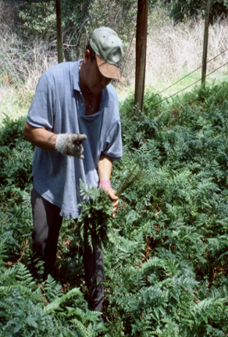
Farmworker Demographics
Enumeration is difficult.
Estimated 2.5 million farmworkers
Florida - fourth largest population in US
Florida DoH estimates 150,000-200,000 in Florida
US Department of Labor National Agricultural Workers Survey (NAWS), 2015-2016:
Male;
Mexican origin;
Do not migrate within the US;
Average age - 37.

Slide 5
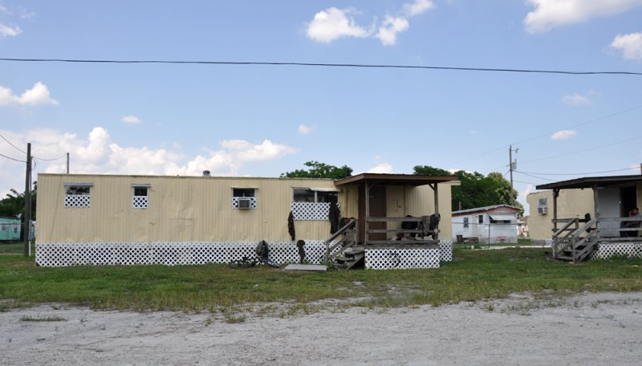
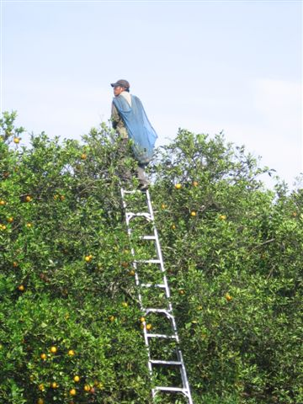
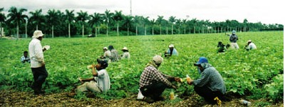
Factors Contributing to Farmworker Health Outcomes
Low socioeconomic status
Poor general health
High rate of occupational injury and illness
Little access to health care, no insurance, no sick leave
Lack of detection and treatment for injuries and illnesses
Substandard living conditions
Lack of legal status
More pesticides are used in Florida than other states because disease and insects thrive in humid and hot weather.

Slide 6
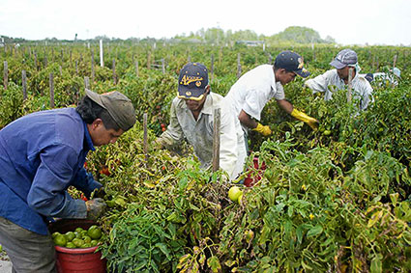
Farmworker Pesticide Exposure
Exposed to hundreds of chemicals, tens of thousands of combinations.
Excluded from some protective regulation.
Contact is dermal, oral, and/or respiratory.
Acute effects: Nausea, dizziness ,vomiting, headaches, rashes, stomach pain, eye irritation.
Chronic effects: Neurological, respiratory, immune, and reproductive systems. Can be carcinogenic and mutagenic.
Studies suggest:
Knowledge related to risk perception
Risk perception associated with sense of control
Knowledge and control can increase safety behavior

Slide 7
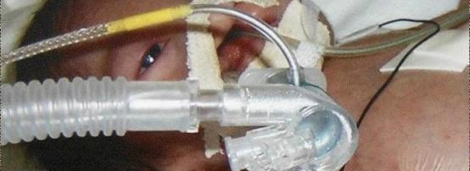
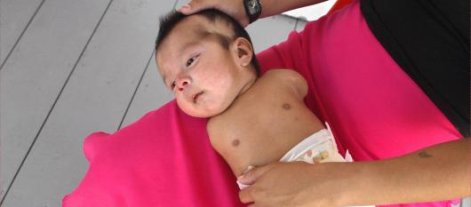
Case Study: Birth Defects among Infants born to Florida Tomato Workers, 2004-2005.
Three babies with birth defects born to farmworker mothers who:
Worked for same tomato harvesting company in FL and NC;
Lived within 200 yards of each other; and
Were exposed to at least two dozen pesticides.
One mother quit working two months into her pregnancy.
The other two worked until they were 7 months pregnant.
One child was born without limbs, another had a deformed jaw, and the third was born with no nose or visible sex organs and died after birth.

Slide 8
Case study cont’d
Company had recent pesticide regulation violations.
Media coverage of cases resulted in:
Company discontinuing use of five pesticides,
Florida Department of Agriculture and Consumer Services (FDACS) and Health Department investigations,
Retailers stopping sales of company’s products,
Lawsuit by one family.
Joint CDC/Health Department investigation does not establish link between pesticide exposures and the birth defects. However, the fungicide Mancozeb is noted as a chemical of concern.

Slide 9
Pregnancy Health Among Florida Farmworkers (2009-2013)
Funded by: National Institute for Occupational Health and Safety (NIOSH)
Project partners: Farmworker Association of Florida, Emory University, Farmworker Health and Safety Institute.
Goal: To examine perceptions of work hazards and pregnancy health among female farmworkers; assess heat, ergonomic, and chemical exposures that may impact pregnancy; and develop culturally-appropriate health promotion materials.

Slide 10
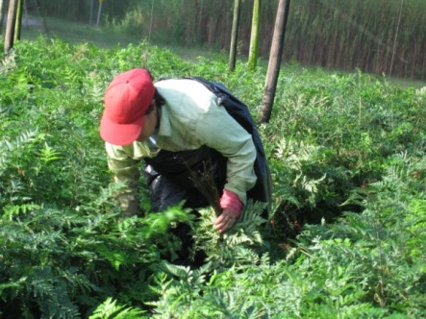
Female Nursery and Fernery Workers in Central Florida
Pierson | Facts
Population | 1,736
Hispanic or Latino origin | 54.1 %
Female | 47.1 %
Apopka | Facts
Population | 41,542
Hispanic or Latino origin | 25.4 %
Female | 51.5 %
4 Counties:
Orange , Lake, Volusia, and Putnam

Slide 11
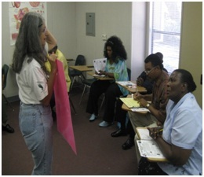
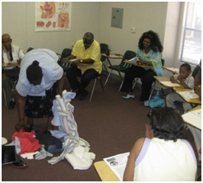
Project Plan
YEAR ONE
Healthcare Provider Interviews
Worker Focus Groups
Survey Development
YEAR FOUR
Disseminate Results and Training to the Community
YEAR TWO
Pilot Survey
Disseminate information from focus groups to community
Conduct Survey
Collect Biomarkers
YEAR THREE
Analyze Survey
Analyze Biomarkers
Disseminate survey and biomarker results to community
Develop educational module
Pilot educational module

Slide 12
Health Care Provider Interviews
What do health care providers (HCPs) understand about the environmental and occupational health issues of pregnant farmworkers?
8 HCPs from clinics in target agricultural communities.
Semi-structured interviews.
Data coded and sorted into five themes:
(1) Information collected at intake;
(2) Barriers to health care;
(3) Patient occupation, culture, and pregnancy health;
(4) Occupational and environmental hazards during pregnancy; and
(5) Health care provider needs.

Slide 13
HCP Interview Results Highlights
HCPs do not routinely collect information about a patient’s occupation and are unaware of whether a patient works at home or in a field.
Farmworker patients do not generally complain about health issues and do not inquire about pesticide exposure.
HCPs do not believe transportation or taking time off work to see a HCP is a problem for patients.
Several HCPs said they would not know how to advise women about pesticide exposure.
Kelley M, Flocks J, Economos J, and McCauley L. “Female Farmworkers’ Health during Pregnancy-Health Care Providers’ Perspectives.” Workplace Health and Safety 61(7):308-313, 2013.

Slide 14
Quote from HCP
“If they're changing clothing like they're supposed to . . . if they're wearing a mask like they're supposed to . . . if they're not entering a field prior to the time they're supposed to . . . you're not going to have any additional risk of exposure. So instead of saying ‘Well now you're pregnant, so you need to reduce your risk’ if you were doing what you were supposed to, your risks were already reduced. The problem is . . . not everything happens like it's supposed to happen."

Slide 15
Worker Focus Groups
What are female farmworkers perceptions of pesticides, ergonomics, and heat stress?
Five focus groups
Three with nursery workers
Two with fern workers
Total of 35 workers
Mean age = 38
Average of 3.4 children
Data were organized into six themes
Two themes related to pesticides; these were further categorized into two inquiries:
How do workers define and describe pesticides or chemicals used at work?
How do workers describe pesticide-related health issues affecting all types of workers and the means of treating these problems?

Slide 16
Pesticide-related Focus Groups Results
Description of pesticides
Workers do not know the names of chemicals, so they identify them according to form, color, the effect thy have on a plant or the effect they have on workers.
Pesticide related reproductive and pregnancy health issues
Infertility and male sterility
Rashes in the female genital area
Miscarriages
Birth defects
Developmental disabilities in children and
Respiratory illness in children exposed in uterus
Flocks J, Kelley M, Economos J, and McCauley L. “Female Farmworkers’ Perceptions of Pesticide Exposure and Pregnancy Health.” Journal of Immigrant and Minority Health 14:626-632, 2012.

Slide 17
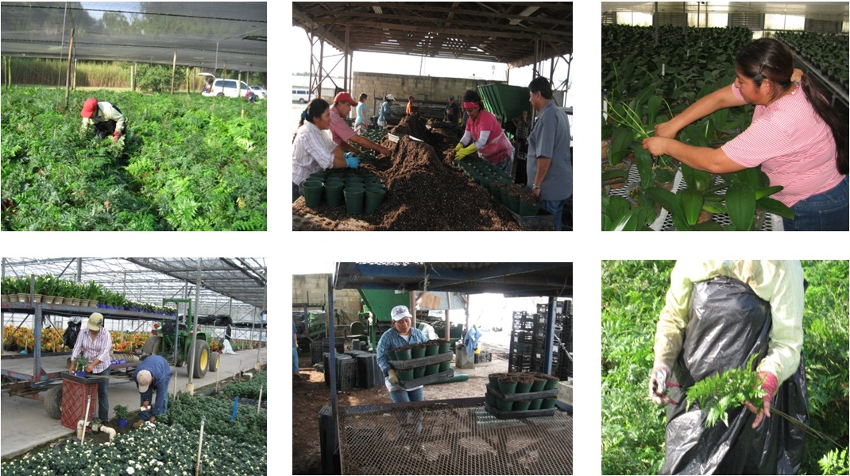
Quote from Worker
“I went to a gynecologist. She asked me where I worked. I told her in the nurseries, and I also explained to her that from the time I came to this country I worked in the fields with my parents. She told me that could be the reason why I am unable to have children.”

Slide 18
Worker Survey and Urine Test
Survey items: demographics, work practices, workplace hygiene, health beliefs, pregnancy histories.
Single void urine samples from 100 study participants and 30 controls were analyzed for five nonspecific dialkyl phosphate (DAP) metabolites and for ethylenethiourea (ETU) – the main metabolite in Mancozeb.
Runkle J, Flocks J, Economos J, Tovar-Aguilar JA and McCauley L. “Occupational Risks and Pregnancy and Infant Health Outcomes in Florida Farmworkers.” International Journal of Environmental Research and Public Health 11:7820-7840, 2014.
Runkle JD, Tovar-Aguilar JA, Economos E, Flocks J, Williams B, Muniz J, Semple M, and McCauley L. “Pesticide Risk Perception and Biomarkers of Exposure in Florida Female Farmworkers.” Journal of Occupational and Environmental Medicine 55(11):1286-92, 2013.

Slide 19
Worker Survey - Demographics from Community Survey
Survey Demographics by site | Age | Country of Origin | Marital Status | Currently Pregnant
Nursery n = 116 | 31.9 | US 4.3% Mexico 53.4% Haiti 25.9% | Married 37.9% Single 30.2% | 6.0%
Fernery n = 144 | 31.7 | US 3.5% Mexico 96.5% | Married 53.5% Single 14.6% | 10.4%

Slide 20
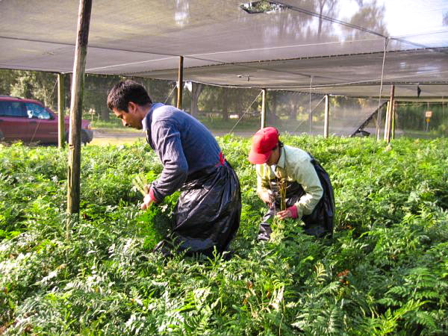
Survey Results – Workplace Hygiene
(Ricardo Ramirez Buxeda / Orlando Sentinel)

Slide 21
Did you work during your last pregnancy?
% of participants responding

Slide 22
Did you tell your supervisor you were pregnant?
% of participants responding

Slide 23
Did your doctor ask about the type of work you were doing during your pregnancy?
% of participants responding

Slide 24
During your pregnancy, did a healthcare provider ask you to change anything about the work you were doing?
% of participants responding

Slide 25
Symptoms frequently or sometimes experienced while working
% of those reporting symptoms

Slide 26
Organophosphate Metabolites
Table 1. Creatinine-adjusted OP metabolites in the urine of 97 female farmworkers working in nursery and fernery operations in Central Florida, April-June 2011.
ªp-values <.001 for differences detected between Nursery workers and Fernery workers and the control group

Slide 27
Education Materials Outcomes
Data-driven content design
Community-based delivery design
Pilot-evaluation
From 2014-2016 the Farmworker Association of Florida trained 400 women and 11 men. They currently have funding to continue offering two trainings per year in each of their five offices for the next three years.
http://prezi.com/adczcu6cepoj/la-salud-prenatal-de-las-trabajadoras-agricolas

Slide 28
Acknowledgements
Farmworkers Association of Florida
Jeannie Economos
Antonio Tovar-Aguilar, PhD
Emory University
Jennifer Runkle, PhD
Valerie Mac, PhD, RN
Maureen Kelley, PhD
Linda McCauley, PhD
Funded by grant award R21OH009830 from the Centers for Disease Control and Prevention – National Institute for Occupational Safety and Health.

