Slide 1

Chemical Process Safety
PSM – Value Beyond Regulatory Compliance
FL AIHA October 2020
Presented by:

Slide 2

Learning Objectives
Chemical process safety concepts can be successfully applied apart from regulatory compliance.
OSHA’s Process Safety Management (PSM) is not just for large, complex processes.
PSM concepts should be used as a risk management tool.

Slide 3
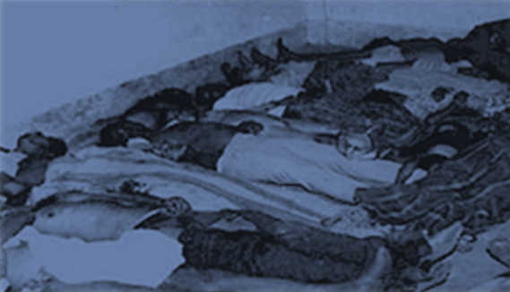
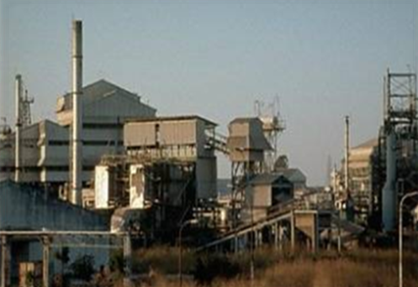
Why Chemical Process Safety Management?
Methyl Isocyanate Release
Bhopal, India – Dec. 2-3, 1984
Causes:
          Poor safety management practices
          Numerous failures of control systems
          Poor early warning systems
          Lack of community preparedness
2,800 people dead (other estimates put immediate death toll as high as 8,000)

Slide 4
Why Chemical Process Safety Management?
1950s
loss prevention concepts
1960s
basic process safety management principles developed
1970s
importance of human factors introduced
1980s
first industry consensus PSM standard
Bill Bridges, Process Improvement Institute

Slide 5


Regulatory Background
OSHA proposes the standard in 1990
Clean Air Act Amendments of 1990
  Sec. 304 required Sec. of Labor to work with EPA Administrator to promulgate a PSM regulation
Final PSM Regulation in 1992
  Coordinates with EPA Risk Management Plan (RMP)

Slide 6
Regulatory Background
Occupational Safety and Health Administration (OSHA)
  OSHA Process Safety Management (PSM) Standard
  137 listed highly hazardous chemicals and
  Flammable liquids and gases > 10,000 lbs

Slide 7
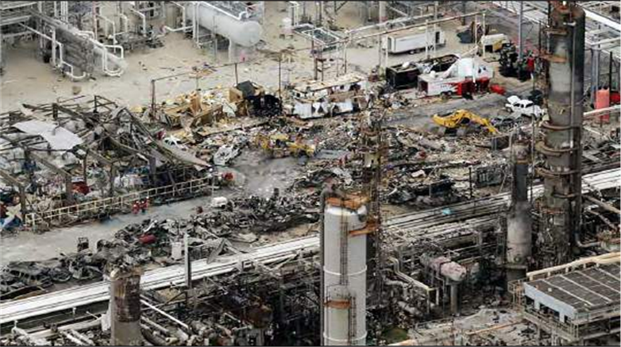
Why PSM?
BP American Refinery Explosion
Texas City, Texas – March 23, 2005
15 workers killed and 180 others injured.
Many of the victims were in or around nearby work trailers.
Cause: Distillation tower flooded with hydrocarbons and was over pressurized, causing a geyser-like release from the vent stack.

Slide 8
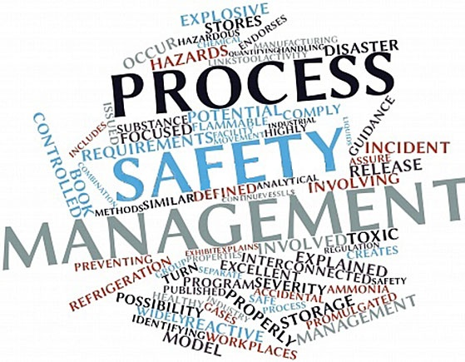
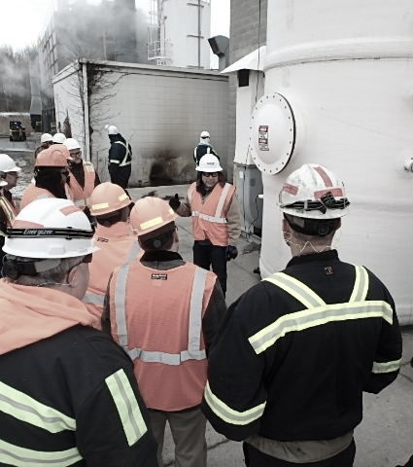
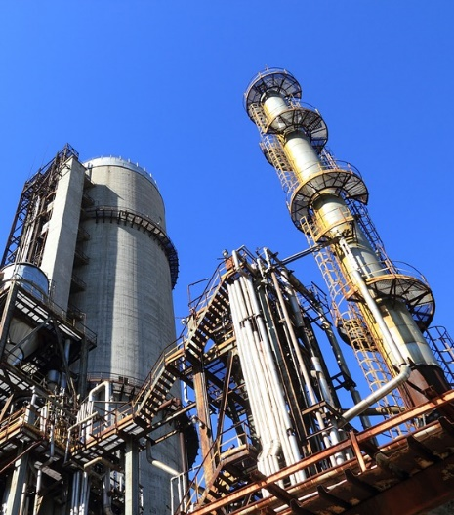

Slide 9

PSM
Well, maybe not all of the time!

Slide 10
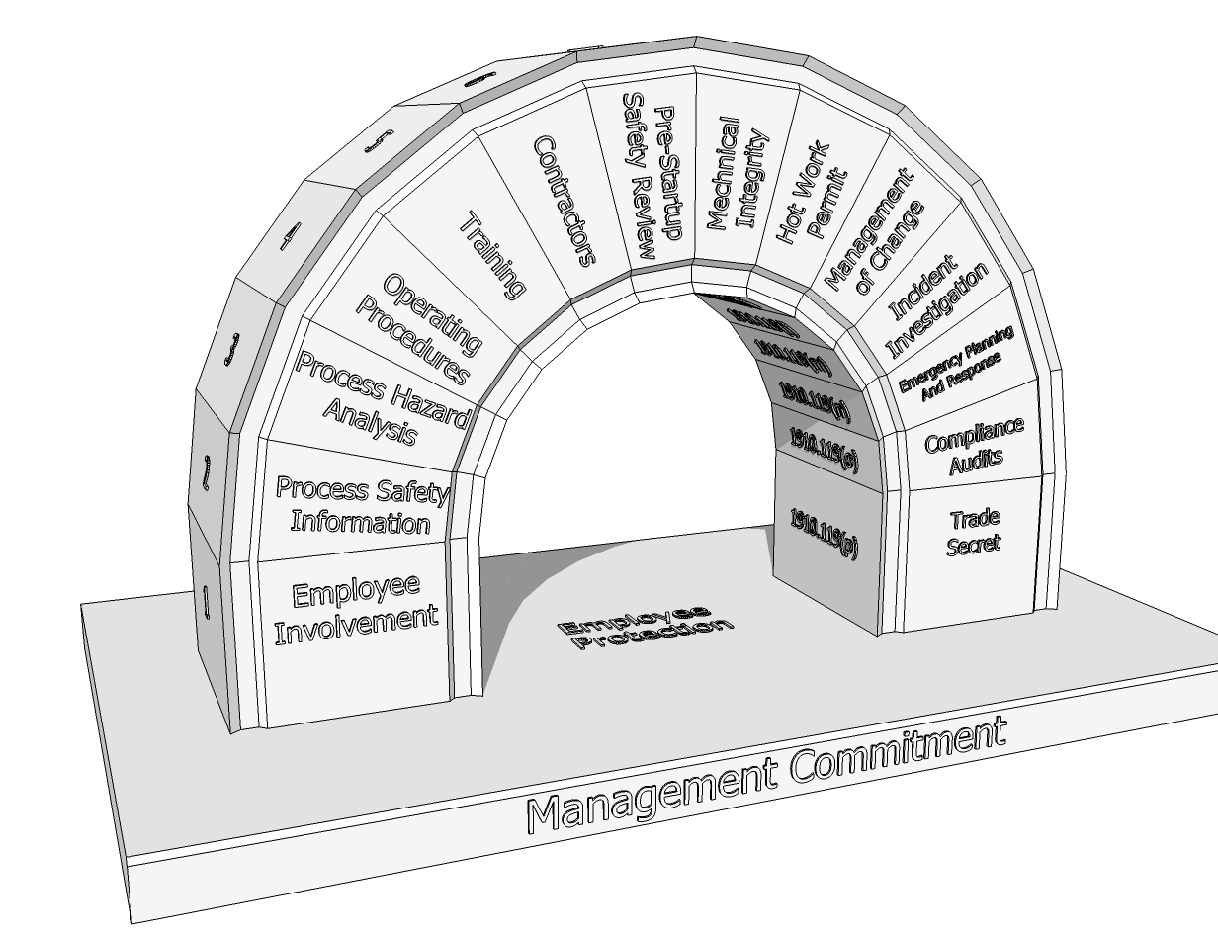
Comprehensive System
Provides rich framework for
risk management

Slide 11
OSHA’s Process Safety Management Elements
  Employee Participation
  Process Safety Information
  Process Hazard Analysis
  Operating Procedures
  Training
  Contractors
  Pre-Startup Safety Review
  Mechanical Integrity
  Hot Work
  Management of Change
  Incident Investigation
  Emergency Planning and Response
  Compliance Audits
  Trade Secrets

Slide 12

Is there value in the PSM regulation beyond compliance?
Absolutely!!!

Slide 13
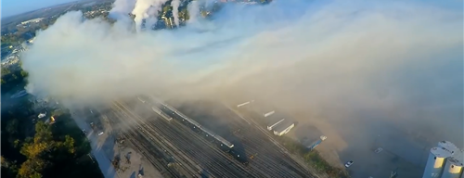
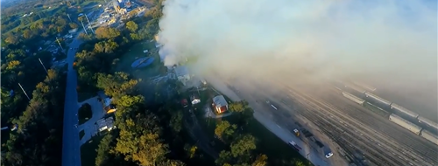
MGP Ingredients Processing, Atchison, KS
A series of unfortunate events leads to a bad day.

Slide 14

According to the National Association of Chemical Distributors (NACD), whose membership represents more than 85% of U.S. chemical distributors,
in 2016, more than
39.9 million tons of product
were delivered to customers
every 8.4 seconds.

Slide 15
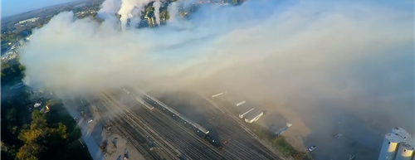
MGP Ingredients Processing, Atchison, KS
Site employs 140 personnel
Creates food–grade alcohol and corn oil products
Contract manufacturer of premium distilled spirits

Slide 16
MGP Ingredients Processing Atchison, KS
OHSAS 18001 and ISO 14001 certified since 2009
Public company since 1988
Includes grain processing, distilling, warehouse, labora-tories, & HQ office

Slide 17
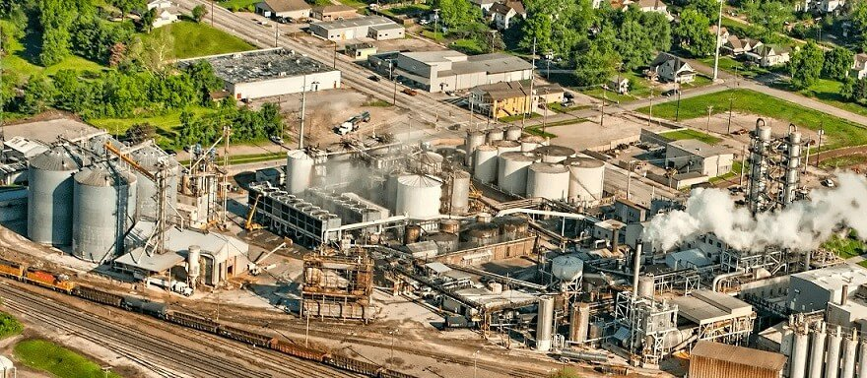
2016 Incident Overview
October 21, 2016
7:35am
Delivery of sulfuric acid
  Routine delivery by Harcos Chemical
  Harcos also supplied NaOH and propylene oxide
  Driver had made 6 previous sulfuric acid deliveries to site in 2016

Slide 18
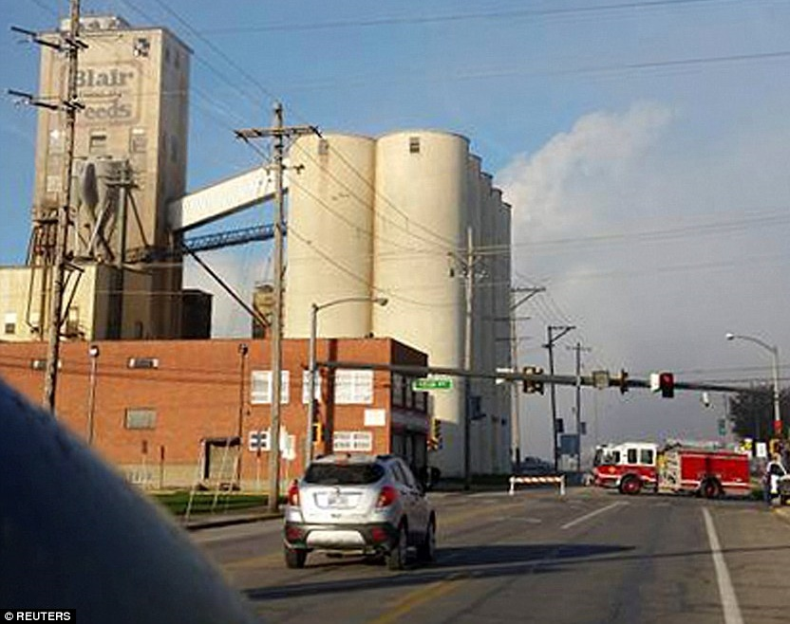
2016 Incident Overview
Cross connection of sulfuric acid to sodium hypochlorite tank - connected truck hose to wrong fill port
Incompatible chemical reaction resulted in chlorine, chlorine dioxide, and hydrogen chloride gases releasing from tank vent

Slide 19
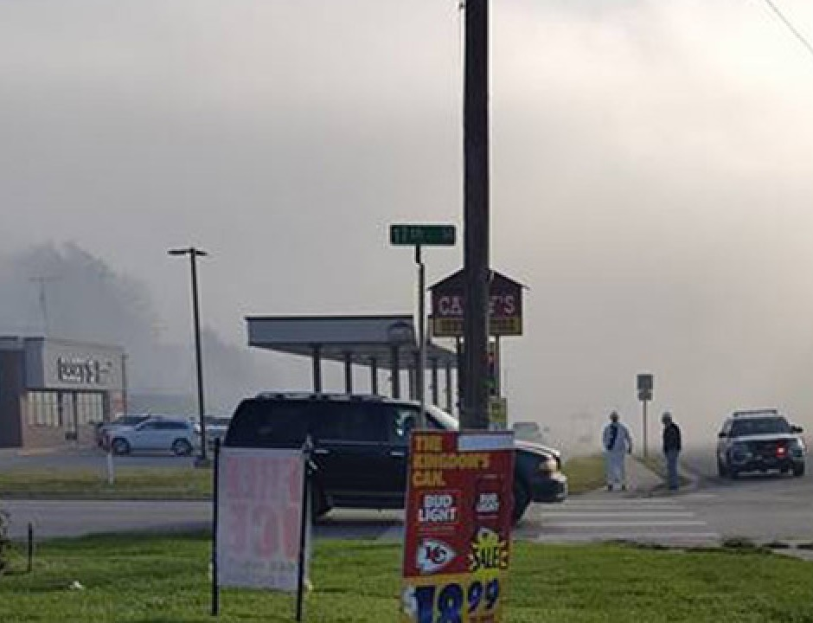
2016 Incident Consequences
4 MGPI employees, Harcos driver and 140 community members sought medical attention
11,000 Atchison residents advised to shelter-in-place
800 middle and high school students evacuated upwind

Slide 20
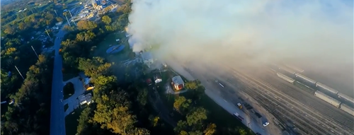
2016 Incident Consequences

Slide 21
2016 Incident Investigation
Driver saw uncapped connection, not realizing that it was not the sulfuric acid port.

Slide 22
2016 Incident Investigation
Improperly labeled connections with close proximity to one another

Slide 23
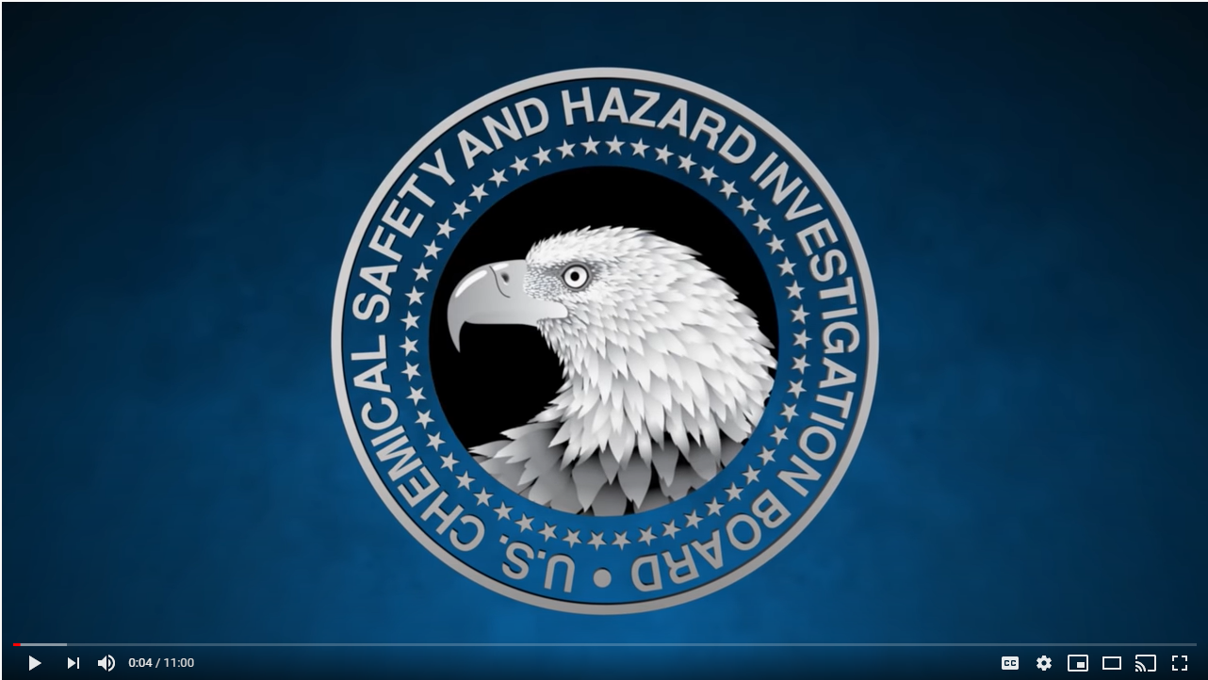
MGPI Processing Animation https://www.youtube.com/watch?v=Tflm9mttAAI

Slide 24
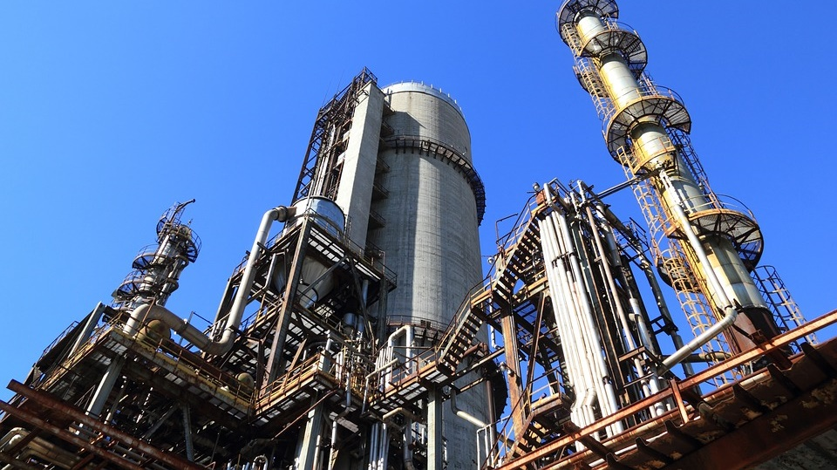
PSM as a Risk Management Tool
Identify hazards (Process Safety Information)
Prioritize risk (Process Hazard Analysis)
Layers of Protection Analysis (LOPA)
Develop Prioritized Risk Management Plan
Implement the RMP

Slide 25
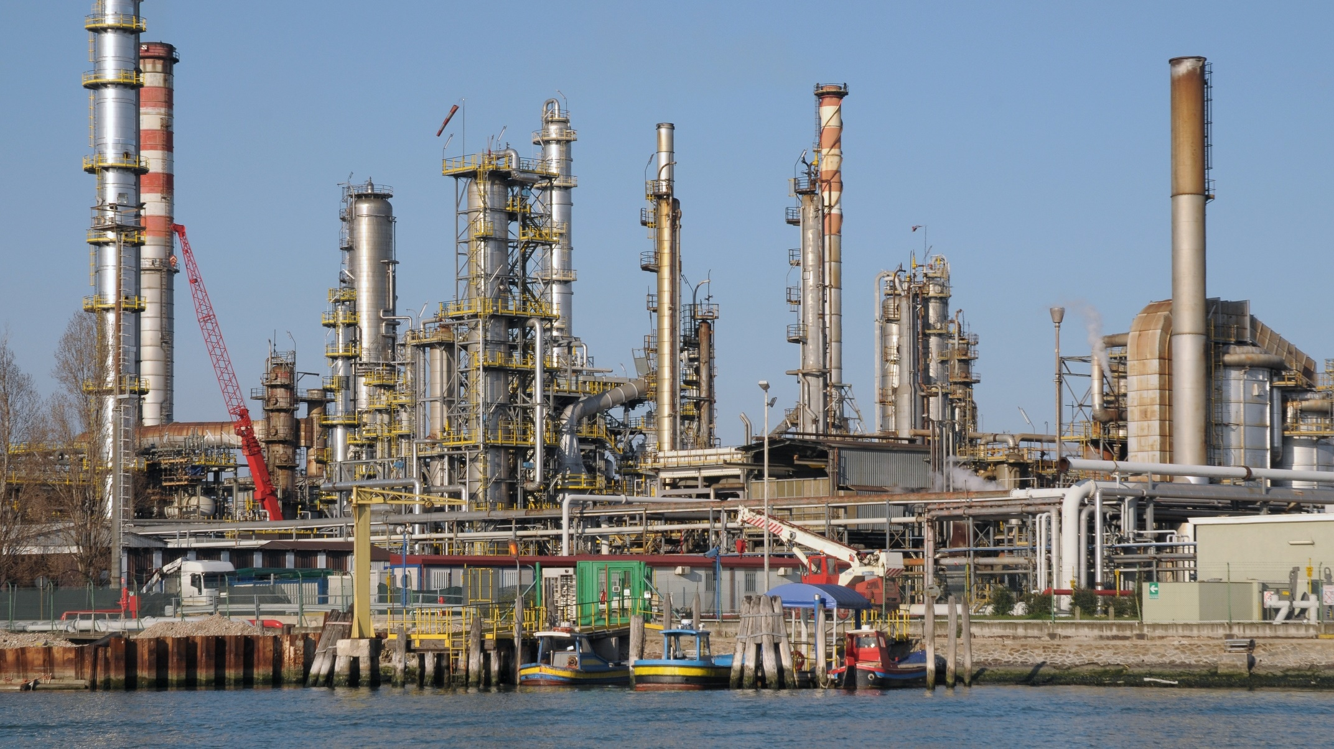
Process Safety Information
What chemicals/processes are on site?
  SDS
  Hazardous Waste/Radiation/Storage
Chemical and Physical Properties
Incompatibles/Reactives

Slide 26
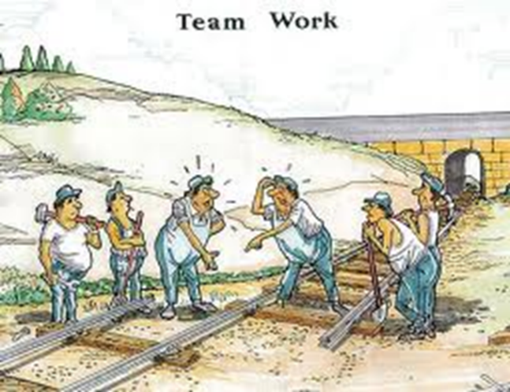
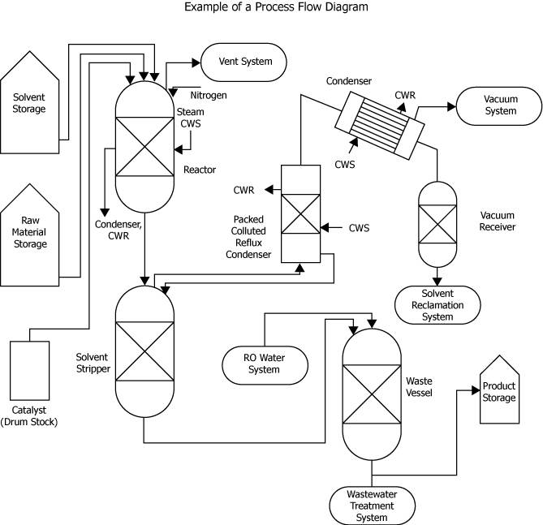
Process Hazard Analysis
Interdisciplinary effort
Select Methodology - HazOp/FMEA/What-if?
Analyze the Process

Slide 27
Process Hazard Analysis
Risk Assessment (HazOp, What-if?, FMEA)
  severity
  likelihood
  current controls (LOPA)
PHA

Slide 28
Layers of Protection Analysis (LOPA)
LOPA
Engineering Controls vs. Work Practices
Redundancy
Single points of failure

Slide 29
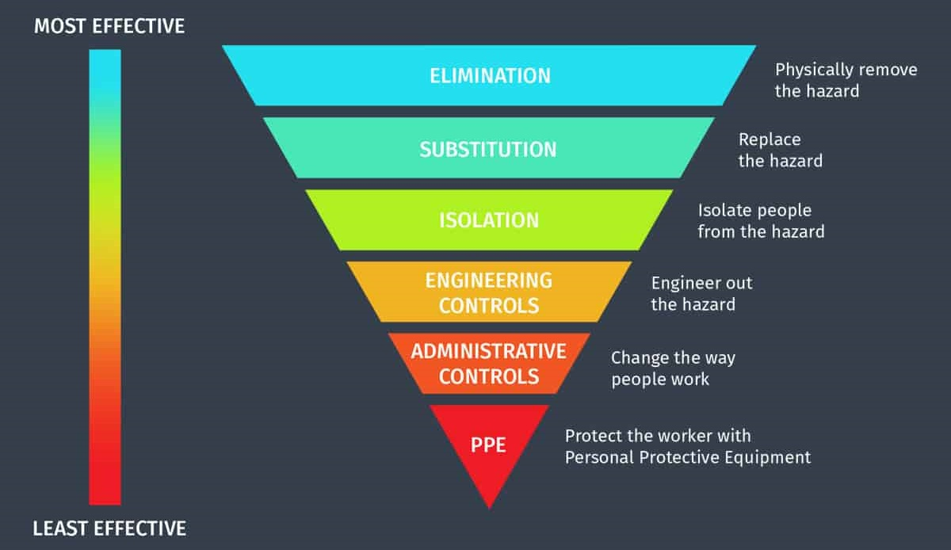
Credit: National Institute for Occupational Safety & Health

Slide 30

Layers of Protection Analysis - MGP
Reliance on administrative controls
Work practices allowed to deteriorate
Single points of failure allowed to develop - labeling and identification

Slide 31
Layers of Protection Analysis - MGP

Slide 32
Layers of Protection Analysis - MGP

Slide 33
Develop a Risk Management Plan
Prioritize gaps from PHA
Focus on weak links in LOPA
Identify actions needed to build a safer process – short and long term
Use PHA and LOPA to justify changes to management

Slide 34

CSB Suggestions for MGP
Human factors - interactions with employees and contractors
Fill line proximity
Identical connections and locks
Pipe and connection marking
SOPs not aligned with work practices
Training and active monitoring
Automation and remote controls

Slide 35

Implement the Plan
Management of Change Process
  Physical changes
  Process changes
Corrective Action Tracking Process
Collaborate with Other Departments

Slide 36
Questions?
Frank Rooney, CIH
frooney@ensafe.com

