Slide 1
Heat Stress and Hydration: Mitigating Heat Related Illness
Florida AIHA/FCHPS Fall Meeting
Cori Repp MD, MRO
October 18, 2019

Slide 2
Understand types of heat related illness and predisposing factors
Understand the concepts of proper hydration and acclimatization
Have awareness of components of a successful heat related illness mitigation program, with real world examples of success
1
2
INSTRUCTIONS
This is the agenda/table of contents slide. Add or remove section names and number circles as appropriate. Be sure to follow the established color pattern.
3

Slide 3
True or False
Some common thoughts on heat illness prevention
Employees should be encouraged to drink as much water as they can
False
Taking breaks in an air conditioned space will make workers less able to work in the heat
False

Slide 4
True or False
Some common thoughts on heat illness prevention
Sports drinks are the best choice for general rehydration
False
There is a greater incidence of heat related illness in the summer in Ohio than in Florida
True

Slide 5
True or False
Some common thoughts on heat illness prevention
Salt tablets should be used commonly to replace sodium
False
The longer you have worked in a hot environment, the more you sweat
True

Slide 6
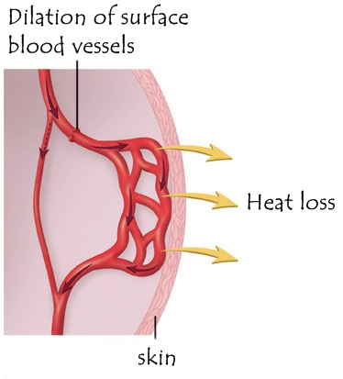
Our Body’s Radiator
How does the body cool down?
Blood is pumped to the skin for cooling

Slide 7
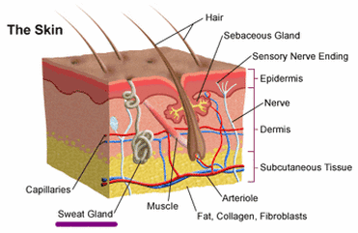
Our Body’s Radiator
How does the body cool down?
Sweat evaporation dissipates heat

Slide 8
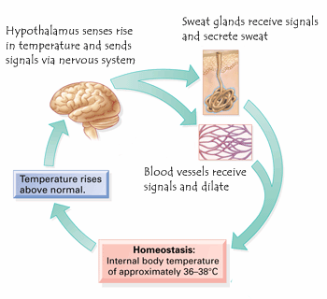
Our Body’s Radiator
How does the body cool down?
What is the Mechanism of Sweat Stimulation?

Slide 9
Causes of Heat Related Illness
Exertional
Exertional heat stroke occurs when someone is vigorously active in a hot environment.
It typically strikes young, otherwise healthy people, those least likely to be concerned about the effects of heat on their health.
Because of the lack of concern, early symptoms may be dismissed or ignored.

Slide 10
Causes of Heat Related Illness
Non-Exertional
Non-exertional heat stroke tends to occur in people who have a diminished ability to regulate body temperature, such as older people, very young children or people with chronic illnesses.
High heat in the surrounding environment, without vigorous activity, can be enough to cause heat stroke in these people.

Slide 11
In Most Cases a Bit of Both

Slide 12
Types of Heat Related Illness
Heat Stroke
Heat Exhaustion
Heat Cramps
Heat Rashes

Slide 13
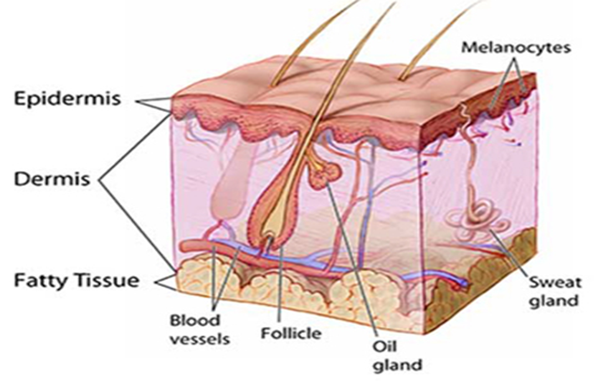
Types of Heat Related Illness
Heat Rashes (Miliaria)
Small red bumps or small blisters on the skin in areas that stay wet from sweat—usually on the upper chest, neck, inside of the elbow.
Caused by blocked sweat ducts and trapped sweat beneath the skin.

Slide 14
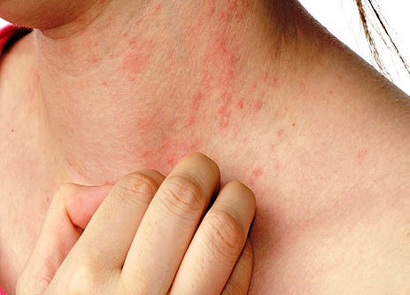
Types of Heat Related Illness
Heat Rashes (Miliaria)
The rash may appear as blisters or red lumps. Heat rash may cause itchiness or a prickly feeling.
Heat rash usually goes away on its own. Use of fans and lightweight clothing can help

Slide 15
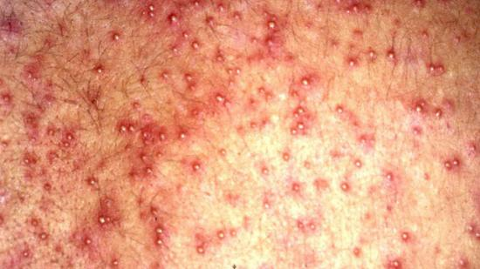
Types of Heat Related Illness
Heat Rashes (Miliaria)
Depending on degree of disease, may require worker to avoid work in hot environments for 8-12 weeks.

Slide 16
Types of Heat Related Illness
Heat Cramps

Slide 17
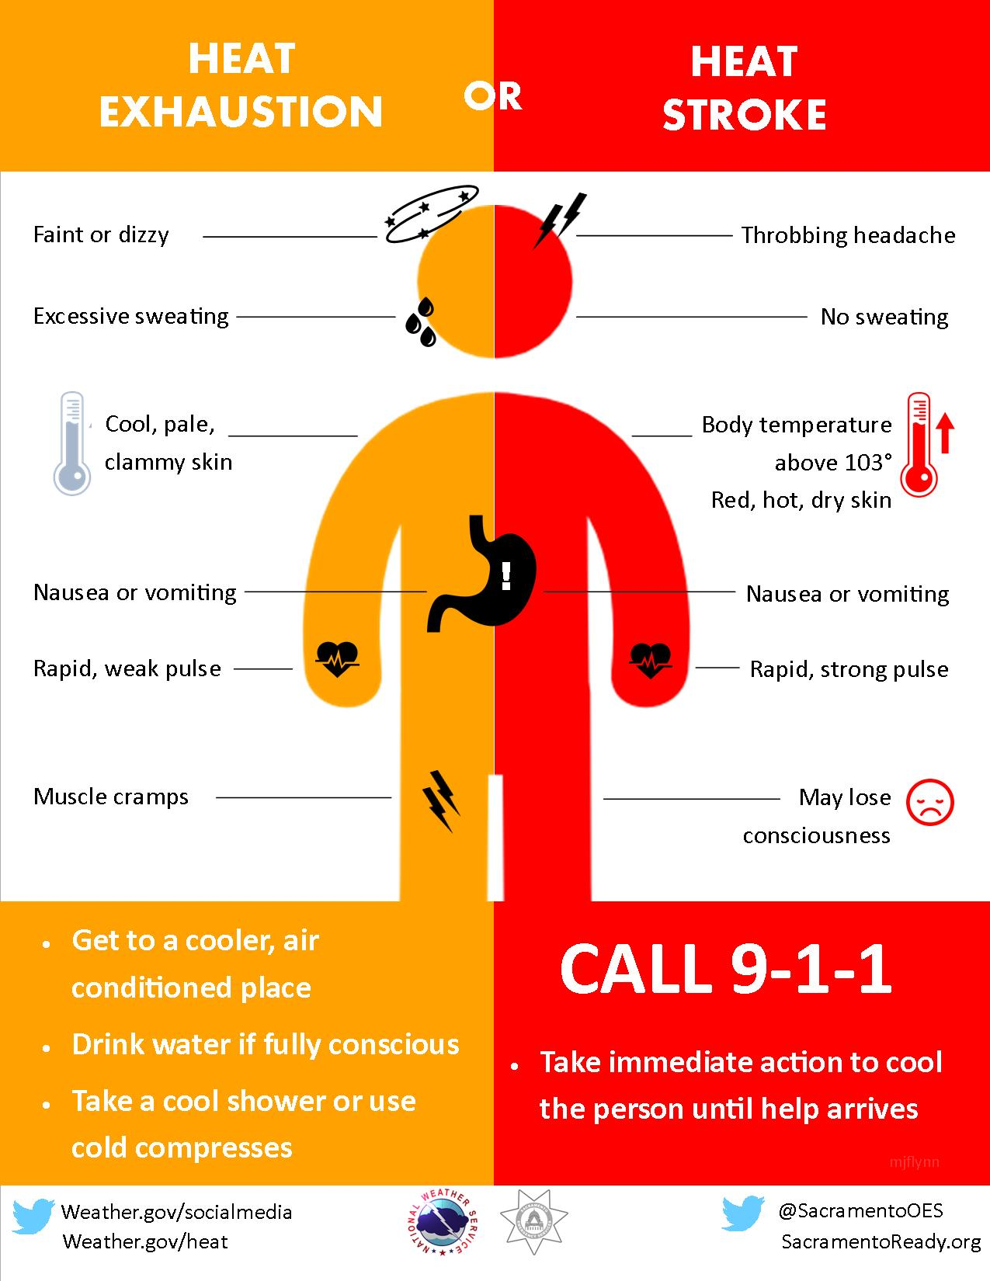
Types of Heat Related Illness
Notes:
Heat Exhaustion
Heavy sweating.
Muscle cramps.
Cool, moist skin.
Headache.
Nausea.
Dizziness.
Fainting.
Weakness.
Irritability
Pale skin color.
Weak and quick pulse.
Quick and shallow
breathing.
Thirst
Heat Stroke
Temperature of 103°F or higher.
Throbbing headache.
Nausea.
Muscle twitching.
Red, hot, dry skin.
Confusion, altered mental state, slurred speech.
Dizziness or fainting.
Rapid pulse.
Seizures.
Lack of sweating.
Hallucinations.
Loss of consciousness
Can cause permanent damage to heart, liver, kidneys, muscles, and nervous system

Slide 18
Predisposing Factors for Heat Related Illness
Medical conditions
Age
Weight
Type of clothing
Degree of physical fitness
Metabolism
Use of alcohol or drugs
Degree of acclimatization

Slide 19
Predisposing Factors for Heat Related Illness
Medical conditions
Diabetes
Kidney disease
Heart problems
High blood pressure
Pregnancy
Infection
Prior history heat related illness

Slide 20
Predisposing Factors for Heat Related Illness
Age
Older adults do not adjust as well as young people to sudden changes in temperature.
They are more likely to have a chronic medical condition that changes normal body responses to heat.
They are more likely to take prescription medicines that affect the body’s ability to control its temperature or sweat.
“(2) A comprehensive physical examination should be conducted. At the discretion of the responsible healthcare provider, candidates who anticipate increased stress of physical activity of the job in a hot environment, those over 50 years of age or those younger than 50 years of age with underlying cardiac risk factors may need to have additional testing (e.g., electrocardiogram (ECG) with interpretation by a cardiologist).” -- NIOSH, Recommendations for an Occupational Standard for Workers Exposed to Heat and Hot Environments

Slide 21
Predisposing Factors for Heat Related Illness
Weight
Carrying excess weight can affect your body's ability to regulate its temperature and cause your body to retain more heat.
Obesity puts addition stress on cardiac and respiratory systems, causing them to work harder
“An assessment of obesity, defined as a body mass index (BMI) ≥ 30. Measure height and weight to calculate body mass index according to the following formula:
BMI = weight (in pounds) × 703 / [height (in inches)]2 “-- NIOSH, Recommendations for an Occupational Standard for Workers Exposed to Heat and Hot Environment

Slide 22
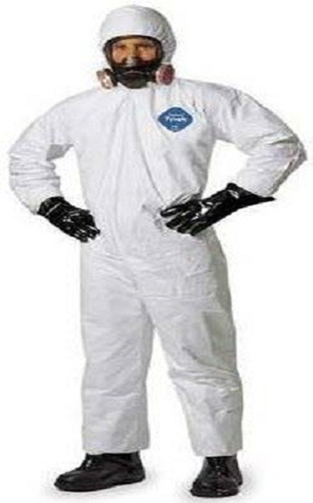
Predisposing Factors for Heat Related Illness
Type of clothing
Choose lightweight, light-colored, loose-fitting clothing.
Be especially aware of PPE that may retain heat (This topic alone can fill an entire lecture!)

Slide 23
Predisposing Factors for Heat Related Illness
Degree of physical fitness
The ability of your cardiovascular system to accommodate a greater load improves with regular physical activity
Be aware of risks of deconditioning

Slide 24
Predisposing Factors for Heat Related Illness
Metabolism
Processes such as infection, hyperthyroid conditions, Stimulant drugs and drug withdrawal can cause increased metabolism
This puts and additional burden on the cardiovascular system

Slide 25
Predisposing Factors for Heat Related Illness
Drugs
An assessment of the use of therapeutic drugs, over-the-counter medications, supplements, alcohol, or caffeine that may increase the risk of heat injury or illness

Slide 26
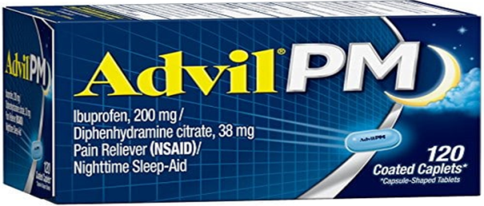
Predisposing Factors for Heat Related Illness
Decrease sweating
Some medicines decrease the body’s ability to sweat and cool itself off.
Examples include some antidepressants and anti-psychotic mediations, medicines for Parkinson’s disease, Benadryl, and other cold and allergy medicines.

Slide 27
Predisposing Factors for Heat Related Illness
Dehydration
Some medicines remove water and electrolytes from the body. That increases the risk of HRI.
Examples of these medicines include medicines to lower high blood pressure, pills to reduce fluid retention, and caffeine and alcohol.
Medicines that cause diarrhea or vomiting can also increase the risk for dehydration.

Slide 28
Predisposing Factors for Heat Related Illness
Raise the level of drugs in your body
Some medicines work only if taken at a precise dose. If you become dehydrated, it can cause the drug level to be too high.
This can cause negative side effects such as vomiting, weakness and confusion.
Examples of these medicines include medicines to treat bipolar disorder, some heart conditions such as atrial fibrillation and some anti-seizure medicines.
It also includes medication delivered from patches for conditions such as pain and high blood pressure.

Slide 29
Predisposing Factors for Heat Related Illness
Decrease your skin’s ability to cool down.
Some medicines decrease the amount of blood that flows to the skin, making it harder to get rid of excessive heat.
Examples include beta blockers used to treat heart conditions and some blood pressure medicines.

Slide 30
Predisposing Factors for Heat Related Illness
Increase your body temperature.
Stimulant medicines used to treat ADHD cause your body to produce more heat.
Examples of legal medicines include Adderall and Ritalin.
Illegal stimulants include cocaine, ecstasy and methamphetamine.

Slide 31
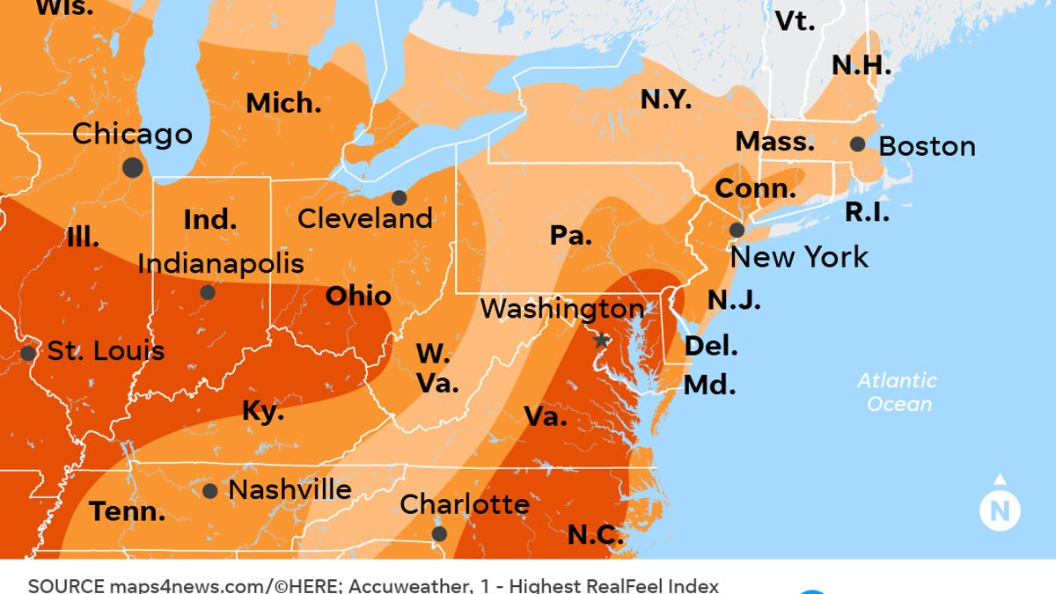
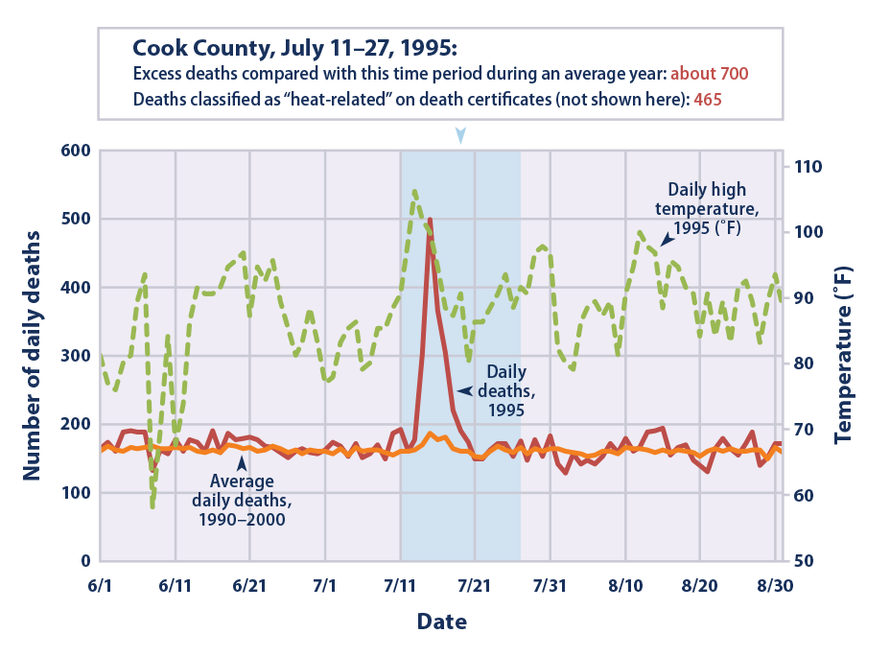
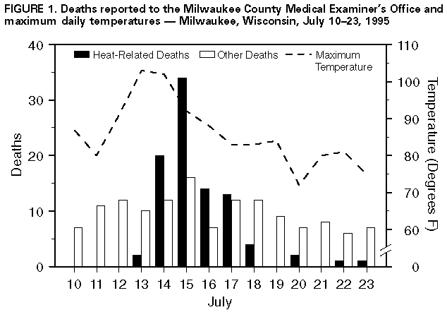
Acclimatization
Many studies worldwide from reputable sources, including the CDC, show acclimatization to be the key component in preventing heat stress

Slide 32
Acclimatization
Acclimatization is the beneficial physiological adaptations that occur during repeated exposure to a hot environment. These physiological adaptations include:
Increased sweating efficiency (earlier onset of sweating, greater sweat production, and reduced electrolyte loss in sweat).
Stabilization of the circulation.
The ability to perform work with lower core temperature and heart rate.
Increased skin blood flow at a given core temperature.

Slide 33
Acclimatization
To acclimatize workers, gradually increase their exposure time in hot environmental conditions over a 7-14 day period.
New workers will need more time to acclimatize than workers who have already had some exposure.

Slide 34
Acclimatization
When exposed to hot weather, the body will sweat more profusely – up to 1.5 liters per hour average maximum
This will double in 7-10 days, increase to a maximum of 9 liters per day in six weeks due to a direct increase in the sweating ability of the glands themselves
The body will decrease the concentration of NaCl in sweat, with a reduction to 3-5 grams per day after 4-6 weeks
Notes:
American diet 3-4 g per day

Slide 35
Acclimatization schedule
For new workers, the schedule should be no more than a
20% exposure on day 1
Increase of no more than 20% on each additional day.
In addition, the level of acclimatization each worker reaches is relative to the initial level of physical fitness and the total heat stress experienced by the individual.

Slide 36
Acclimatization schedule
For workers who have had previous experience with the job, the acclimatization regimen should be no more than a
50% exposure on day 1
60% on day 2
80% on day 3
100% on day 4
The level of acclimatization each worker reaches is relative to the initial level of physical fitness and the total heat stress experienced by the individual.

Slide 37
Maintaining acclimatization
Workers can maintain their acclimatization even if they are away from the job for a few days, such as when they go home for the weekend.
If they are absent for a week or more then there may be a significant loss in the beneficial adaptations leading to an increased likelihood of heat-related illness and a need to gradually reacclimatize to the hot environment.

Slide 38
Maintaining Acclimatization
Regained in 2 to 3 days upon returning to a hot job.
Appears to be better maintained by those who are physically fit.
Seasonal shifts in temperatures may result in difficulties.
Working in hot, humid environments provides adaptive benefits which also apply in hot, desert environments, and vice versa.
Air conditioning will not affect acclimatization.

Slide 39
Hydration
Hydrate Before, During and After Work
Drink before feeling thirsty. By the time you feel thirsty, you are already behind in fluid replacement.
When working in the heat, drink 1 cup (8 ounces) of water every 15–20 minutes.
This translates to ¾–1 quart (24–32 ounces) per hour.
Drink Water
Caution with Sport Drinks

Slide 40
Hydration
What about Sports Drinks?
Mixed recommendations but primarily in activities over two hours
Caffeine containing drinks generally not recommended
CHO (carbohydrate) over 6% generally not recommended

Slide 42
Safety, control, and prevention techniques that can be suggested to employees/clients
Job training
Supervisor Training
Hydration Stations
Job Rotation
Access to Shade/Facilities
Frequent Breaks
Acclimatization

Slide 43
Safety, control, and prevention techniques that can be suggested to employees/clients
NIOSH has recommended that employers adopt a comprehensive heat-related illness prevention program, including at least the following general components:
Measure heat stress throughout the day using WBGT;
Take actions to prevent heat exposure in excess of exposure limits;
Use a heat index of 85 when WBGT is unavailable to screen for hazardous heat exposure;

Slide 44
Safety, control, and prevention techniques that can be suggested to employees/clients
Use an acclimatization schedule for newly hired or long-term unacclimatized workers;
Use engineering and administrative controls to reduce heat stress;
Provide medical surveillance; and
Provide fluids and shade areas for rest breaks.

Slide 46
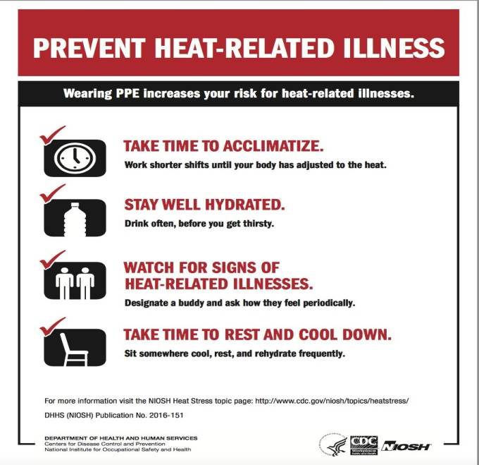
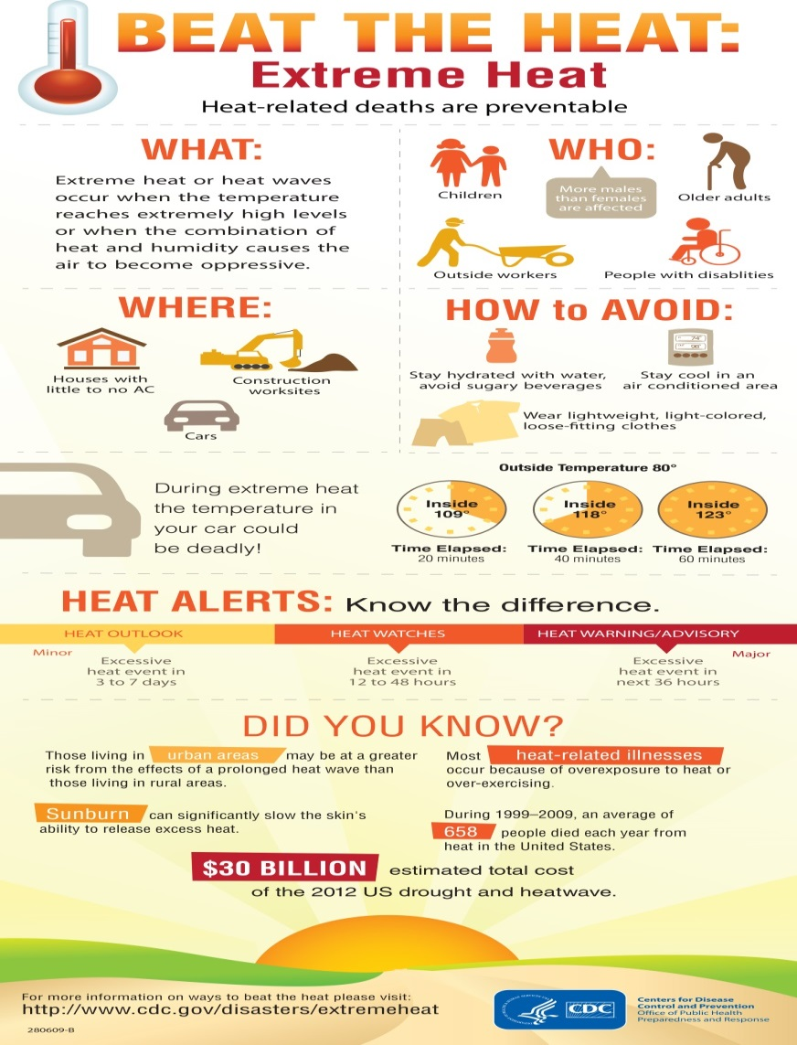

Slide 47
References
https://www.cdc.gov/disasters/extremeheat/older-adults-heat.html
https://www.cdc.gov/niosh/docs/2016-106/pdfs/2016-106.pdf?id=10.26616/NIOSHPUB2016106
https://www.mayoclinic.org/diseases-conditions/heat-exhaustion/symptoms-causes/syc-20373250
https://www.ncbi.nlm.nih.gov/pmc/articles/PMC4596225/
https://ksi.uconn.edu/prevention/heat-acclimatization/
https://www.ncbi.nlm.nih.gov/pmc/articles/PMC3550168/
https://my.clevelandclinic.org/health/diseases/16425-heat-illness
https://www.cdc.gov/disasters/extremeheat/warning.html
https://www.healthpartners.com/hp/about/press-releases/medicines-can-increase-risk-of-heat-stroke.html
https://www.cdc.gov/pictureofamerica/pdfs/picture_of_america_heat-related_illness.pdf
http://www.e-mjm.org/2019/v74n4/heat-related-illness.pdf
https://www2a.cdc.gov/nioshtic-2/BuildQyr.asp?s1=mccarthy&f1=%2A&Startyear=&Adv=0&terms=1&D1=10&EndYear=&Limit=10000&sort=&PageNo=1&RecNo=2&View=f& Outcomes of a Heat Stress Awareness Program on Heat-Related Illness in Municipal Outdoor Workers Sept 2019
Petitti DB1, Hondula DM, Yang S, Harlan SL, Chowell G.;Multiple Trigger Points for Quantifying Heat-Health Impacts: New Evidence from a Hot Climate. Environ Health Perspect. 2016 Feb;124(2):176-83. doi: 10.1289/ehp.1409119. Epub 2015 Jul 28. https://www.ncbi.nlm.nih.gov/pubmed/26219102
BECKER, Johnathan MD; LYNSEY K. STEWART, MD, Heat Related Illness; Am Fam Physician. 2011 Jun 1;83(11):1325-1330.

Slide 48
Q&A
crepp@concentra.com
Q&A

